Slide 1
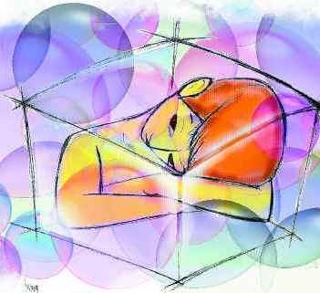
Autism

Slide 2
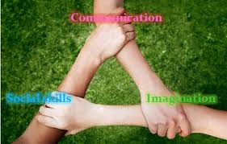
What is Autism?
Autism is a spectrum of neurodevelopmental conditions, characterised by a Triad of Impaiments

Slide 3
What is Autism?
Autism is a lifelong developmental condition that affects how a person communicates with, and relates to, other people. It also affects how they make sense of the world around them
Autism is a spectrum condition.
This means that the symptoms experienced can vary from very mild, which may never be diagnosed, to extremely severe, which is marked by a complete inability to communicate or interact with other people.
The threshold for diagnostic purposes is set at the level where autistic traits are significantly interfering in daily life, determined by clinical judgement.
Notes:
.

Slide 4
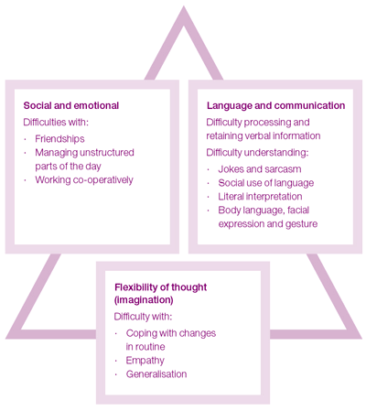
What sort of challenges are experienced?
People with autism may also experience over or under-sensitivity to sounds, touch, tastes, smells, light or colours.
Notes:
People with ASCs often exhibit fixed, repetitive behaviours, unusually strong narrow interests, repetitive behaviour, and difficulties in coping with unexpected change.

Slide 5
What is the Difference between Autism and Asperger’s Syndrome?
Classic autism typically involves associated learning difficulties (below average IQ) and language delay.
Asperger syndrome is a form of autism. People with Asperger syndrome are often of average or above average intelligence. They have fewer problems with speech but may still have difficulties with understanding and processing language. They do not usually have the accompanying learning disabilities associated with autism, but they may have specific learning difficulties. These may include dyslexia and dyspraxia or other conditions such as attention deficit hyperactivity disorder (ADHD) and epilepsy.
Many people with ASCs also have significant cognitive strengths.
Notes:
It is very important to realise that diagnostic practices vary. Some people may be diagnosed with autism without below average IQ.
According to DSM IV, a diagnosis of AS cannot be made for an individual with below normal IQ.
The movie Rain Man exposed millions of people to autism as well as the autistic savant phenomenon. (Unfortunately, some people now have the impression that all autistic individuals have these abilities.) In the movie, Raymond displayed a great memory for ball player statistics, memorized parts of the telephone book, and counted cards in Las Vegas.

Slide 6
Symptoms and Associated Conditions
Symptoms generally start to be apparent by the age of two, although a diagnosis is rarely given below the age of five.
Regression common, but not inherited
80% ASC some learning impairment, 50% with IQ below 50 Fombonne 1999
Notes:
ASCs vary widely in severity and symptoms and may go unrecognized, especially in mildly affected children or when it is masked by more debilitating handicaps.
Gastrointestinal symptoms are often reported but a recent review suggests that they are no more frequent or severe than in typically developing children.

Slide 7
About 1/3 of people with ASC have extraordinary talents.
Steven Wiltshire, drawing the London skyline from memory.
Notes:
Savant skills rarely associated with IQ below 50.
It is striking that autism is associated with both intellectual disability and superior talents, and the question is—what sort of neural functioning could account for both?

Slide 8
Other Associated Effects
¼ people with ASC develop epilepsy, usually in adolescence. However, epilepsy is not related to the severity of autism, nor associated with family history.
Brain size is increased in a substantial minority of people with ASC. Is this because there are more neurons or less pruning?
Insomnia & sleep disorders (60%)
Clumsiness
J Autism Dev Disord. 2011 Apr;41(4):395-404.
Progress in understanding autism: 2007-2010.
Rutter ML.
Notes:
Epilepsy affects 22% ASC adults cf 0.63% general population

Slide 9
It is now estimated to affect approximately 1% of people.
1%
2011
National autistic society
However, the prevalence was much lower.
0.04%
1978

Slide 10
So, are more people being affected or is diagnosis more common?
Improved recognition & detection
Increased awareness among professionals and parents.
Changes in how studies are carried out.
Increase in diagnostic services.
Willingness to offer multiple diagnoses.
earlier age at diagnosis and inclusion of milder cases may account for more than two thirds of the increase.
Hertz-Picciotto I, De1wiche L. The rise in autism and the role of age atdiagnosis. Epidemiology 2009;20:84-90
Notes:
Only 30% of children with PDDs ascertained by Chakrabarti & Fombonne were mentally retarded compared with 70% in earlier studies.

Slide 11
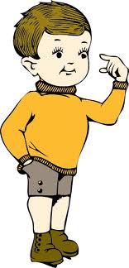
It affects 4 times as many boys as girls Chakrabarti S, Fombonne E (2001) Pervasive developmental disorders in pre- school children. JAMA-J Am Med Assoc 285: 3093–3099
But Asperger’s may affect 11 times as many boys as girls.
Gillberg C, Cederlund M, Lamberg K, Zeijlon L (2006) Brief report: ‘‘the autism epidemic’’. The registered prevalence of autism in a Swedish urban area. J Autism Dev Disord 36: 429–435.
Notes:
We will return to a consideration of gender differences later.

Slide 12
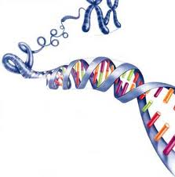
There is a strong genetic component.
Notes:
MZ vs DZ twins concordance studies approx 0.9
Later sib risk 8.6%, with 2 or more affected children, sib risk rises to 35%
Some identifiable genetic causes.
For 20-25% of children, a genetic cause (there are several known, chromosomal abnormalities, CNVs & single gene disorders) can be identified. For the remainder, the causes remain unknown.
CNVs affect more genes than SNPs Talk about gene dosage. Huge diversity of CNVs that do not cause problems.

Slide 13
What genes are known to be involved. Gorgeous picture in article on desktop also supplementary slide
Interactome?
Although specific CNVs may predispose to a variety of neurologic disorders, the specifics of the final phenotype will depend on the individual's genetic background.
Supports a second ht model
Autism or autistic features are commonly identified in a large number of single-gene disorders.
Notes:
Neuronal cell adhesion molecules & genes involved in ubiquitin pathways. Note that many of these genetic defects are also associated with MR, seizures, ADHD, dyslexia, schizophrenia & bipolar disorder.
Examples of single gene disorders are: Fragile X (CGG rpt in FMR1 gene),
PTEN Microcephaly Syndrome (phosphatase and tensin homologue PI3 kinase involvement)
Rett Syndrome (MECP2 gene),
Tuberous sclerosis, Timothy syndrome etc

Slide 14
Ways of looking at Genetic Information
Adapted by permission from Macmillan Publishers Ltd: Nature Reviews Genetics (Abrahams and Geschwind, 2008: 9, 341-355), copyright 2008
Notes:
Over twenty years of autism genetics research has implicated nearly every chromosome, and generated many
candidate genes
A schematic summary of association and linkage studies of ASD, organised by chromosome. Purple bands indicate a chromosomal region that
shows a linkage with ASD. Red and yellow bars (parallel to the chromosome) correspond to losses/gains in copy number, respectively, that are
observed in people with ASD when compared to matched controls. Green bars correspond to genes that are observed to modulate the risk for
ASD (either through a rare syndrome or genetic association): light green and dark green bars represent locations of candidate genes.

Slide 15
How to look for genetic causes
An hypothesis has been formulated that common genetic variants of small to moderate effect underlie the susceptibility to common disorders: the common disease/common variant (CDCV) hypothesis.
The success of the current wave of genomewide association studies (GWASs) crucially depends on the CDCV hypothesis, as even very large samples would not provide the power to detect individual rare variants of small effects.
The problem is, GWASs have not found the genetic causes for ASCs

Slide 16
What is likely to be the case
interactions between common genetic variants and environmental factors.
Cumulative effect of multiple mildly deleterious pleiotropic mutations that are under negative selection but are still present in the genetic pool as they are of relatively recent origin – multiple hit model
The hallmark of a contribution from rare mutations of recent origin is association with increasing paternal age
Notes:
Rare variants of recent origin because little regional variation in prevalence.
Most physical illnesses occur later in life after repro age
Mental illness should lead to repro disadvantage
Mental disorders common
CDCV untenable for most mental illness
An alternative evolution-informed framework is proposed, which suggests that gene–environment
interactions and rare genetic variants constitute most of the genetic contribution to mental
illness. Common mental illness with mild reproductive disadvantage is likely to have a large
contribution from interactions between common genetic variants and environmental
exposures. Severe mental illness that confers strong reproductive disadvantage is likely to
have a large and pleiotropic contribution from rare variants of recent origin.
The role of genetic variation in the causation of mental illness: an evolution-informed framework.
Uher R.
Mol Psychiatry. 2009 Dec;14(12):1072-82. Epub 2009 Aug 25. Review.
Although specific CNVs may predispose to a variety of neurologic disorders, the specifics of the final phenotype will depend on the individual's genetic background.
Supports a second hit model.
Autism or autistic features are commonly identified in a large number of single-gene disorders.

Slide 17
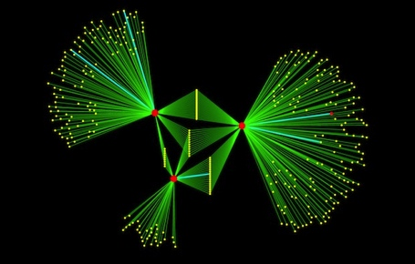
What can proteins tell us?
Pictured here is a portion of the network showing how proteins encoded by autism-associated genes (red circles) share many partner proteins (yellow). The turquoise lines are previously known interactions; the green lines are newly identified ones.

Slide 18
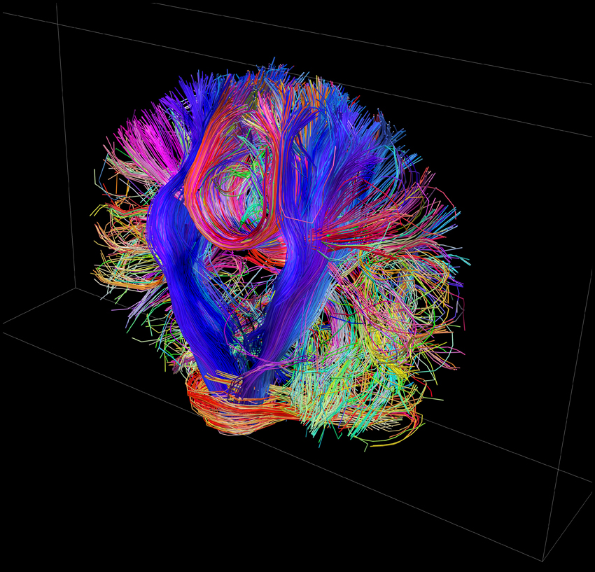
What does the evidence suggest?
Notes:
Genes involved in neural growth, patterning, formation and stabilisation of synapses are involved.
Neuroimaging studies of adults with ASD have shown some evidence of altered connectivity, suggesting a degree of atypical wiring.

Slide 19
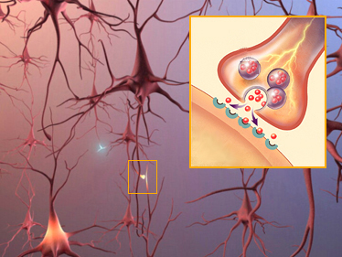
Synapses – where nerves talk to each other.

Slide 20
Examples of proteins involved in synaptic function
Notes:
Interacting synaptic proteins disrupted by CNVs in Pinto (colored) and/or implicated in other cognitive disorders in humans (black star) and mouse (red star)

Slide 21
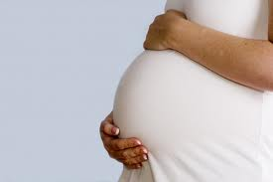
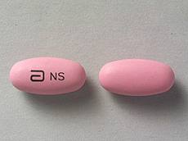
Environmental factors are probably also involved
Notes:
Environmental effects:
MMR triple vaccine x
Thimerosal in vaccines x
Paternal age likely
Maternal age less certain
Valproate certain
Babies born weighing less than 4lb (1.8kg) could be more prone to developing autism than children born at normal weight, a study suggests.
Writing in Pediatrics journal, US researchers followed 862 New Jersey children born at a low birthweight from birth to the age of 21.
Some 5% were diagnosed with autism, compared to 1% of the general population.
But experts say more research is needed to confirm and understand the link.
Links between low birthweight and a range of motor and cognitive problems have been well established by previous research.

Slide 22
Other Research
disorders such as autism and schizophrenia may arise from imbalances in the ratio of excitatory to inhibitory synaptic inputs (E/I balance) in discrete neuronal populations2,3
an increase in E/I balance may underlie some of the common symptoms of neuropsychiatric diseases

Slide 23
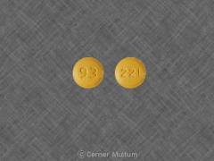
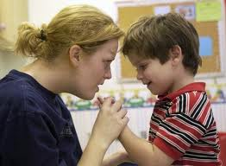
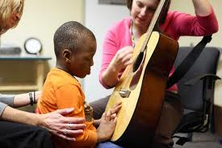
There is no known cure
But some interventions help some people

Slide 24
“Social Neuropeptides”
Oxytocin & Arg Vasopressin are neuropeptides involved in social cognition and behaviours.
The Oxytocin gene is known to be associated with ASCs
OXT genetically implicated
Used in very limited trials in ASC with possibly promising results – improvement in emotional recognition, increased social interactions and feelings of trust
increased patients’ gazing time on the eye region of pictures of faces. enhanced emotional understanding of speech intonation and decreased repetitive behaviours in individuals with ASD
Oxytocin and vasopressin in the human brain: social neuropeptides for translational medicine.
Meyer-Lindenberg A, Domes G, Kirsch P, Heinrichs M.
Nat Rev Neurosci. 2011 Aug 19;12(9):524-38. doi: 10.1038/nrn3044. Review.
Notes:
These peptides have had key roles throughout mammalian evolution in the regulation of complex social cognition and behaviours1, such as attachment, social exploration, recognition and aggression, as well as anxiety, fear conditioning and fear extinction. Recently, studies have begun to provide evidence that the function of these neuropeptides is impaired in mental disorders associated with social deficits.
Intranasal delivery

Slide 25
ASCs are very individual phenomena
Early intensive behavioural intervention has been shown in some trials to be partially effective – relies on very early diagnosis.– ASCs are individual – each person needs to have their own best approach.
Drug interventions are largely unsuccessful

Slide 26
Artist’s Response
What are the differences in ways of thinking?
What is meant by a spectrum condition and how does this affect diagnosis?
What are the factors influencing ASCs?
Why wiring matters so much in a complex organism

Slide 27
Early Intensive Behavioural Intervention
An important new randomized controlled trial of early intensive behavioural intervention provides possibly the best evidence to date (Dawson et al. 2009). Findings showed that there was a significant increase in IQ (albeit of modest size) in the treated group but not in controls. However, what this means is uncertain because there was no increase in social functioning as measured by the Vineland scale at 12 months. Also, the results showed that there was no effect of the treatment on core features of autism as assessed by the autism diagnostic observation schedule. Accordingly, the study certainly does not support the Lovaas claims (Lovaas 1987; McEachin et al. 1993) about the huge benefits of early treatment leading to recovery

Slide 28
Theory of Mind
‘Theory of mind’ refers to the everyday ability to infer what others are thinking (believing, desiring) in order to explain and predict their behaviour. The ability to represent thoughts has been tested, classically, with ‘false belief’ tests. For example: when Sally leaves her ball in her basket and goes out, Ann moves it to her own box; now Sally returns and wants her ball – where will she look for it? The correct answer – in the basket – is based on our representation of her mistaken belief: that is where she thinks it is. Most normally developing four-year-olds pass such
tests, but most people with autism, even quite bright adolescents with this diagnosis, answer that Sally will look in the box, where the ball really is. This failure to represent Sally’s belief has been taken as evidence of impaired theory of mind in autism (Ref. a).
Reference a Baron-Cohen, S., Tager-Flusberg, H., and Cohen, D.J., eds (1993)
Understanding Other Minds: Perspectives from Autism, Oxford University Press
One current account of autism proposes that a differ- ent, rather than merely deficient, mind lies at the centre of autism. Frith, prompted by a strong belief that assets and deficits in autism might have one and the same origin, pro- posed that autism is characterized by weak ‘central coher- ence’5. Central coherence (CC) is the term she coined for the everyday tendency to process incoming information in its context – that is, pulling information together for higher-level meaning – often at the expense of memory for detail. For example, as Bartlett’s classic work showed, the gist of a story is easily recalled, while the detail is effortful to retain and quickly lost6. Similarly, global processing pre- dominates over local processing in at least some aspects of perception7,8. This preference for integration and global processing also characterizes young children and individuals with (non-autistic) mental handicap who, unlike those with autism, show an advantage in recalling organized versus jumbled material9. Indeed, recent research suggests that global processing might predominate even in infants as young as three months.

Slide 29
Executive Function
A currently influential deficit account of autism proposes that executive dysfunction underlies many of the social and non- social impairments. ‘Executive function’ is an umbrella term covering a range of higher-level capacities necessary for the con- trol of action, especially action in novel contexts. Planning and monitoring of behaviour, set-shifting, inhibiting automatic ac- tions, and holding information on-line in working memory, are all included among executive functions. Executive impairment, presumed to reflect frontal-system abnormalities, is proposed to explain the repetitive and restricted behaviour in autism. While
executive impairments are widespread in a number of develop- mental disorders, deficits in set-shifting and in planning appear to be characteristic of autism. There is debate concerning the possible causal relationship between such impairments and social handicaps, and whether problems in executive control or in theory of mind are primary (Ref. a).
Reference a Russell, J., ed. (1998) Autism as an Executive Disorder, Oxford
University Press

Slide 30
Integrating Information in the Brain
The right hemisphere has long been implicated in global, integra- tive and context-sensitive processing. Individuals with acquired right-hemisphere damage show deficits on visuospatial–construc- tional tasks, maintaining details but missing global configuration (Ref. a). Discourse also becomes piecemeal in such patients, with difficulties in integrating verbal information and extracting gist (Ref. b). Functional imaging work, too, suggests a role for right- hemisphere regions in configural processing. Fink et al., using fMRI, found right lingual gyrus activation during attention to global aspects of a hierarchical figure (e.g. an H made up of Ss), and left inferior occipital activation during local focus (Ref. c). Electrophysiological (ERP) studies, too, suggest increased right- hemisphere activity during global (versus local) tasks (Ref. d).
Because people with autism show piecemeal processing, as well as repetitive stereotyped behaviour (normally suppressed by activity in regions in the right hemisphere; Ref. e), it is tempting to look for the origins of autism in right-hemisphere anomalies. To date, however, there is relatively little conclusive evidence of localized and specific structural damage. At least one brain imaging study to date has found right-hemisphere abnor- malities in (three) individuals with a high-functioning form of autism, Asperger syndrome (Ref. f). However, evidence of
damage in limbic, frontal and cerebellar regions has also been reported – and it is by no means clear which anomalies are specific and universal to autism (Ref. g).
References aRobertson, L.C. and Lamb, M.R. (1991) Neuropsychological
contribution to theories of part/whole organization Cognit.
Psychol. 23, 299–330 b Benowitz, L.I., Moya, K.L. and Levine, D.N. (1990) Impaired verbal
reasoning and constructional apraxia in subjects with right
hemisphere damage Neuropsychologia 23, 231–241 c Fink, G.R. et al. (1997) Neural mechanisms involved in the processing of global and local aspects of hierarchically organized
visual stimuli Brain 120, 1779–1791 d Heinze, H.J. et al. (1998) Neural mechanisms of global and local
processing: a combined PET and ERP study J. Cogn. Neurosci. 10,
485–498 e Brugger, P., Monsch, A.U. and Johnson, S.A. (1996) Repetitive
behavior and repetition avoidance: the role of the right
hemisphere J. Psychiatry Neurosci. 21, 53–56 f McKelvey, J.R. et al. (1995) Right-hemisphere dysfunction in
Asperger’s syndrome J. Child Neurol. 10, 310–314 g Frith, U. (1997) The neurocognitive basis of autism Trends Cognit.
Sci. 1, 73–77

Slide 31
Discussion Topics
Theories about autism old bad stuff refrigerator mothers
MMR, Thimerosal
Extreme male brain
Associative mating
Testosterone
Mirror neurons
Notes:
Although female germ cells only undergo 24 divisions and do not divide post-pubertally, male germ cells continue to divide and undergo B23 divisions every year and each division increases the
cumulative risk of new mutations. It has been shown that the majority of new mutations occur during divisions of male germ cells and the risk of new mutations increases with post-pubertal age of the father. Therefore, the age of father is an indicator of the burden of newly arising mutations. Balancing selection hypothesis – a variant associated with susceptibility to a fitness reducing trait (for example, sickle cell) is maintained in a population because it is also associated with a trait that confers reproductive advantage (for example, resistance to malaria). The advantageous trait may be
expressed in a large number of carriers of the susceptibility allele who are not affected by the illness and is propagated by these individuals, who benefit from the fitness-increasing trait.
A third, emerging, line of evidence suggests that the extent of exposure to testosterone in the womb
('prenatal testosterone') is related to the development of autistic-like traits in the general population (Baron-
Cohen, Knickmeyer and Belmonte, 2005). A primary clue for this line of investigation has been that ASD is
associated with a strong sex difference, affecting nearly seven times as many males when compared to
females. Two recent studies (Chakrabarti et al., 2009; Hu et al., 2009) have found evidence that genes related
to sex hormone function are associated with ASD and/or autistic traits in the general population.

