Slide 1
Getting on your Nerves

Slide 2
What a lot of nerve!
There are about 100,000,000,000 neurons in an adult human.
These form 10,000,000,000,000 synapses, or connections
They represent 2% of the body’s weight, 0.04-0.07% cells and 20-44% of the body’s power consumption
50,000 neurons die each day

Slide 3
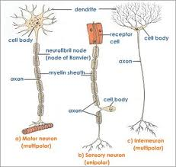
There are many different types of neurons
They can be classified according to their structure,
(which is closely related to their function)

Slide 4
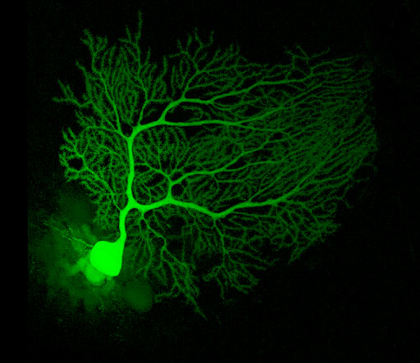
Some neurons have specialised functions
Notes:
Purkinje neuron. Facebook analogy

Slide 5
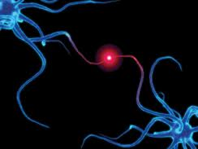
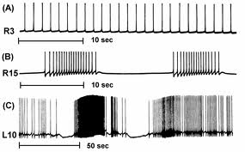
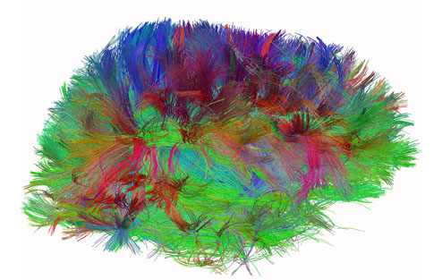
Other criteria can also be used to classify types of neurons:
Action on other neurons (excitatory or inhibitory)
Type of neurotransmitter (pathway)
Patterns of firing
Notes:
Music analogy. Pitch, rhythm, texture, timbre, dynamics

Slide 6
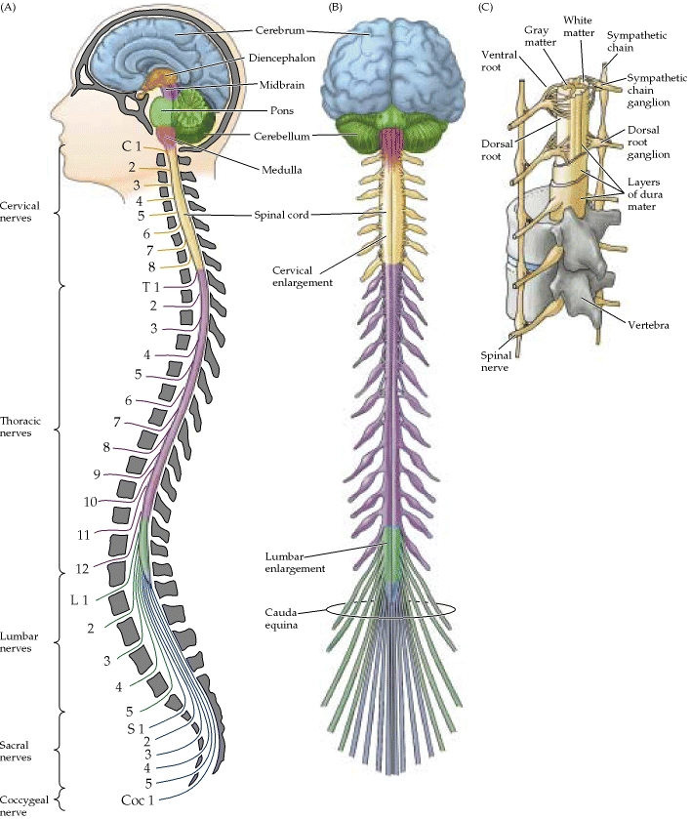
The Central Nervous System
Notes:
Connect areas within the brain & spinal cord.

Slide 7
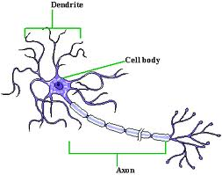
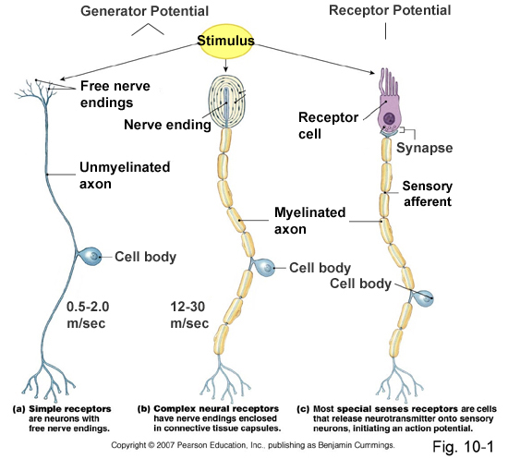
The peripheral nervous system: motor & sensory nerves
Notes:
Unipolar neurons have one process from the cell body that splits into longer processes. Sensory
Bipolar neurons have two processes - one axon & one dendrite. These neurons are also sensory. For example, biopolar neurons can be found in the retina of the eye.
Multipolar neurons are so-named because they have many (multi-) processes that extend from the cell body: lots of dendrites plus a single axon. Functionally, these neurons are either motor (conducting impulses that will cause activity such as the contraction of muscles) or association (conducting impulses and permitting 'communication' between neurons within the central nervous system).

Slide 8
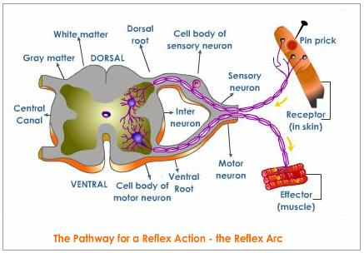
Crosstalk – The Reflex Arc

Slide 9
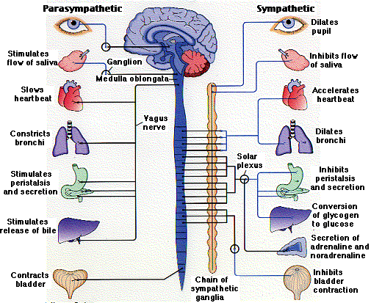
The Autonomic Nervous System
Notes:
Not under voluntary control.
Sympathetic – emergency responses; parasympathetic, slowing.

Slide 10
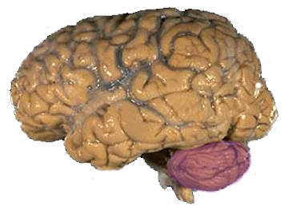
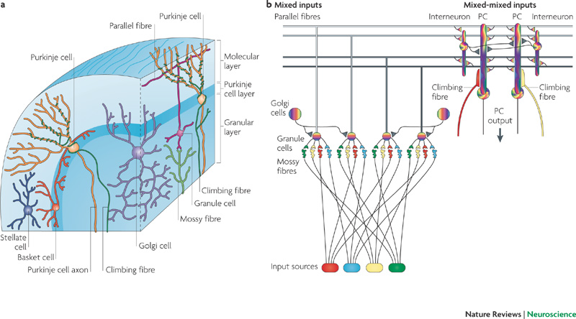
The Cerebellum
Notes:
Cerebellum composed of repeating subunits. Differences in function from one area to another are based entirely on difference in inputs and output from the cortex.
More neurons in the cerebellar cortex than the rest of the brain combined. Only five different types of neurons in the cortex.
3 layers, the granule cell layer is deepest, the Purkinje cell layer is in the middle and a superficial layer is termed the molecular layer.
granule cells (the most numerous cell type in the human brain) are in the granule cell layer along with Golgi cells. The Purkinje cells appear in a single layer, the Purkinje cell layer. Finally, the molecular layer contains basket and stellate cells. All of these cell types, with the exception of the granule cells, use the inhibitory neurotransmitter, GABA. It is also important to note that the Purkinje cell is the only neuronal type that has an axon that leaves the cerebellar cortex. The remaining cell types make connections only within this thin layer of the cerebellar cortex.

Slide 11
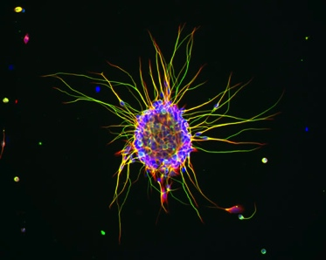
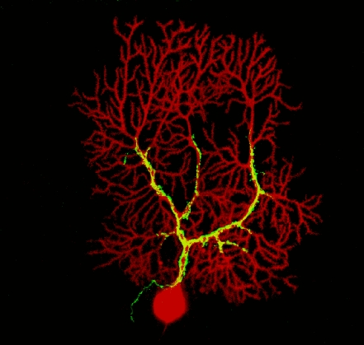
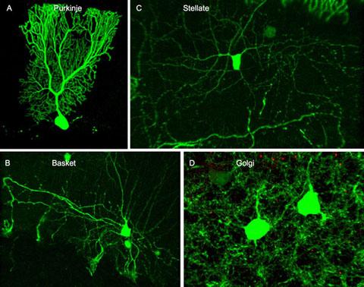
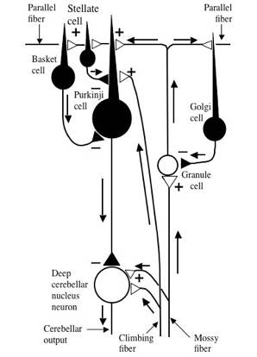
Cerebellar Circuitry
Granule cell
Notes:
Two types of axons that enter the cerebellum, mossy fibers and climbing fibers, release excitatory neurotransmitter .
Mossy fibers branch extensively as they enter the cortex, exciting the granule cell.
They crossing the dendritic arbors of many Purkinje cells, with which they make excitatory "en-passant" synapses.
Each parallel fiber input makes a minute input, but they can summate to activate the Purkinje cell.
The Purkinje cell axons are the only nerve fibers to actually leave the cerebellar cortex and they synapse on deep cerebellar nucleus neurons, powerfully inhibiting them.
This is a process akin to sculpture, where the unwanted parts of the stone are removed to create a pattern.
Climbing fibres powerfully excite the Purkinje cells 1 fibre per PC, may supply 2 or 3 PCs. Error detection & correction system.

Slide 12
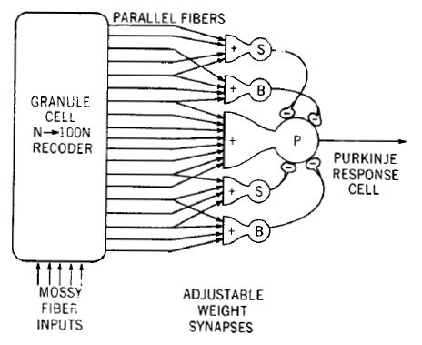
Feedforward processing
signal processing is almost entirely feedforward
the cerebellum, in contrast to the cerebral cortex, cannot generate self-sustaining patterns of neural activity.
Ensures a quick and unambiguous response to an input.
Notes:
That is, signals move unidirectionally through the system from input to output, with very little recurrent internal transmission. What there is is excitatory, not inhibitory.

Slide 13
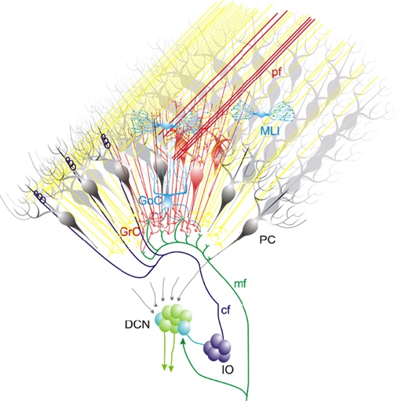
Divergence and convergence
the cerebellar network receives a modest number of inputs, processes them very extensively through its rigorously structured internal network, and sends out the results via a very limited number of output cells.
Notes:
information from 200 million mossy fibre inputs is expanded to 40 billion granule cells, whose parallel fibre outputs then converge onto 15 million Purkinje cells.
Because of the way that they are lined up longitudinally, the 1000 or so Purkinje cells belonging to a microzone may receive input from as many as 100 million parallel fibers, and focus their own output down to a group of less than 50 deep nuclear cells.

Slide 14
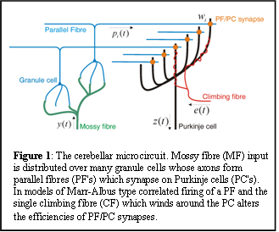
Modularity
The cerebellar system is functionally divided into more or less independent modules

Slide 15
Plasticity
The synapses between parallel fibers and Purkinje cells, and the synapses between mossy fibers and deep nuclear cells, are both susceptible to modification of their strength.
Each synapse between the parallel fiber and the Purkinje cell can be adjusted so that the next time the movement is performed, it is performed more accurately from the beginning
Synapses that were active around the time of climbing fiber input will be weakened, so that the next time the specific parallel fiber is active, it will have less of an excitatory effect on the Purkinje cell.
Climbing fibers convey error signals, so the granule cell to Purkinje cell synapses that were active at the time of the error will be inhibited.
Therefore, each synapse can be adjusted during a process of learning to produce the correct output. This allows for procedural learning, where each time an action is performed, it becomes somewhat more accurate since the "right synapses" are contributing to the response.
Notes:
In a single cerebellar module, input from as many as a billion parallel fibers converges onto a group of less than 50 deep nuclear cells, and the influence of each parallel fiber on those nuclear cells is adjustable. This arrangement gives tremendous flexibility for fine-tuning the relationship between cerebellar inputs and outputs.

Slide 16
Learning to Fly

Slide 17
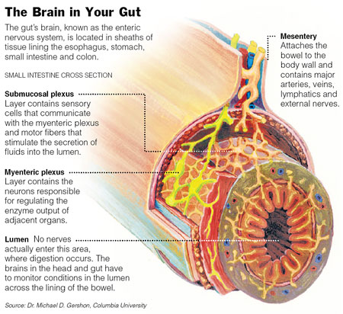
Enteric Nervous System

Slide 18
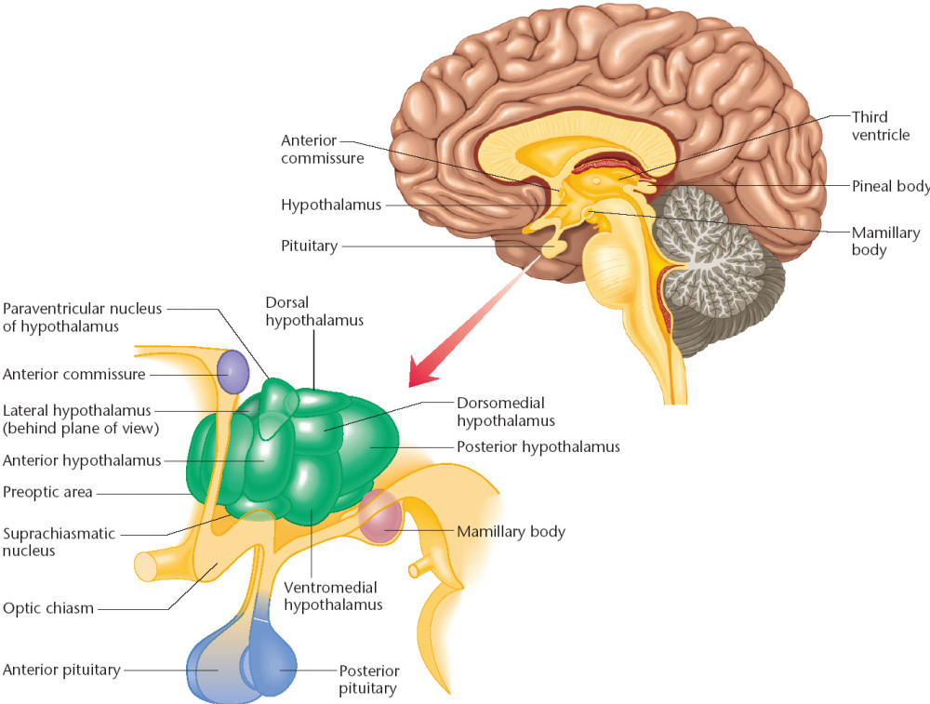
The Hypothalamus The Chat Room for the Endocrine & Nervous Systems
Notes:
So how are the endocrine and nervous system linked? The brain structure known as the hypothalamus connects these two important communication systems. The hypothalamus is a tiny collection of nuclei that is responsible for controlling an astonishing amount of behavior. Located at the base of the forebrain, the hypothalamus regulates basic needs such as sleep, hunger, thirst and sex in addition to emotional and stress responses. The hypothalamus also controls the pituitary glands, which then controls the release of hormones from other glands in the endocrine system.

Slide 19
Inappropriate Eating

Slide 20
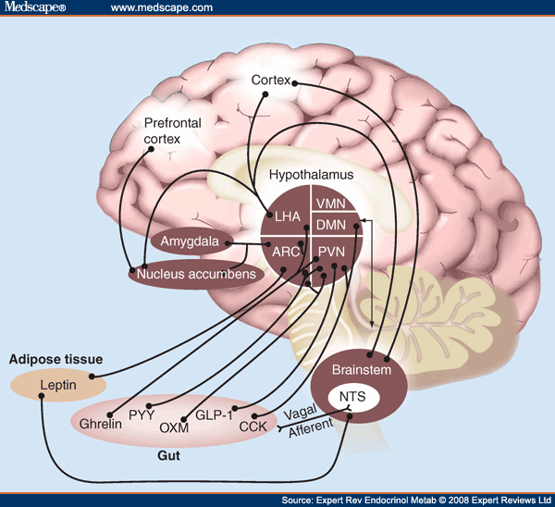
Appetite Control
Notes:
The best characterized pathways are the orexigenic neuropeptide Y/Agouti-related protein and the anorexigenic pro-opiomelanocortin/cocaine- and amphetamine-related transcript neurons in the arcuate nucleus of the hypothalamus. These project from the arcuate nucleus to other key hypothalamic nuclei, such as the paraventricular, dorsomedial, ventromedial and lateral hypothalamic nuclei. There are also projections to and from the brainstem, cortical areas and reward pathways, all of which influence food intake.

Slide 21
Inflammatory Crosstalk
Notes:
Ways of controlling sepsis:
The inflammatory response to microorganisms, and ways of controlling it. Clockwise
from lower right: many bacteria contain lipopolysaccharide in their cell walls, which
stimulates macrophages. These immune cells then make and release various cytokine (‘alarm’)
molecules, including tumour-necrosis factor (TNF) and interleukin-1. But too much TNF in
the blood can be harmful, leading to excessive inflammation and septic shock. Several drugs
(orange boxes) inhibit steps in TNF synthesis. In addition, Tracey and colleagues have found
that when the vagus nerve detects interleukin-1 (left), it releases acetylcholine (right), which binds
to the a7 receptor2 on macrophages and inhibits cytokine production. This suggests possible
new ways of controlling inflammation: through electrically stimulating the vagus nerve, by
acupuncture, or with the use of nicotine (which mimics acetylcholine).

Slide 22
Secretomotor and Inflammatory Actions of Clostridium difficile Toxin A.
Notes:
C. difficile toxin A causes injury to and necrosis of enterocytes. The necrotic enterocytes release noxious substances that stimulate primary splanchnic afferent neurons. Neural impulses are
transmitted up and then back down a separate branch of the bifurcated axon in the axon reflex (red arrows), which stimulates the release of substance P around adjacent mast cells and submucosal arterioles. Substance P stimulates the release of a wide variety of chemical mediators from mast cells. The mediators recruit neutrophils (and eosinophils, not shown), which augment the inflammatory process by releasing additional inflammatory mediators. These mediators cause intestinal secretion through direct effects on enterocytes and indirect effects throughthe enteric nervous system. C. difficile toxin A also stimulates motility by inducing repetitive bursts of action potentials. The symbol Ψ represents afferent-nerve endings, and efferent- Y nerve endings.

Slide 23
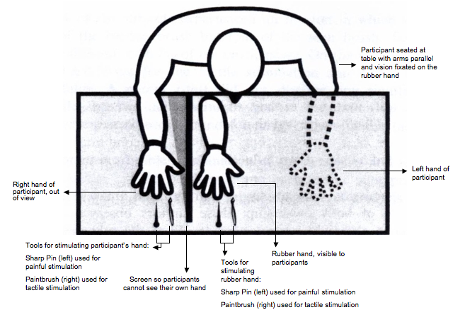
The Rubber Hand Illusion
Notes:
Recent data show the RHI induces a small but robust drop in skin temperature of the real hand. That is, blood flow to the ‘disowned’ hand seems to be selectively reduced.
Predicted that the innate immune system may be upregulated in a manner consistent with rejection of the replaced hand. Consistent with this prediction, the RHI increases
histamine reactivity, which is a key final pathway of the innate immune response and has been implicated in autoimmune disorders, including multiple sclerosis

Slide 24
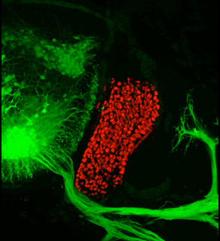
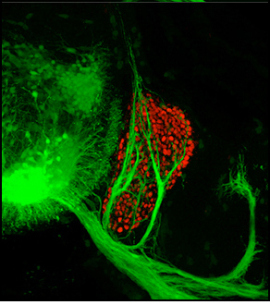
Ephrin/Eph signalling in the spine
Notes:
Constant crosstalk between motor (shown in green) and sensory (shown in red) nerves ensures that the two different types of neurons join up after they emerge from the spinal cord but sort into separate fascicles containing either sensory or motor axons, but never both. Bottom: Without communication between motor and sensory axons, the sorting between the fascicles breaks down and instead of reaching for muscles, some motor neurons leave their lane, make a U-turn and head back toward the spinal cord. Constant crosstalk between motor (shown in green) and sensory (shown in red) nerves ensures that the two different types of neurons join up after they emerge from the spinal cord but sort into separate fascicles containing either sensory or motor axons, but never both. Bottom: Without communication between motor and sensory axons, the sorting between the fascicles breaks down and instead of reaching for muscles, some motor neurons leave their lane, make a U-turn and head back toward the spinal cord. Images: Provided by the Pfaff laboratory, Salk Institute for Biological Studies
There are many examples of extensive neuronal reorganization following spinal cord injuries and one often underappreciated byproduct is severe pain.

Slide 25
Artists’s Response
How structure relates to function in examples of different types of neurons.
How communication and crosstalk is essential to coordinate complex systems behaviours.

