Slide 1
Statistical Theory; Why is the Gaussian Distribution so popular?
Rob Nicholls
MRC LMB Statistics Course 2014
Notes:
Lasted 1 hour – a bit too long.

Slide 2
Contents
Continuous Random Variables
Expectation and Variance
Moments
The Law of Large Numbers (LLN)
The Central Limit Theorem (CLT)
Notes:
Last week -> formalism. This week -> observed data.
Real data -> small sample. Nevertheless infer info regarding population.
When working with such small samples, it’s important to consider how reliable conclusions are.
Given we have estimated a statistic, how reliable? Uncertainty?
When hypothesis testing, how certain can we be of our conclusions?
This is one of the primary purposes of statistical theory.
In order to achieve such objectives, it’s important to know something about the data and their underlying distribution.
Ideally we would suspect a particular distribution.
Can investigate (e.g. extract quantitative info about shape).
Whenever we annotate data, e.g. saying it’s Normally distributed, we inject prior info -> changes the way data analysed.
Utilising more info can be good, but inappropriate prior information is bad.
Today:
build on last week, extending to the continuous case.
Explore how distributions can be described using various statistics.
Focus on the Normal distribution -> give one explanation why it is so popular.
Today focus on theoretical justification; next week hypothesis testing and practical application.
Today there will be lots of maths, but it will be less abstract.

Slide 3
Continuous Random Variables
A Random Variable is an object whose value is determined by chance, i.e. random events
Probability that the random variable X adopts a particular value x:
: discrete
: continuous

Slide 4
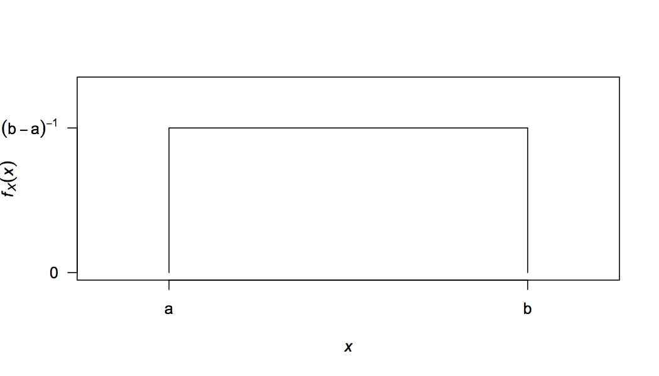
Continuous Random Variables
Continuous Uniform Distribution:
Probability Density Function:

Slide 5
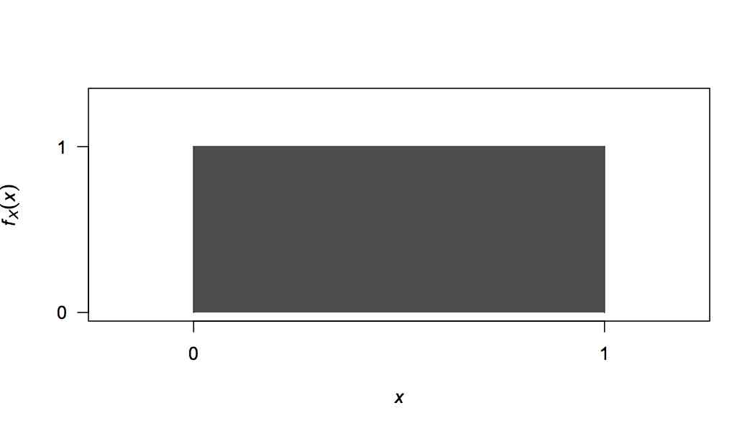
Continuous Random Variables
Example:

Slide 6
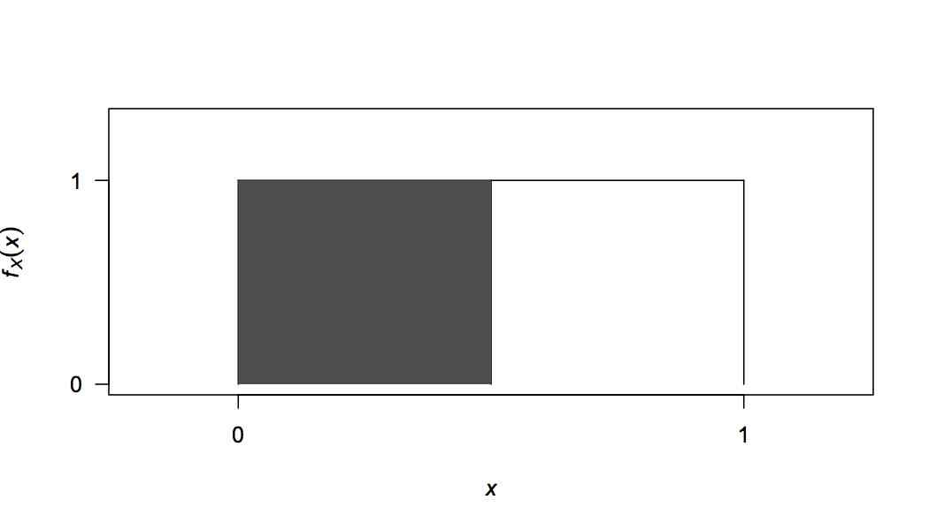
Continuous Random Variables
Example:

Slide 7
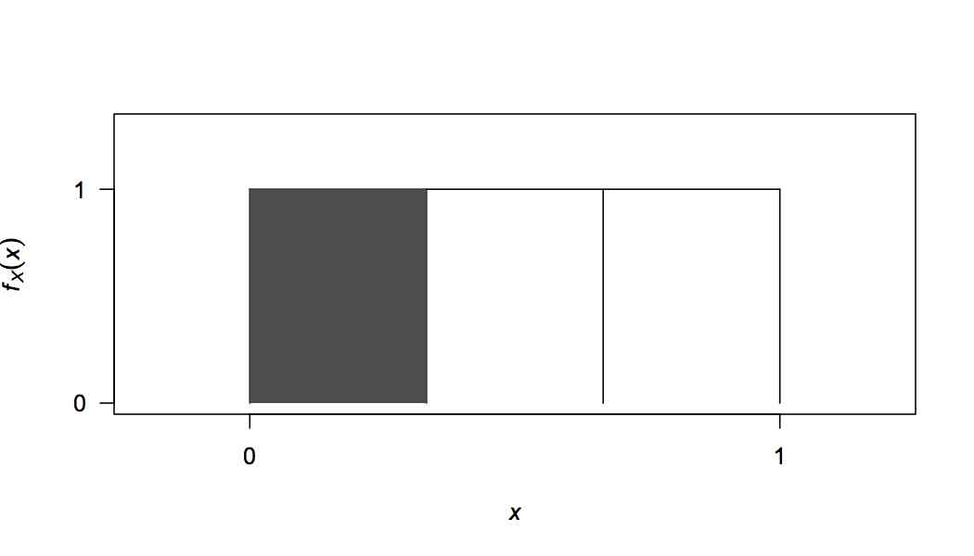
Continuous Random Variables
Example:

Slide 8
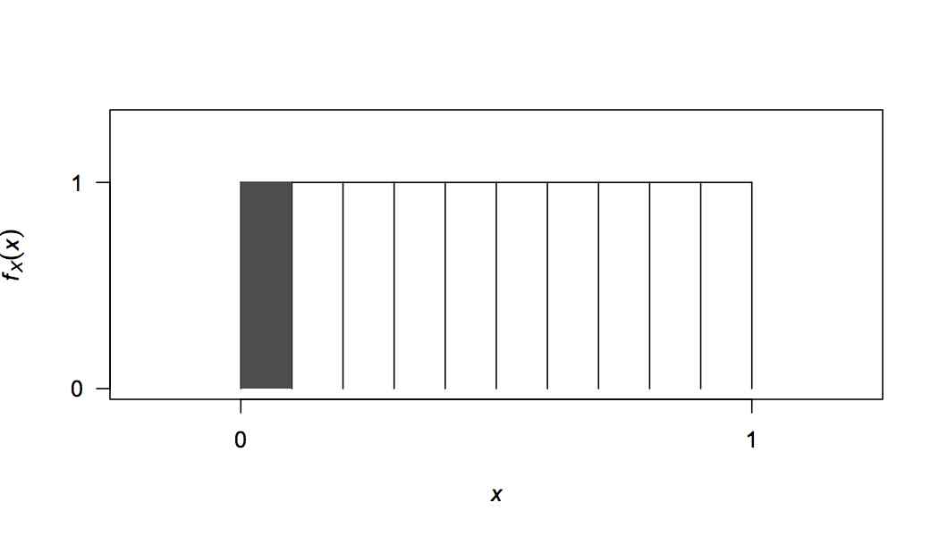
Continuous Random Variables
Example:

Slide 9
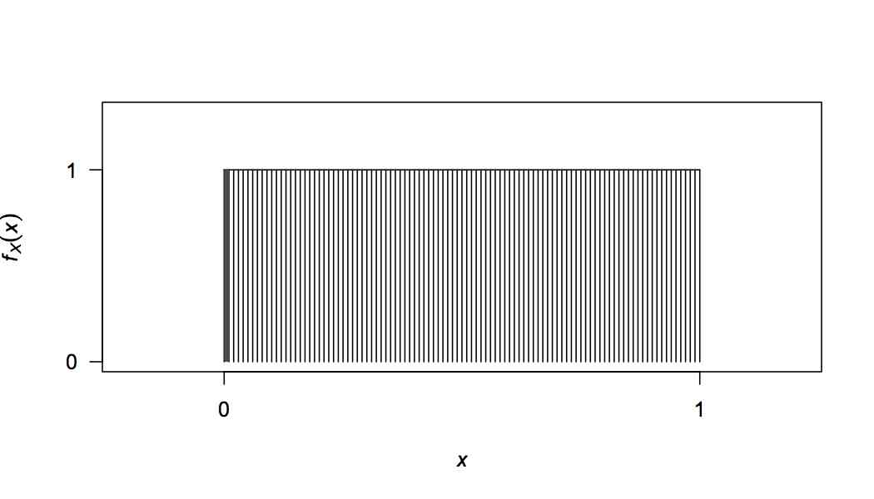
Continuous Random Variables
Example:

Slide 10
Continuous Random Variables
Example:
In general, for any continuous random variable X:

Slide 11
Continuous Random Variables
: discrete
: continuous
“Why do I observe a value if there’s no probability of observing it?!”
Answers:
Data are discrete
You don’t actually observe the value – precision error
Some value must occur… even though the probability of observing any particular value is infinitely small

Slide 12
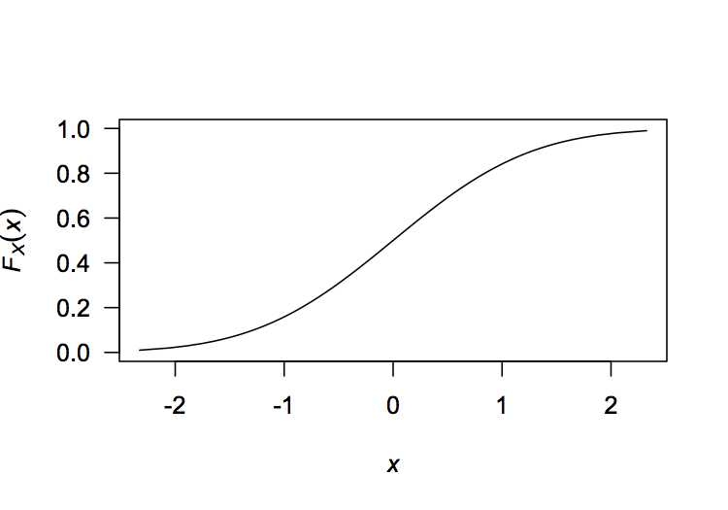
Continuous Random Variables
For a random variable:
The Cumulative Distribution Function (CDF) is defined as:
(discrete/continuous)
Properties:
Non-decreasing

Slide 13
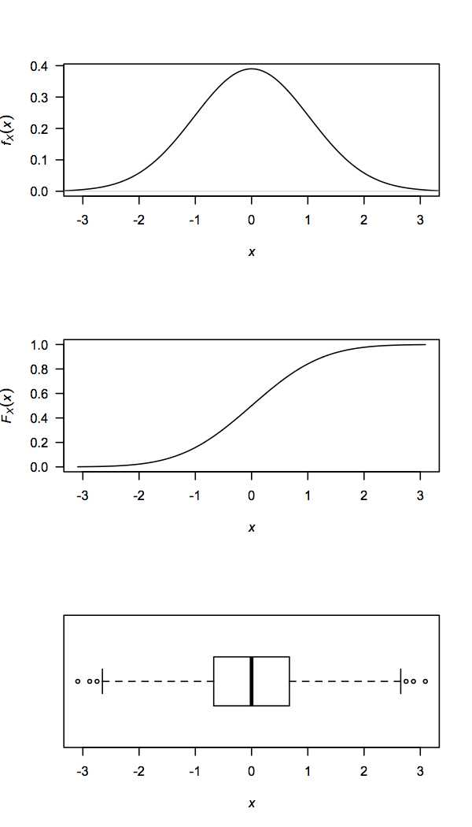
Continuous Random Variables
Probability Density function:
Cumulative Distribution function:
Boxplot:
Notes:
----- Meeting Notes (16/03/2014 21:47) -----
write PDF and CDF in full

Slide 14
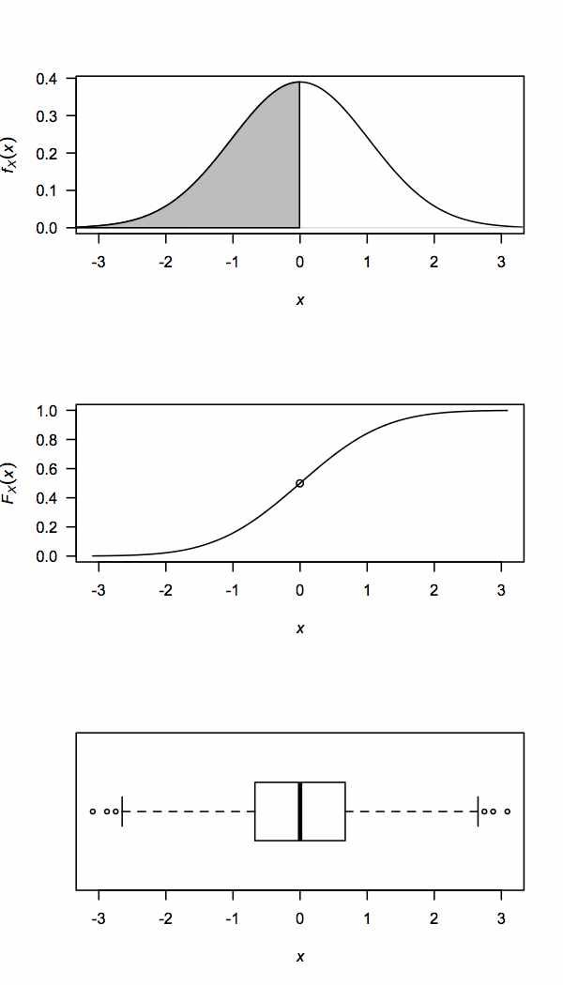
Continuous Random Variables
Probability Density function:
Cumulative Distribution function:
Boxplot:
Notes:
Median

Slide 15
Continuous Random Variables
Probability Density function:
Cumulative Distribution function:
Boxplot:

Slide 16
Continuous Random Variables
Probability Density function:
Cumulative Distribution function:
Boxplot:

Slide 17
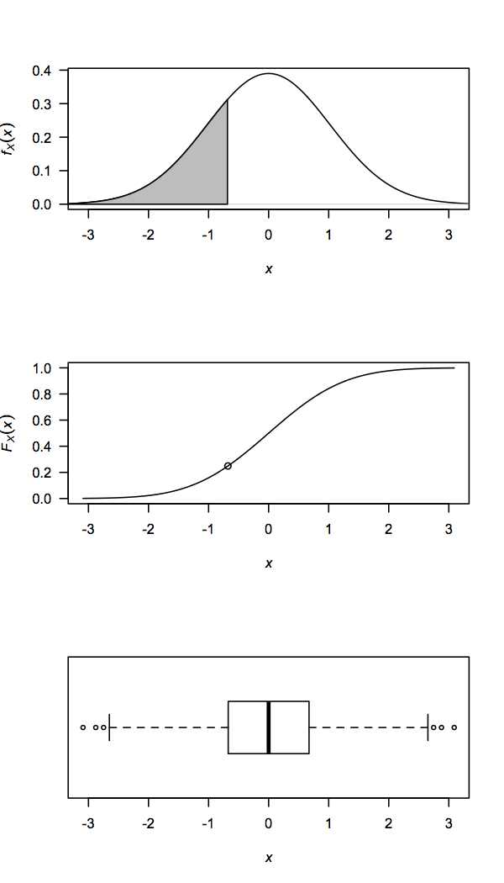
Continuous Random Variables
Probability Density function:
Cumulative Distribution function:
Boxplot:
Notes:
1st quartile

Slide 18
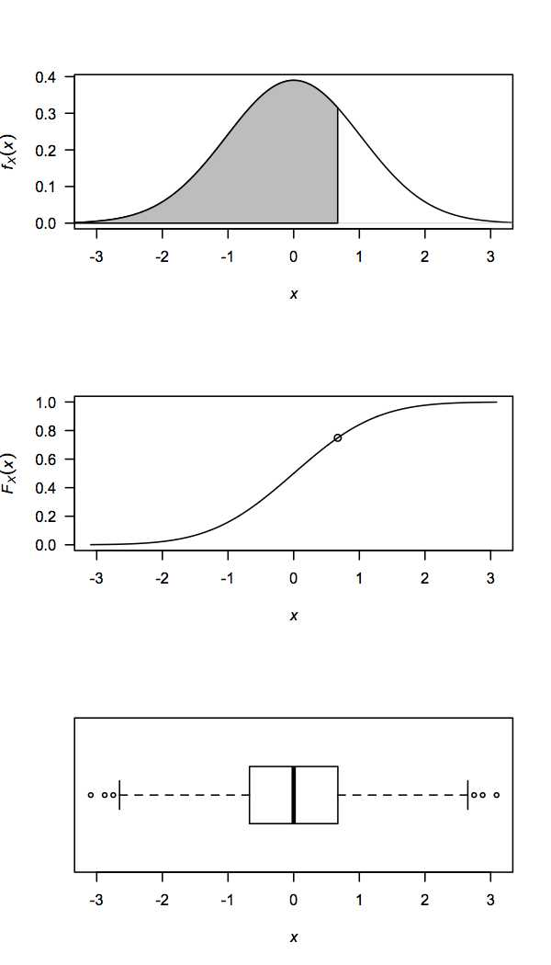
Continuous Random Variables
Probability Density function:
Cumulative Distribution function:
Boxplot:
Notes:
3rd quartile

Slide 19
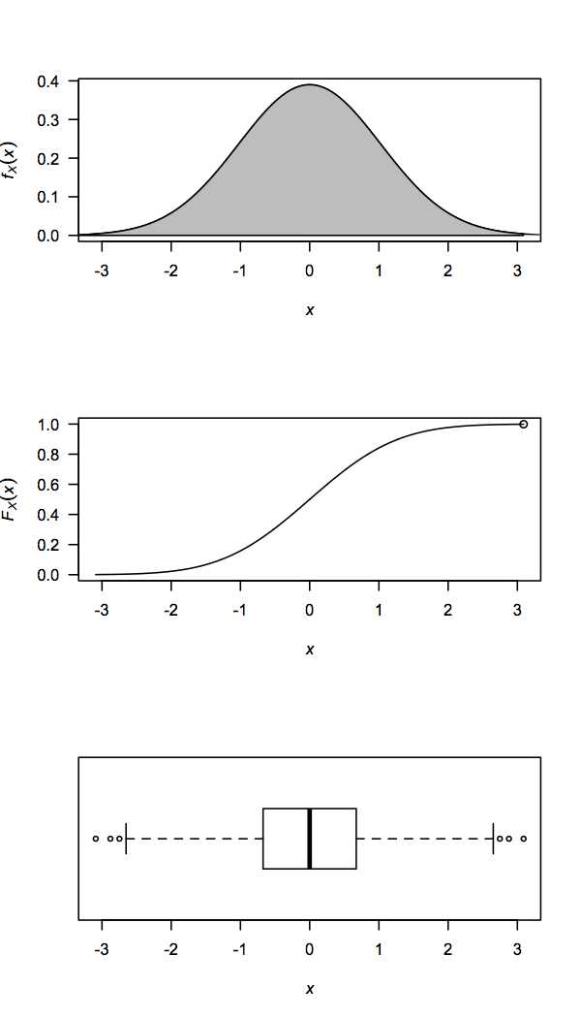
Continuous Random Variables
Probability Density function:
Cumulative Distribution function:
Boxplot:

Slide 20
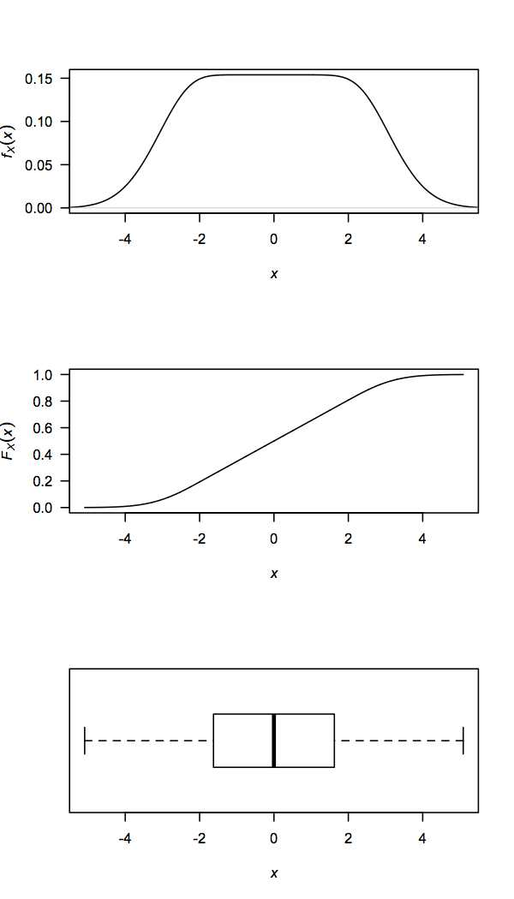
Continuous Random Variables
Probability Density function:
Cumulative Distribution function:
Boxplot:

Slide 21
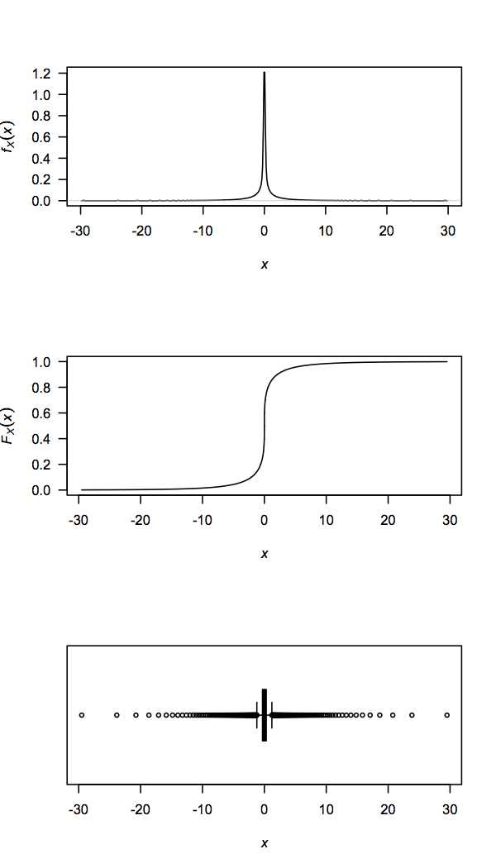
Continuous Random Variables
Probability Density function:
Cumulative Distribution function:
Boxplot:

Slide 22
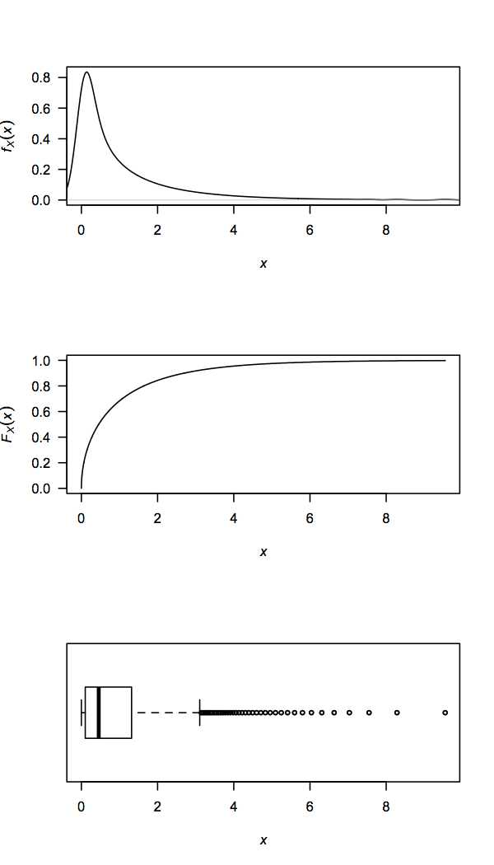
Continuous Random Variables
Probability Density function:
Cumulative Distribution function:
Boxplot:

Slide 23
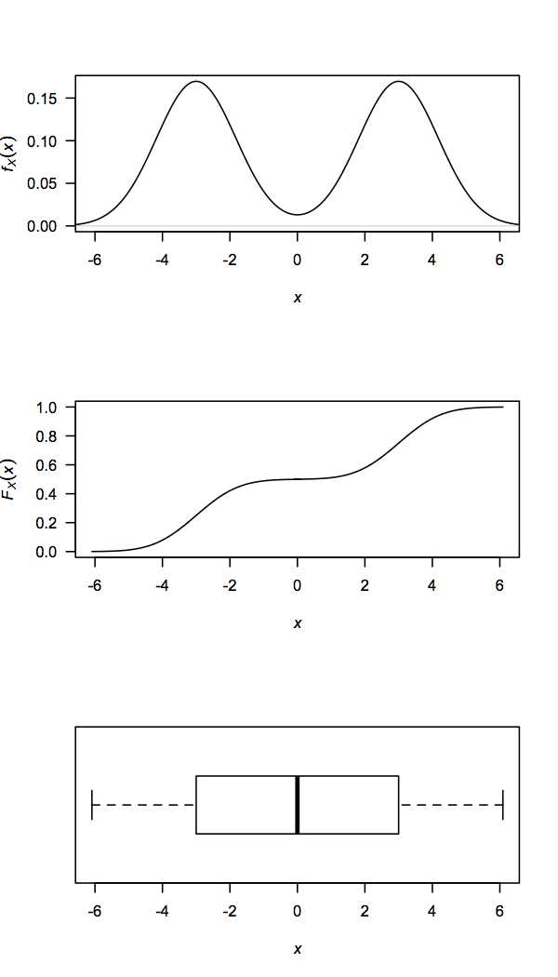
Continuous Random Variables
Probability Density function:
Cumulative Distribution function:
Boxplot:

Slide 24
Continuous Random Variables
Cumulative Distribution Function (CDF):
Discrete:
Continuous:
Probability Density Function (PDF):
Discrete:
Continuous:

Slide 25
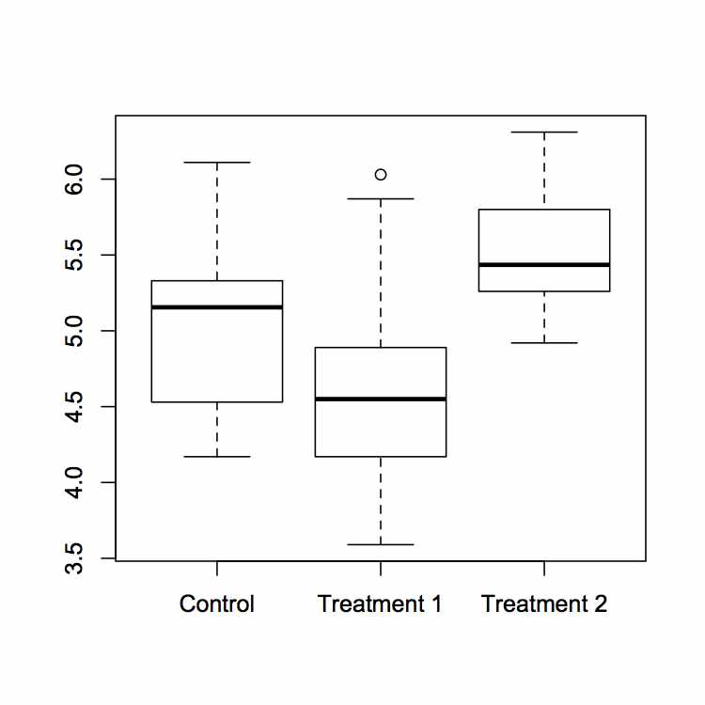
Expectation and Variance
Motivational Example:
Experiment on Plant Growth (inbuilt R dataset)
- compares yields obtained under different conditions
Notes:
Now that we’ve caught up with the continuous case, we’re now going to move on to looking at expectation, variance and higher moments.
At this point, I’m just going to remind you why were doing all this by means of a motivational example.
There are many cases where such analyses would be performed - another example that’s more close to home could be comparing responses to different drugs.

Slide 26
Expectation and Variance
Motivational Example:
Experiment on Plant Growth (inbuilt R dataset)
- compares yields obtained under different conditions
Compare means to test for differences
Consider variance (and shape) of the distributions – help choose appropriate prior/protocol
Assess uncertainty of parameter estimates – allow hypothesis testing
Notes:
Now that we’ve caught up with the continuous case, we’re now going to move on to looking at expectation, variance and higher moments.
At this point, I’m just going to remind you why were doing all this by means of a motivational example.
There are many cases where such analyses would be performed - another example that’s more close to home could be comparing responses to different drugs.

Slide 27
Expectation and Variance
Motivational Example:
Experiment on Plant Growth (inbuilt R dataset)
- compares yields obtained under different conditions
Compare means to test for differences
Consider variance (and shape) of the distributions – help choose appropriate prior/protocol
Assess uncertainty of parameter estimates – allow hypothesis testing
In order to do any of this, we need to know how to describe distributions
i.e. we need to know how to work with descriptive statistics

Slide 28
Expectation and Variance
Discrete RV:
Sample (empirical): (explicit weighting not required)
Continuous RV:
Notes:
The “Expectation” function is context-dependent.
For an experimental sample, we assume that each observation was measured with equal chance. It is not necessary to explicitly impose prior information regarding the functional form of the distribution, as this is implicitly accounted for by the natural spread of the data.
For the purposes of this talk, we will be wanting to describe a particular data sample using a continuous distribution. Consequently, we will be most interested in the third form.

Slide 29
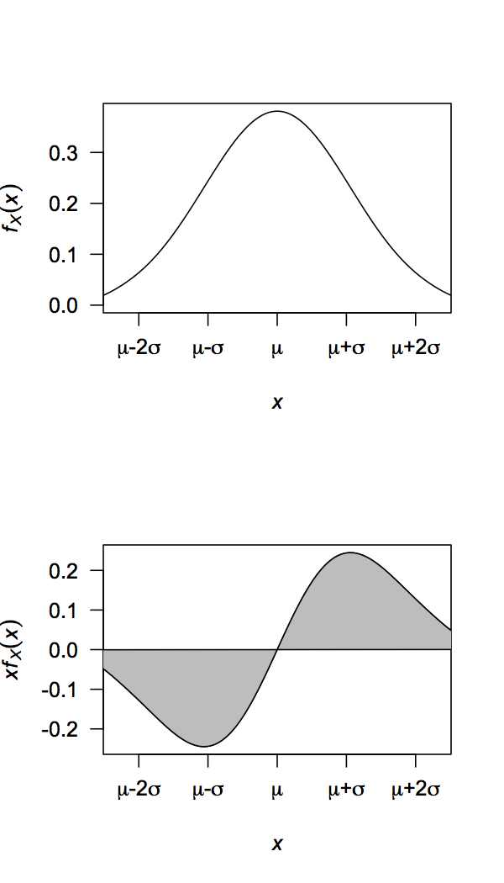
Expectation and Variance
Normal Distribution:
Notes:
Insert info about 95%... Interesting property.

Slide 30
Expectation and Variance
Normal Distribution:

Slide 31
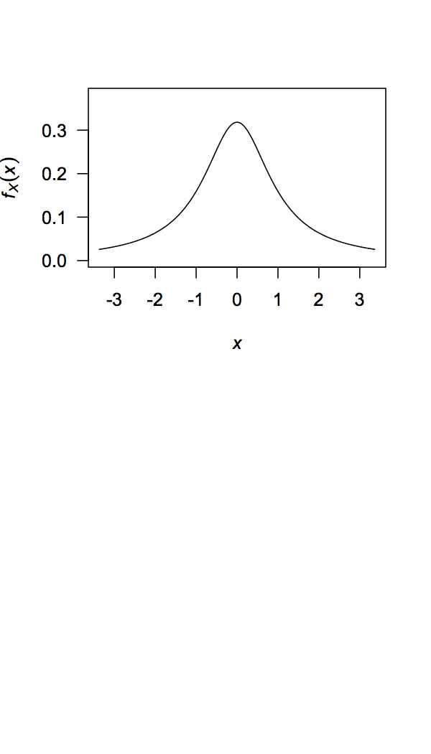
Expectation and Variance
Standard Cauchy Distribution:
(also called Lorentz)
Notes:
unimportant, but an interesting note

Slide 32
Expectation and Variance
Expectation of a function of random variables:
Linearity:

Slide 33
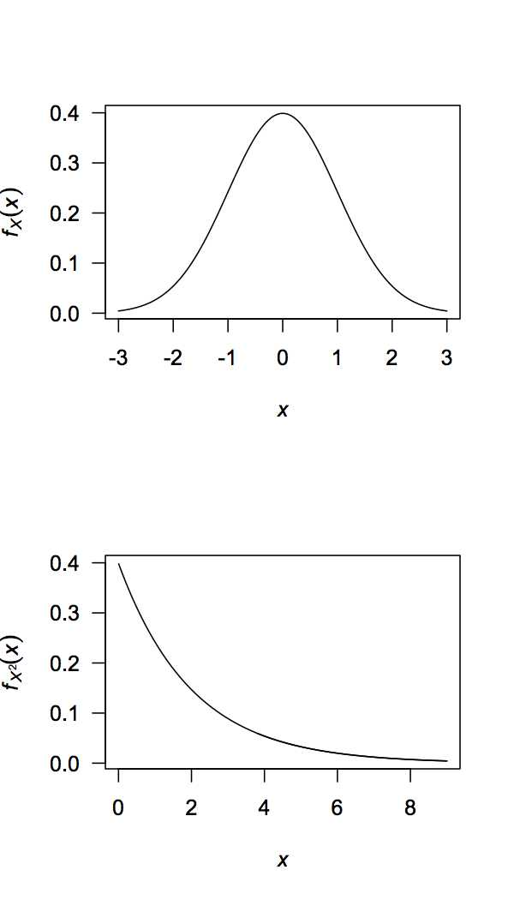
Expectation and Variance
Variance:
X ~ N(0,1)
Notes:
----- Meeting Notes (16/03/2014 21:47) -----
make mean line appear

Slide 34
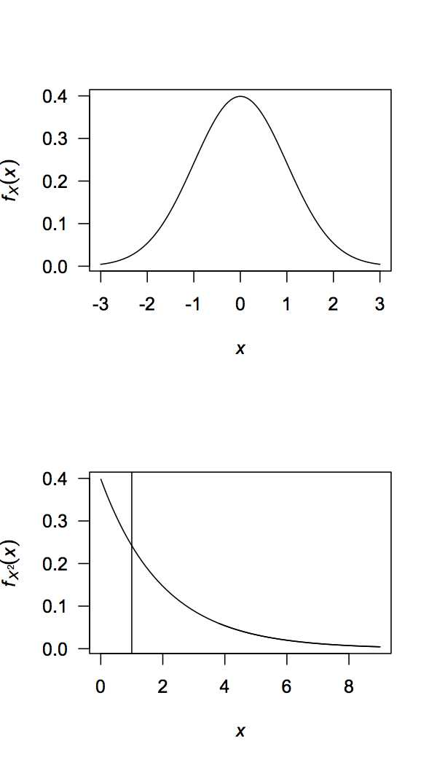
Expectation and Variance
Variance:
X ~ N(0,1)
Notes:
----- Meeting Notes (16/03/2014 21:47) -----
make mean line appear

Slide 35
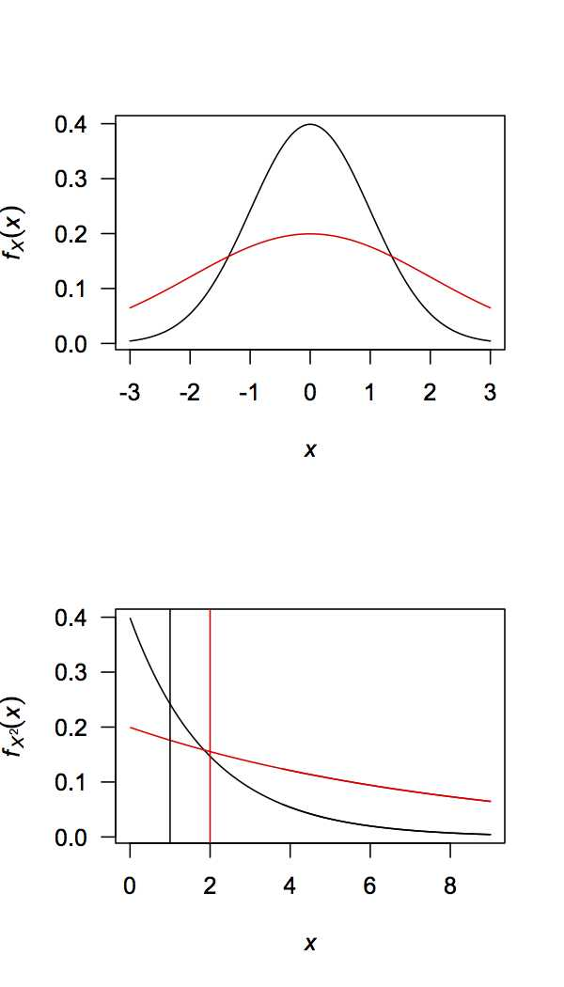
Expectation and Variance
Variance:
X ~ N(0,1)
X ~ N(0,2)

Slide 36
Expectation and Variance
Variance:
X ~ N(0,1)
X ~ N(0,2)
Population Variance:
Unbiased Sample Variance:
Notes:
You may have seen “variance” defined as something else. Note the differences and similarities between the variance of a random variable; population variance, and sample variance.
rat example

Slide 37
Expectation and Variance
Variance:
Standard deviation (s.d.):
Non-linearity:
Notes:
Note this implies that sd(alphaX+beta)=alpha*sd(X)

Slide 38
Expectation and Variance
Variance:
Standard deviation (s.d.):
Non-linearity:
Notes:
Note this implies that sd(alphaX+beta)=alpha*sd(X)

Slide 39
Expectation and Variance
Variance:
Standard deviation (s.d.):
Non-linearity:
Notes:
Note this implies that sd(alphaX+beta)=alpha*sd(X)

Slide 40
Expectation and Variance
Variance:
Standard deviation (s.d.):
Non-linearity:
Notes:
Note this implies that sd(alphaX+beta)=alpha*sd(X)

Slide 41
Expectation and Variance
Variance:
Standard deviation (s.d.):
Non-linearity:
Notes:
So this means that multiplying X by a factor will result in the variance being multiplied by the square of that factor.
Also, adding a fixed value to X will not affect the variance.
Note this implies that sd(alphaX+beta)=alpha*sd(X)

Slide 42
Expectation and Variance
Often data are standardised/normalised
Z-score/value:
Example:

Slide 43
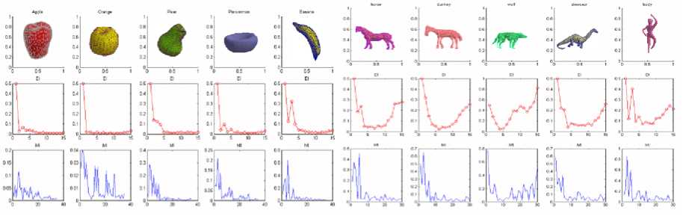
Moments
Shape descriptors
Li and Hartley (2006) Computer Vision
Saupe and Vranic (2001) Springer

Slide 44
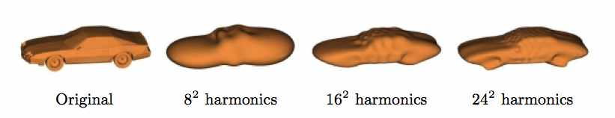
Moments
Shape descriptors
Li and Hartley (2006) Computer Vision
Saupe and Vranic (2001) Springer

Slide 45
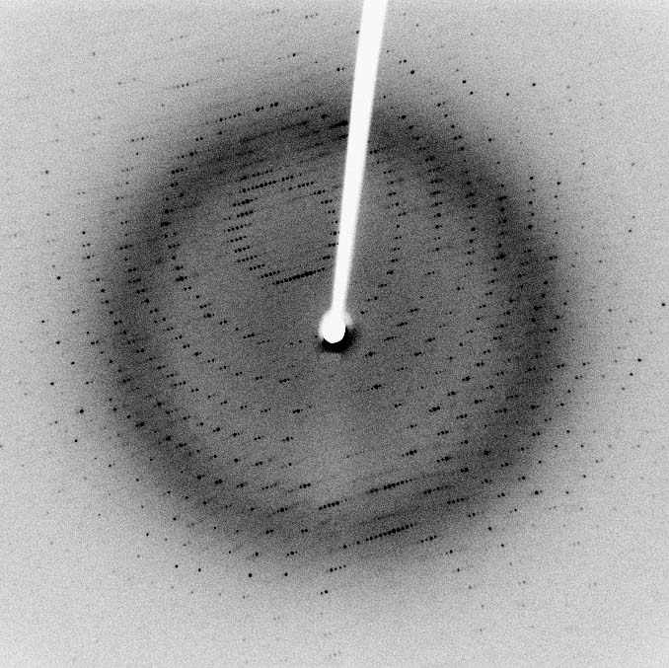
Moments
Shape descriptors
Li and Hartley (2006) Computer Vision
Saupe and Vranic (2001) Springer

Slide 46
Moments
Moments provide a description of the shape of a distribution
Raw moments Central moments Standardised moments
: mean
: variance
: skewness
: kurtosis
Notes:
Past the first moment, the central moments are generally more useful, as they provide information regarding the distribution’s shape, independent of location (i.e. the mean).
The standardised/normalised moments provide shape information that is independent of any change of scale.
higher kurtosis means more of the variance the result of infrequent extreme deviations, as opposed to frequent modestly sized deviations.

Slide 47
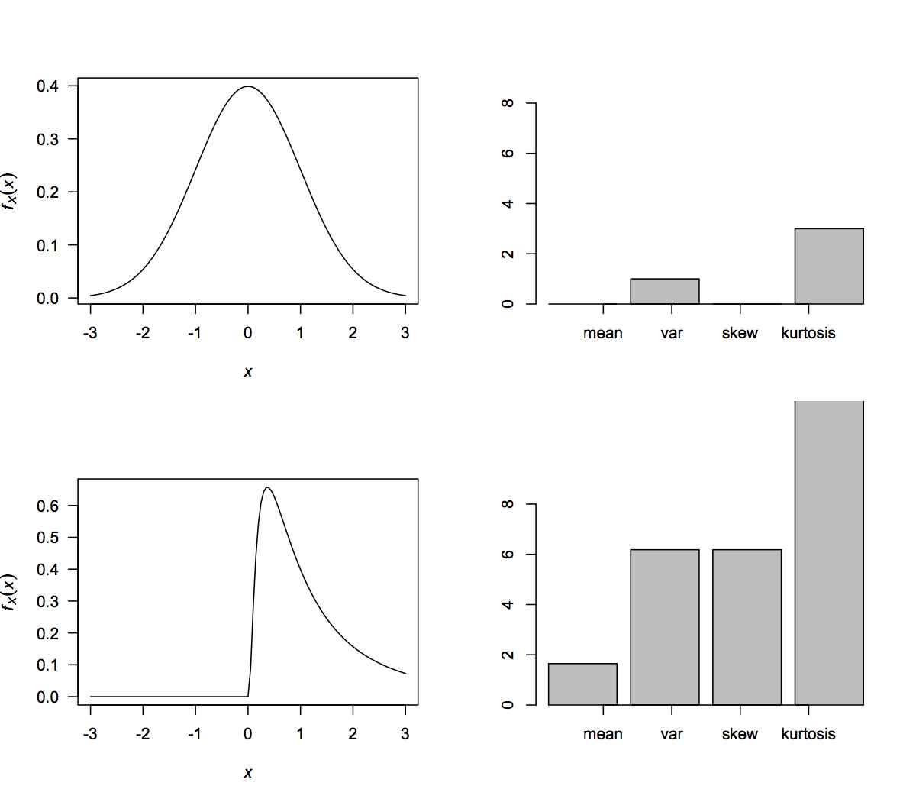
Moments
Standard Normal:
Standard Log-Normal:

Slide 48
Moments
Moment generating function (MGF):
Alternative representation of a probability distribution.

Slide 49
Moments
Moment generating function (MGF):
Alternative representation of a probability distribution.
Example:

Slide 50
Moments
However, MGF only exists if E(X^{n}) exists
Characteristic function always exists:
Related to the probability density function via Fourier transform
Example:
Notes:
MGF doesn’t exist for Cauchy.
Characteristic function is Fourier transform of the PDF
Probability distributions can be characterised by the characteristic functions – these uniquely identify the distribution.

Slide 51
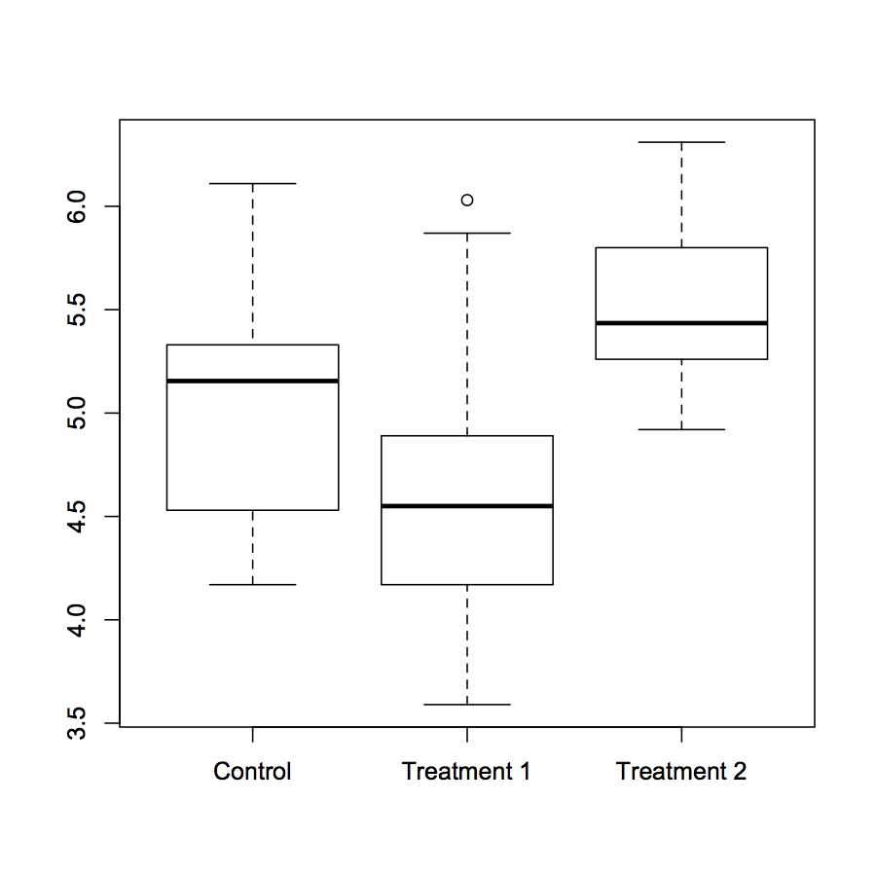
The Law of Large Numbers (LLN)
Motivational Example:
Experiment on Plant Growth (inbuilt R dataset)
- compare yields obtained under different conditions
Want to estimate the population mean using the sample mean.
How can we be sure that the sample mean reliably estimates the population mean?
Notes:
16th century – Cardano (stated without proof)
17th century – Bernoulli (for binary)
19th century – “LLN” coined for Poisson

Slide 52
The Law of Large Numbers (LLN)
Does the sample mean reliably estimate the population mean?
The Law of Large Numbers:
Providing X_{i} : i.i.d.
Notes:
one proof of this arises from Chebyshev’s and Markov’s inequalities
But how to we estimate the uncertainty of the estimate of the population mean?

Slide 53
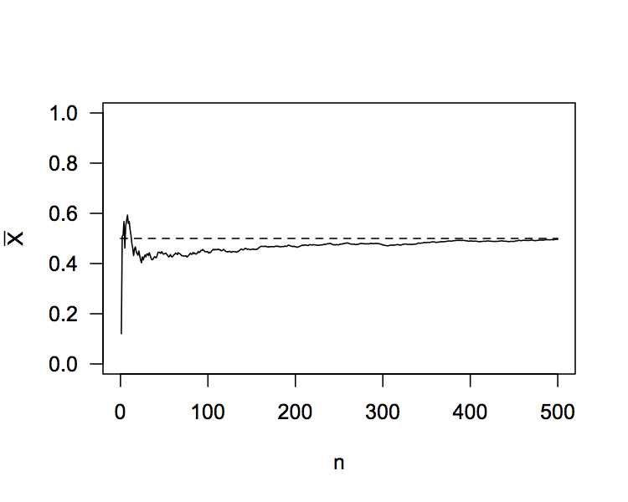
The Law of Large Numbers (LLN)
Does the sample mean reliably estimate the population mean?
The Law of Large Numbers:
Providing X_{i} : i.i.d.
Notes:
one proof of this arises from Chebyshev’s and Markov’s inequalities
But how to we estimate the uncertainty of the estimate of the population mean?

Slide 54
The Central Limit Theorem (CLT)
Question - given a particular sample, thus known sample mean, how reliable is the sample mean as an estimator of the population mean?
Furthermore, how much will getting more data improve the estimate of the population mean?
Related question - given that we want the estimate of the mean to have a certain degree of reliability (i.e. sufficiently low S.E.), how many observations do we need to collect?
The Central Limit Theorem helps answer these questions by looking at the distribution of stochastic fluctuations about the mean as

Slide 55
The Central Limit Theorem (CLT)
The Central Limit Theorem states:
For large n:
Or equivalently:
More formally:
Conditions:
: i.i.d. RVs (any distribution)
Notes:
De Moivre – 18th Century – Binomial
Laplace – 19th Century – Normal Approx to the Binomial
Resurrected by Lyapunov – 1901.
Note for next time -- X: iid not a requirement.

Slide 56
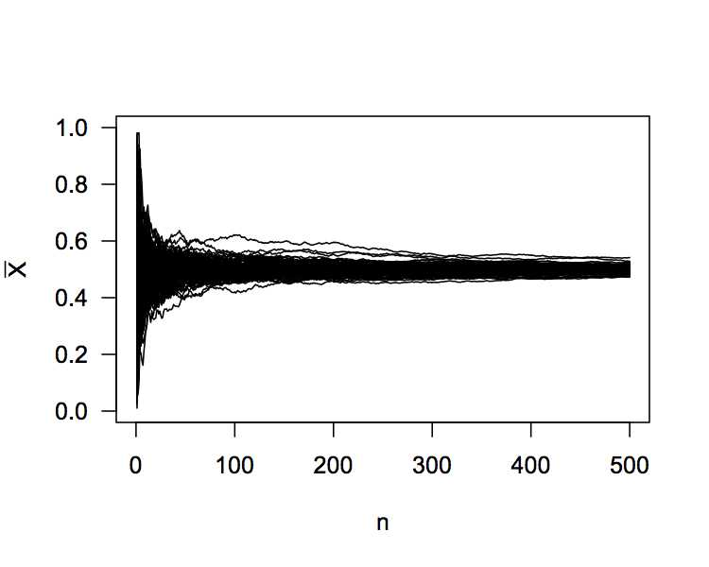
The Central Limit Theorem (CLT)
The Central Limit Theorem states:
For large n:
Notes:
De Moivre – 18th Century – Binomial
Laplace – 19th Century – Normal Approx to the Binomial
Resurrected by Lyapunov – 1901.

Slide 57
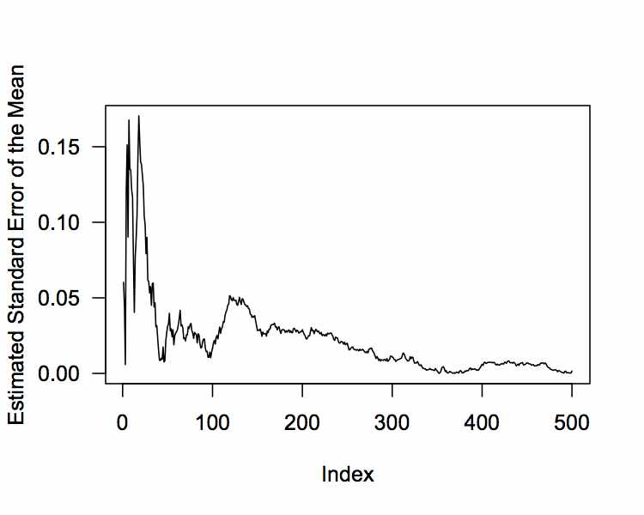
The Central Limit Theorem (CLT)
The Central Limit Theorem states:
For large n:
Notes:
De Moivre – 18th Century – Binomial
Laplace – 19th Century – Normal Approx to the Binomial
Resurrected by Lyapunov – 1901.

Slide 58
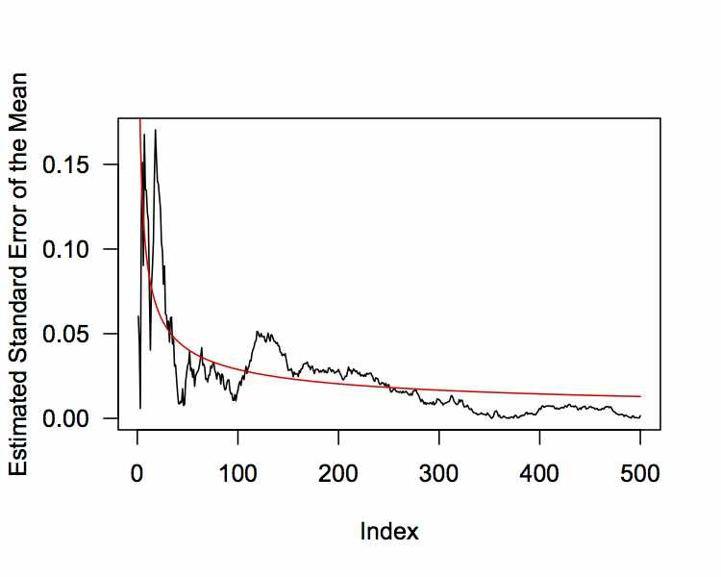
The Central Limit Theorem (CLT)
The Central Limit Theorem states:
For large n:
Notes:
De Moivre – 18th Century – Binomial
Laplace – 19th Century – Normal Approx to the Binomial
Resurrected by Lyapunov – 1901.

Slide 59
The Central Limit Theorem (CLT)
Proof of the Central Limit Theorem:
Notes:
De Moivre – 18th Century – Binomial
Laplace – 19th Century – Normal Approx to the Binomial
Resurrected by Lyapunov – 1901.

Slide 60
The Central Limit Theorem (CLT)
Proof of the Central Limit Theorem:
Notes:
De Moivre – 18th Century – Binomial
Laplace – 19th Century – Normal Approx to the Binomial
Resurrected by Lyapunov – 1901.

Slide 61
The Central Limit Theorem (CLT)
Proof of the Central Limit Theorem:
Notes:
De Moivre – 18th Century – Binomial
Laplace – 19th Century – Normal Approx to the Binomial
Resurrected by Lyapunov – 1901.

Slide 62
The Central Limit Theorem (CLT)
Proof of the Central Limit Theorem:
Notes:
De Moivre – 18th Century – Binomial
Laplace – 19th Century – Normal Approx to the Binomial
Resurrected by Lyapunov – 1901.

Slide 63
The Central Limit Theorem (CLT)
Proof of the Central Limit Theorem:
Notes:
De Moivre – 18th Century – Binomial
Laplace – 19th Century – Normal Approx to the Binomial
Resurrected by Lyapunov – 1901.

Slide 64
The Central Limit Theorem (CLT)
Proof of the Central Limit Theorem:
Notes:
De Moivre – 18th Century – Binomial
Laplace – 19th Century – Normal Approx to the Binomial
Resurrected by Lyapunov – 1901.

Slide 65
The Central Limit Theorem (CLT)
Proof of the Central Limit Theorem:
Notes:
De Moivre – 18th Century – Binomial
Laplace – 19th Century – Normal Approx to the Binomial
Resurrected by Lyapunov – 1901.

Slide 66
The Central Limit Theorem (CLT)
Proof of the Central Limit Theorem:
Notes:
De Moivre – 18th Century – Binomial
Laplace – 19th Century – Normal Approx to the Binomial
Resurrected by Lyapunov – 1901.

Slide 67
The Central Limit Theorem (CLT)
Proof of the Central Limit Theorem:
Notes:
De Moivre – 18th Century – Binomial
Laplace – 19th Century – Normal Approx to the Binomial
Resurrected by Lyapunov – 1901.

Slide 68
The Central Limit Theorem (CLT)
Proof of the Central Limit Theorem:
Notes:
De Moivre – 18th Century – Binomial
Laplace – 19th Century – Normal Approx to the Binomial
Resurrected by Lyapunov – 1901.

Slide 69
The Central Limit Theorem (CLT)
Proof of the Central Limit Theorem:
= characteristic function of a
Notes:
De Moivre – 18th Century – Binomial
Laplace – 19th Century – Normal Approx to the Binomial
Resurrected by Lyapunov – 1901.
This is one reason why the Normal distribution is so commonly used.

Slide 70
Summary
Considered how:
Probability Density Functions (PDFs) and Cumulative Distribution Functions (CDFs) are related, and how they differ in the discrete and continuous cases
Expectation is at the core of Statistical theory, and Moments can be used to describe distributions
The Central Limit Theorem identifies how/why the Normal distribution is fundamental
The Normal distribution is also popular for other reasons:
Maximum entropy distribution (given mean and variance)
Intrinsically related to other distributions (t, F, χ², Cauchy, …)
Also, it is easy to work with

Slide 71
References
Countless books + online resources!
Probability and Statistical theory:
Grimmett and Stirzker (2001) Probability and Random Processes. Oxford University Press.
General comprehensive introduction to (almost) everything mathematics:
Garrity (2002) All the mathematics you missed: but need to know for graduate school. Cambridge University Press.

