Slide 1

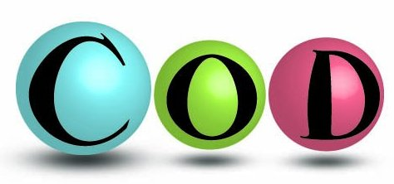
Acedrg:A New Monomer Library based on Crystallography Open Database
Fei Long
MRC-LMB, Cambridge, UK

Slide 2
Recent developments
Tests (outlier analysis) and Bug fixing ( with Paul)
Regeneration of Values of Bonds and Bond-angles existing all structures in (COD). In the current version, we use those values provided by COD. We will replace them using our own data of bonds and bond-angles.
Validation and systematical analysis of those values and bug fixing( with Rob).
Different input file formats. (MMCIF, MDL/SDF, SMILE)
All codes and building are in CCP4 bzr repository (nightly building)
Have been presented AsAc2013 and will be presented in IUCR-2014
Release.
Notes:
Introduction motivations why dictionary, why new and why cod. how

Slide 3
Introduction
Crystallography Open Database(COD)
  The database contains crystal structures of organic, inorganic, metal-organic compounds and minerals.
  All structures are published in peer-review journals, and the database is freely accessible.
  About 250,000 structures, daily updated.
  Unique definitions of atom types.

Slide 4
Introduction
Current CCP4 Monomer Library (Dictionary)
  Dictionary is used as the source for prior chemical information in CCP4 refinement program REFMAC, and other programs such as PHENIX and COOT.
  It contains:
    More than 10000 monomer entries
    More than 100 modification
    More than 200 links
    More than 100 atom types
  Improvement needed:
    The data need better supporting
    More atom types to take account of various chemical environment around atoms, particularly for metal atoms. That leads some problems in handle with unknown ligands.

Slide 5
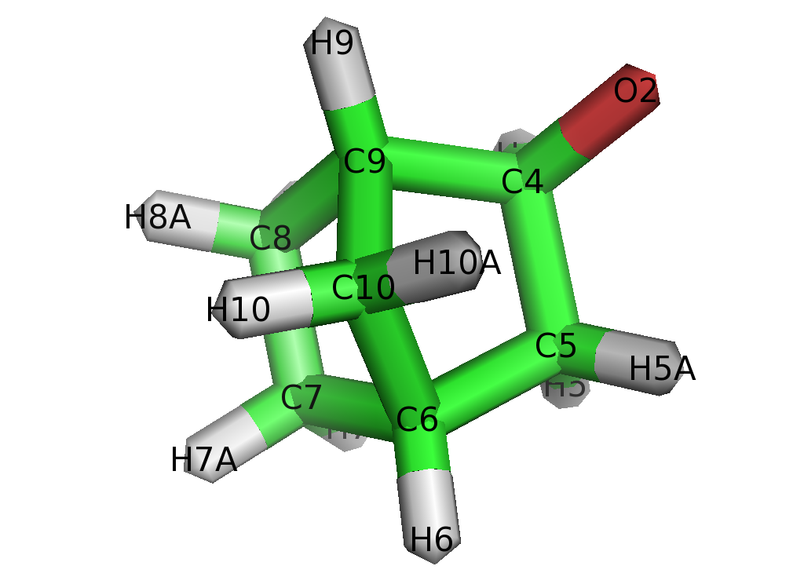
Building the new Dictionary
Classification of atoms in COD
  Atoms in are classified using local graphs
  Atom C9
    C[5,5,6](C[5,5]CHH)(C[5,6]CHH)(C[5,6]CHO)(H)
    Atom C10
    C[5,5](C[5,5,6]CCH)2(H)2
    We have more than 600,000 atom types
    We need to cluster them and use fast search algorithms
    The atom types could be applied to other databases

Slide 6
Building the new Dictionary
Statistical analysis data in COD
  Selection of records for bond and bond-angle
    The data are from single-crystal X-ray crystallography
    R_{obs} < 0.05
    Occupancies > 0.99
  We handle atoms in “organic set” and metal atoms differently. After curating the data, we have the following for organic atoms
    More than 200,000 atom types
    More than 1.5 million distinct bond values
    More than 2.5 million distinct bond-angle value

Slide 7
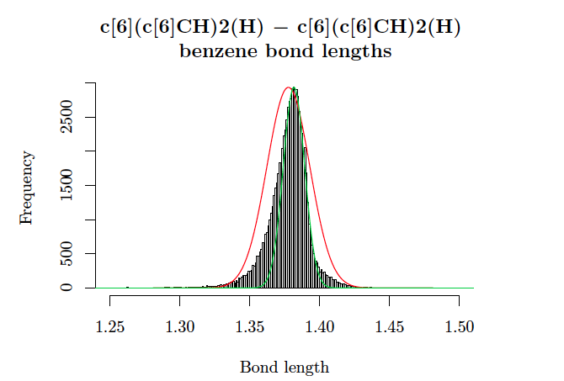
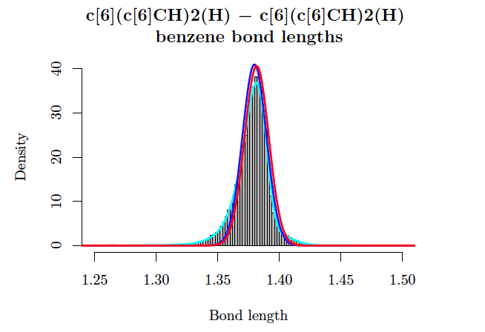
Building the new Dictionary
Statistical analysis data in COD
  Further check:
    Non-normality
    Multimodality
    Skewness
    Outliers
Very tedious ! The work is under way.

Slide 8
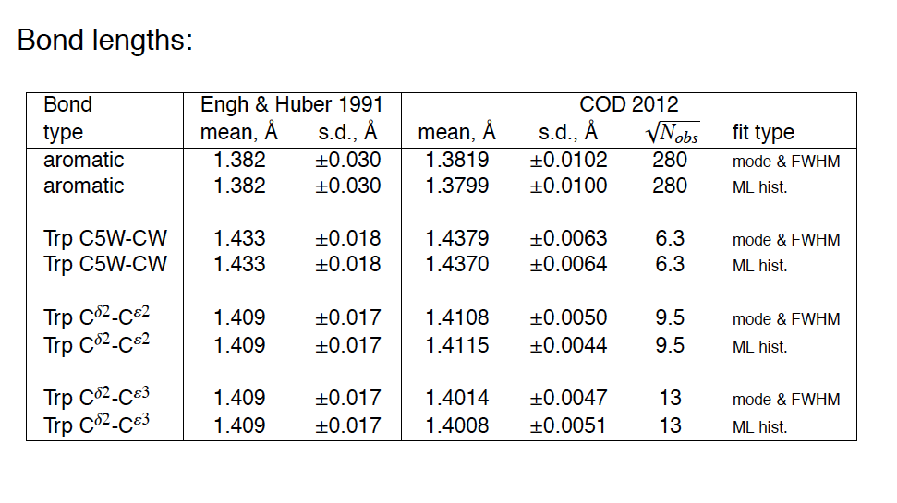
Building the new Dictionary
Statistical analysis data in COD
  Benchmark:

Slide 9
Building the new Dictionary
Clustering the data from COD
The new Dictionary requires:
fast search for user’s atom types (therefore bonds, angles, etc.), if these atom types exist in the Dictionary.
find the most similar atom types if user’s atom types do not exist.
This leads to:
hierarchical tree clustering of atom types
Isomorphism mapping algorithm

Slide 10
Building the new Dictionary
Clustering the data from COD
Hierarchical tree clustering of atom types
Hash number
1st NB composition
1st NB connection
Atom type
Notes:
Search by backtracking

Slide 11
Building the new Dictionary
Clustering the data from COD
Hierarchical tree clustering of atom types
A full record entry of a bond between two organic atoms :
Hash number: a number, e.g. 455, embed minimally required property of atom type for matching, equivalent to the old CCP4 atom types
1st NB connection to 2nd NB, e.g. 3:3:1
2nd NB composition and connection to first NB,
e.g. C[6]-3:C[6]-3:H-1:
Full atom type, e.g. C[6](C[6]CH)(C[6]NN)(H)
29 29 3:3:1: 3:2:3: C[6]-3:C[6]-3:H-1: C[6]-3:N[6]-2:N-3: C[6](C[6]CH)(C[6]NN)(H) C[6](C[6]CH)(N[6]C)(NCC) 1.3864 0.020 165

Slide 12
Building the new Dictionary
Clustering the data from COD
A search algorithm based on local graph isomorphism
    Search layer by layer until exactly matching atom types are found
    If no exactly matching atom types are found
      If it is at layer or lower, using average values at this layer
      If it is above layer, calculate the “distance” between all search atom types at that layer and target atom type. Select atom type of the smallest “distance”
    If search failed at layer, the simplest atom types will be used.
Notes:
Second option, two candidates

Slide 13
Building the new Dictionary
Clustering the data from COD
Bond values
 | Atom type 1 | Atom type 2
 | 111 | 673
 | 4:3: | 2:1:1:1:
 | C-4:C-3: | O-2:H-1:H-1:H-1:
 | A | B
Value | 1.4484
σ | 0.014
N_{obs} | 4258
 | Atom type 1 | Atom type 2
 | 111 | 673
 | 4:3: | 2:1:1:1:
 | C-4:C-3: | O-2:H-1:H-1:H-1:
 | C | B
Value | 1.4443
σ | 0.014
N_{obs} | 193
 | Atom type 1 | Atom type 2
 | 111 | 673
 | 4:3: | 4:2:1:1:
 | C-4:C-3: | C-4:O-2:H-1:H-1:
 | D | E
Value | 1.4586
σ | 0.020
N_{obs} | 2516

Slide 14
Building the new Dictionary
Clustering the data from COD
Metal-organic compounds:
Metal-organic compounds are clustering according to their coordination numbers and geometries
New dictionary includes 26 coordination geometries and the angles within these geometries are stores as tables
For an organic atom that is connected to metal atoms, its non-metal neighbor atoms are treated as described before

Slide 15
Two Associated software tools
A generator of molecule geometries is developed for users to assess the values of bonds, bond-angles, torsion-angles, planes etc. from the Dictionary for their new ligands and molecules
  An initial molecule geometry is generated using the bonds, angles etc. from the new Dictionary
  A global optimization scheme is carried out to bring the initial geometry to the “ideal” one
  It will replace the current CCP4 program “libcheck” as the engine for another program “Jligand”
Notes:
How are your molecules or ligands look like, ideal or one lower E conformer

Slide 16
Generator of molecule geometries using the new Dictionary
A “greedy” global optimization scheme
Notes:
Short time, not certain , no natural evolution compared with sa or gen, global, lower local

Slide 17
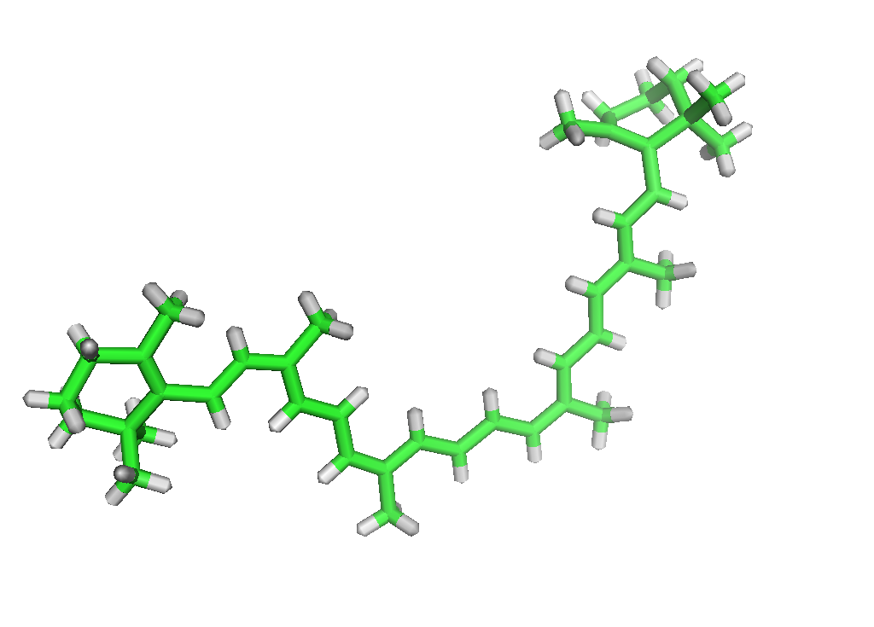
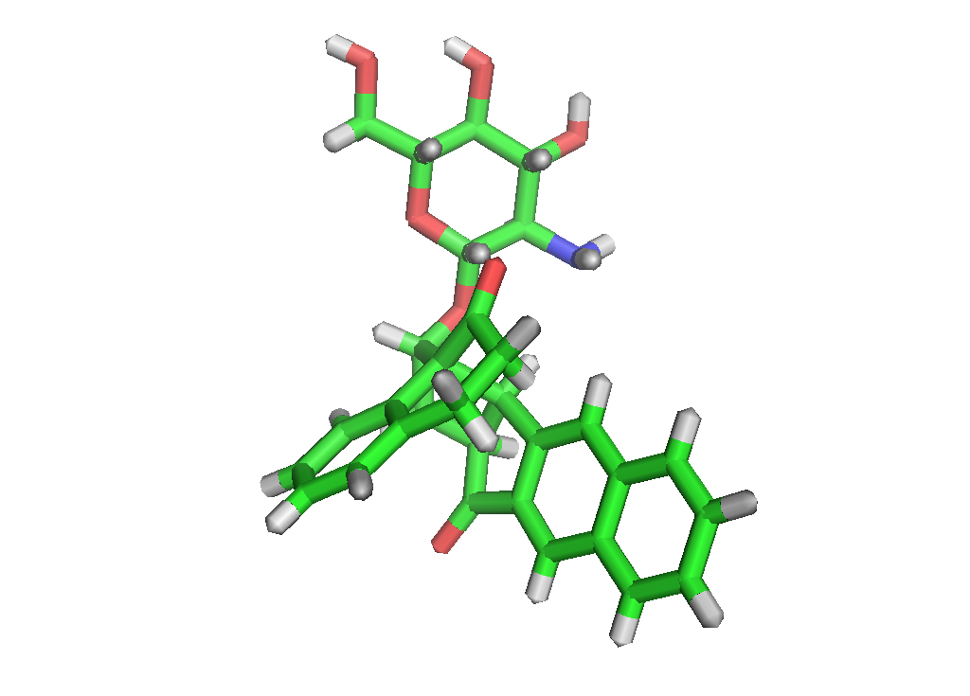
Generator of molecule geometries using the new Dictionary
Examples
DDI
CGL

Slide 18
Two Associated software tools
2) A generator of “ideal” bonds and bond-angles based on the coordinates and our classification of atoms.
  This is for some sources, e.g. some pharmaceutical companies who might not be able to provide the details of ligands they have, but willing to provide the derived properties such as values of bond and bond angles.
  We need these data to enrich our database which is currently based solely on COD.
  Samples of the output are :
  1.3891005 C48 c[6](c[6]CH)2(H) 1 C49 c[6](c[6]CC)(c[6]CH)(H) 1
  1.3834940 C4_1_556 c[6](C[6]CC)(C[6]CH)(H) 1 C3 C[6(c[6]CH)2(CCHH) 1
Notes:
How are your molecules or ligands look like, ideal or one lower E conformer

Slide 19
Summary and future work
An initial version of the new CCP4 monomer library, Dictionary, and the associated software tools have been developed and will be released soon(beta release before Xamas holiday).
The Dictionary is based on openly accessible database of small molecule crystal structures, Crystallography Open database
Some further work:
  Statistical analysis and validation of COD data, in particular on metal-organic compounds
  QM calculation on unknown ligands

Slide 20

Acknowledgement
Other contributors:
Garib Murshudov
Saulius Grazulis, and Andrius Merky
Thanks to:
Paul Emsley, Rob Nicholls, Andrea Thorn
Andrey Lebedev, CCP4 core team

