Slide 1
Probability Theory
Random Variables and Distributions
Rob Nicholls
MRC LMB Statistics Course 2014
Notes:
“Probability theory enables us to find the consequences of a given ideal world, while statistical theory enables us to to measure the extent to which our world is ideal”

Slide 2
Introduction

Slide 3
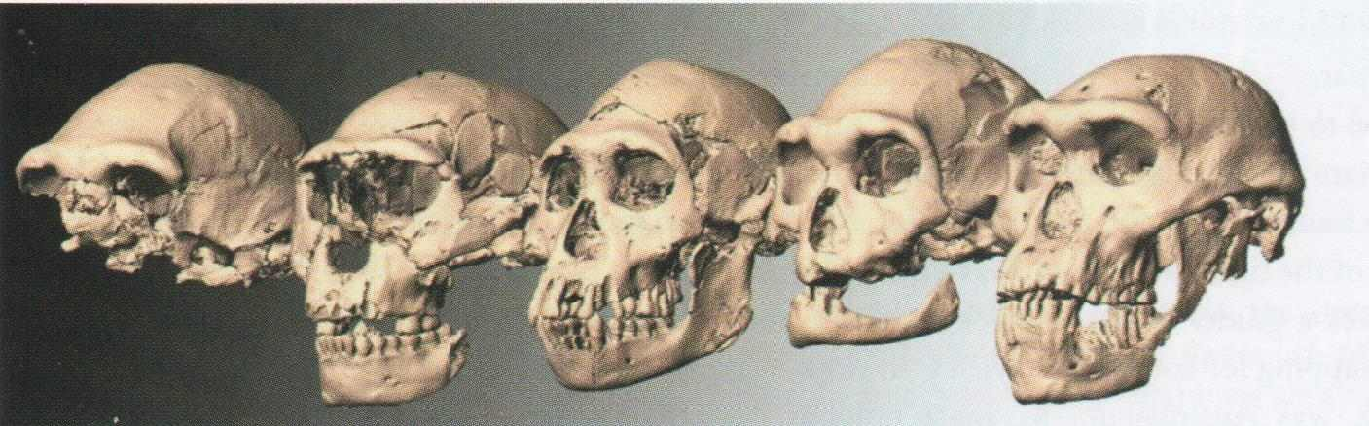

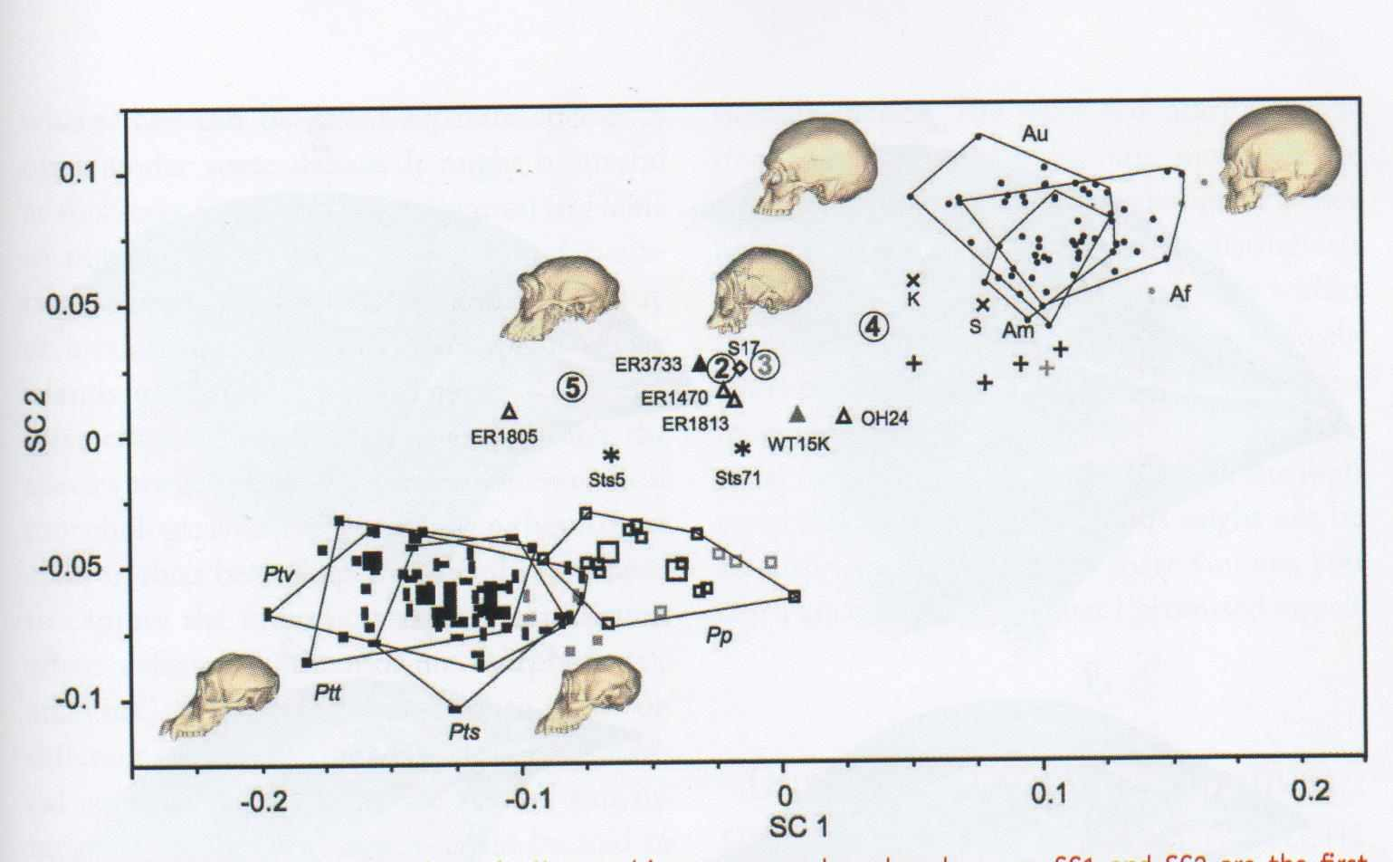
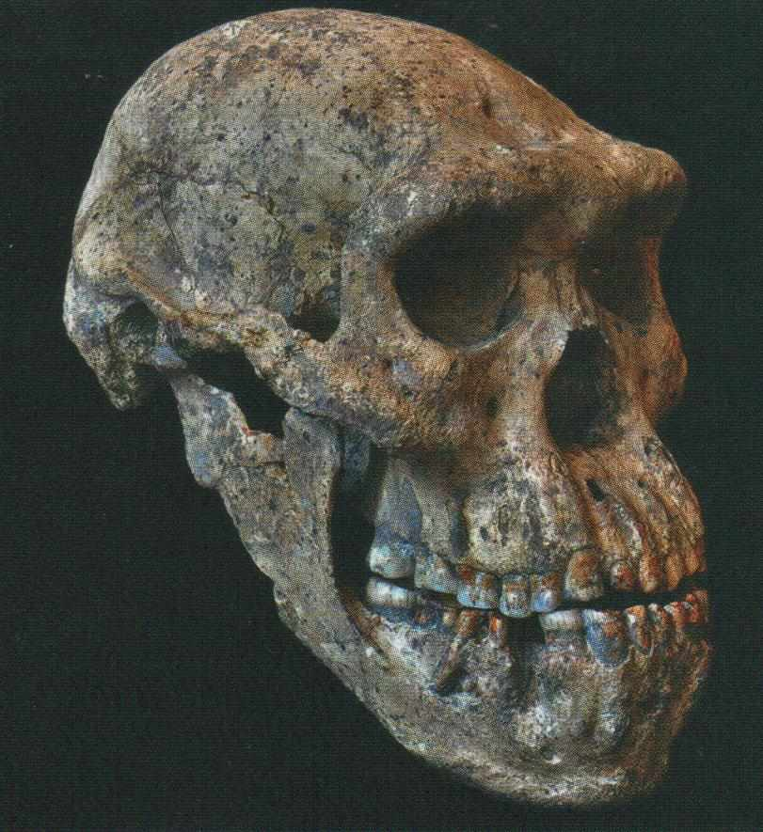
Introduction
  Significance magazine (December 2013) Royal Statistical Society

Slide 4
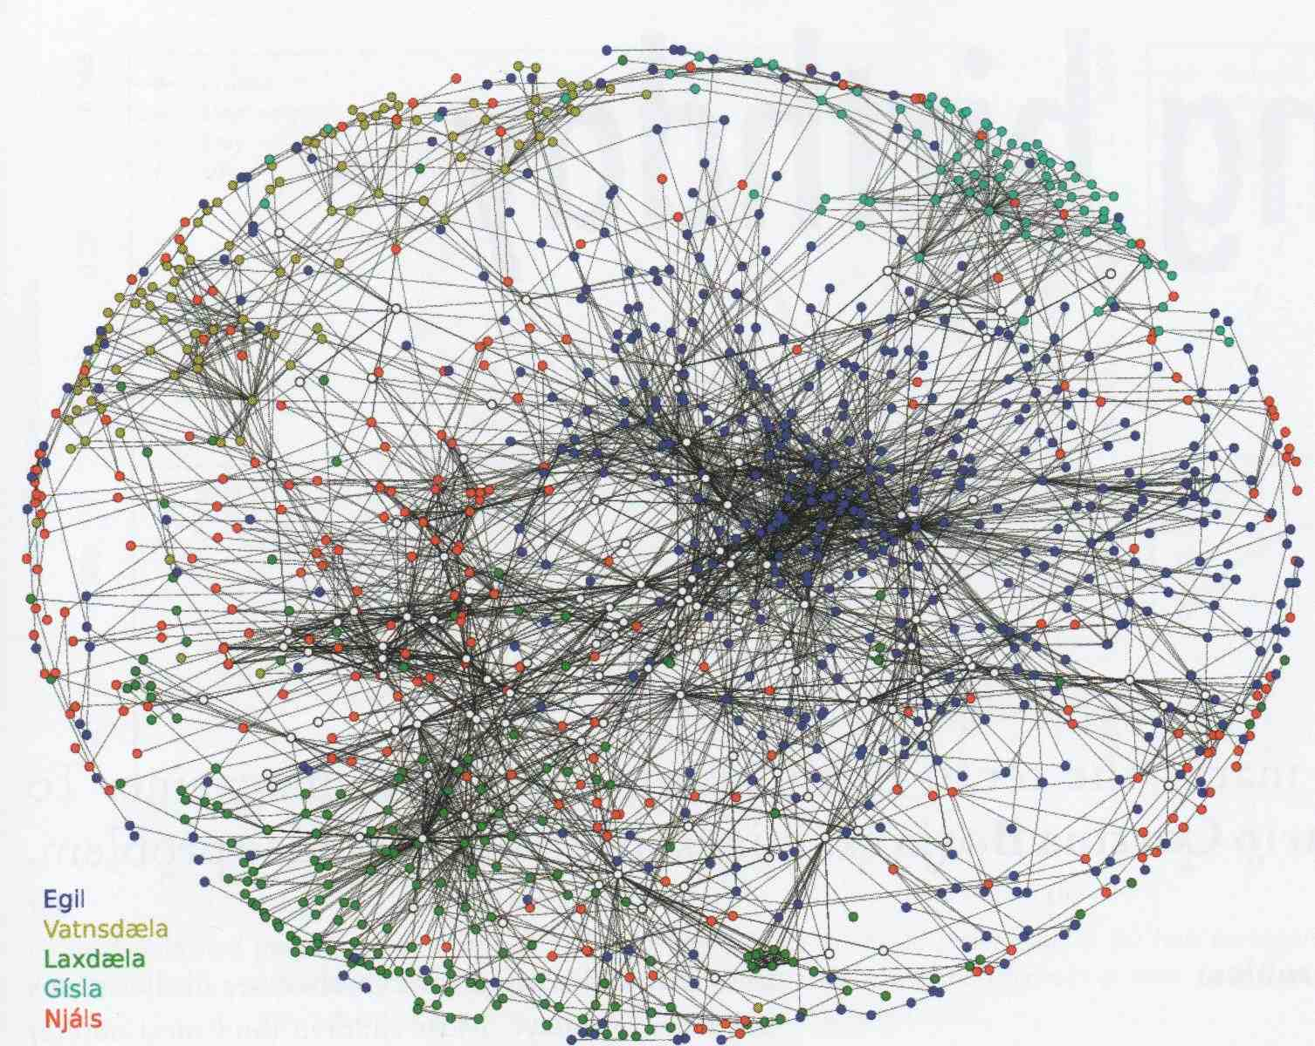


Introduction
  Significance magazine (December 2013) Royal Statistical Society

Slide 5


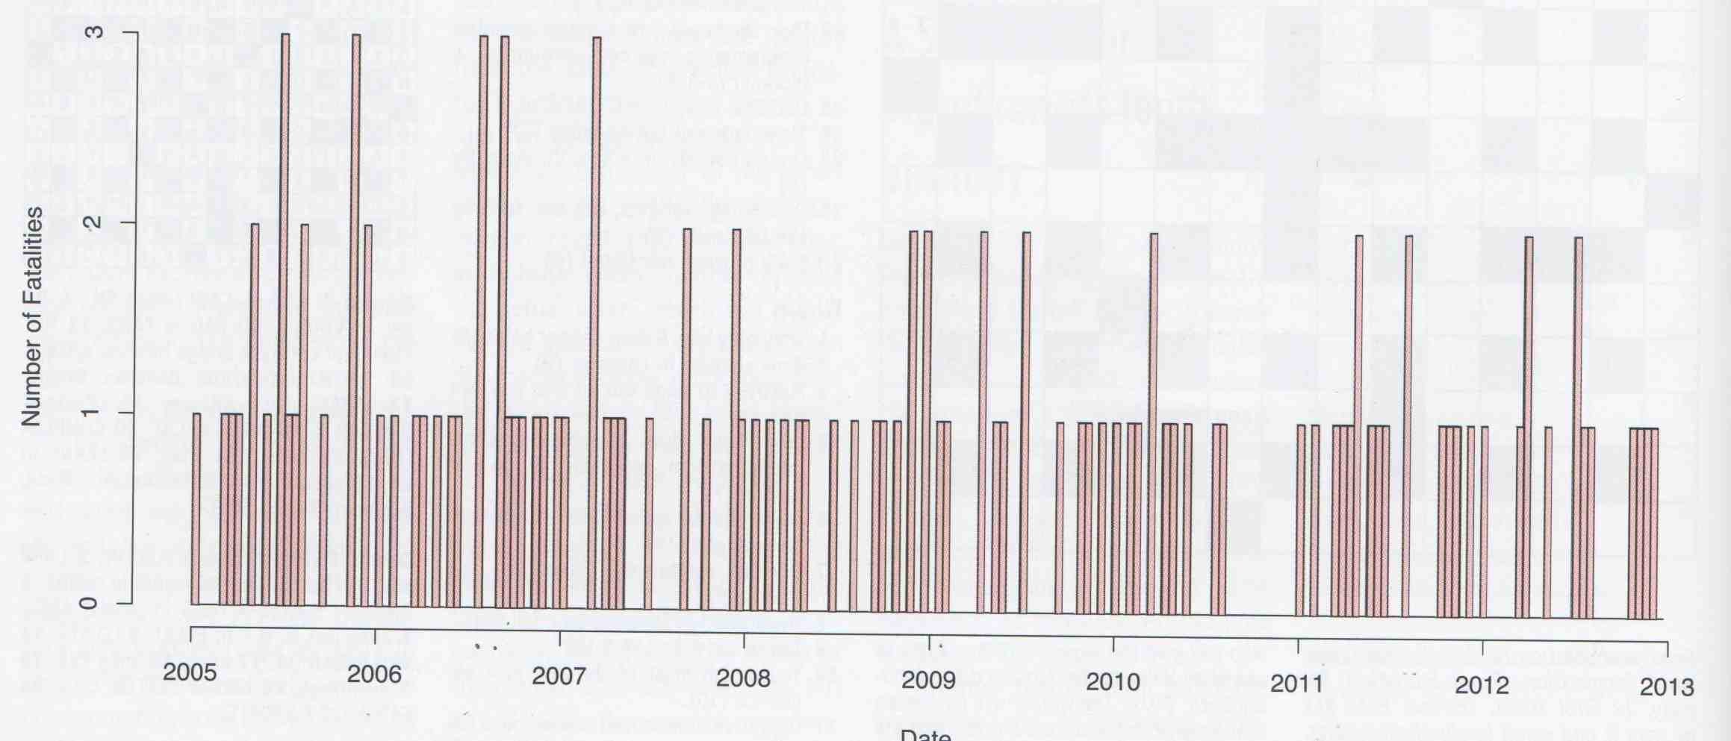
Introduction
  Significance magazine (December 2013) Royal Statistical Society

Slide 6
Contents
Set Notation
Intro to Probability Theory
Random Variables
Probability Mass Functions
Common Discrete Distributions

Slide 7

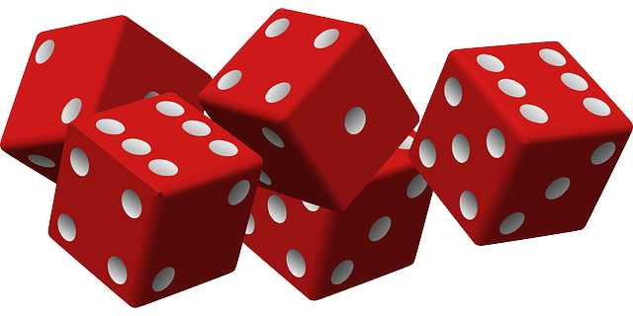
Set Notation
  A set is a collection of objects, written using curly brackets {}
  If A is the set of all outcomes, then:
  A set does not have to comprise the full number of outcomes
  E.g. if A is the set of dice outcomes no higher than three, then:

Slide 8
Set Notation
  If A and B are sets, then:
  Complement – everything but A
  Union (or)
  Intersection (and)
  Not
  Empty Set

Slide 9
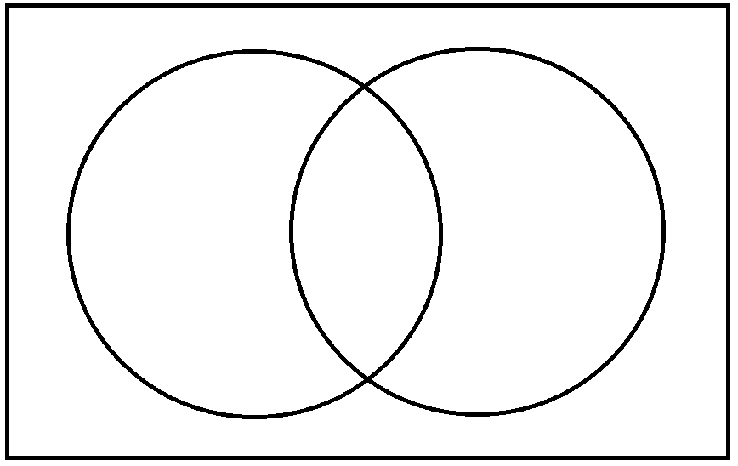
Set Notation
  Venn Diagram:
  one
  two, three six
  four
  five
  A B

Slide 10
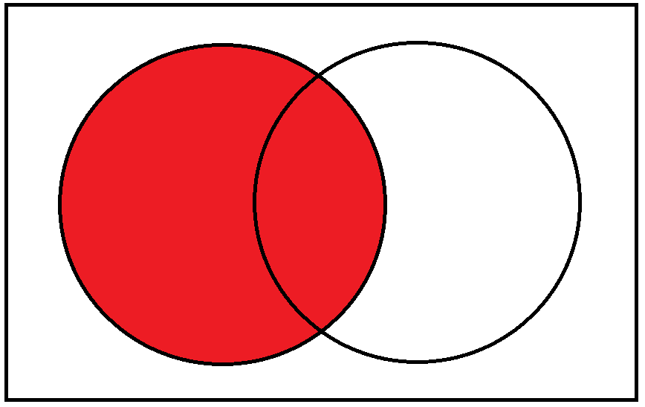
Set Notation
  Venn Diagram:
  one
  two, three six
  four
  five
  A B

Slide 11
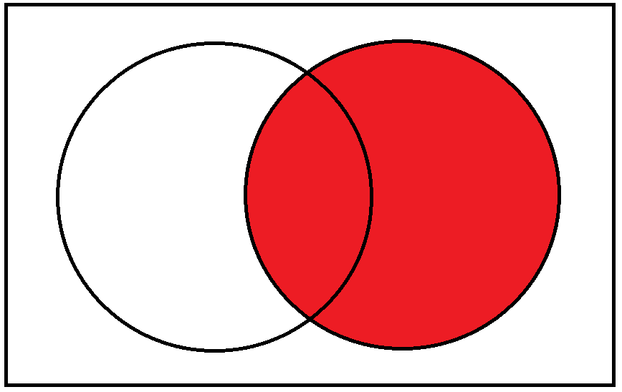
Set Notation
  Venn Diagram:
  one
  two, three six
  four
  five
  A B

Slide 12
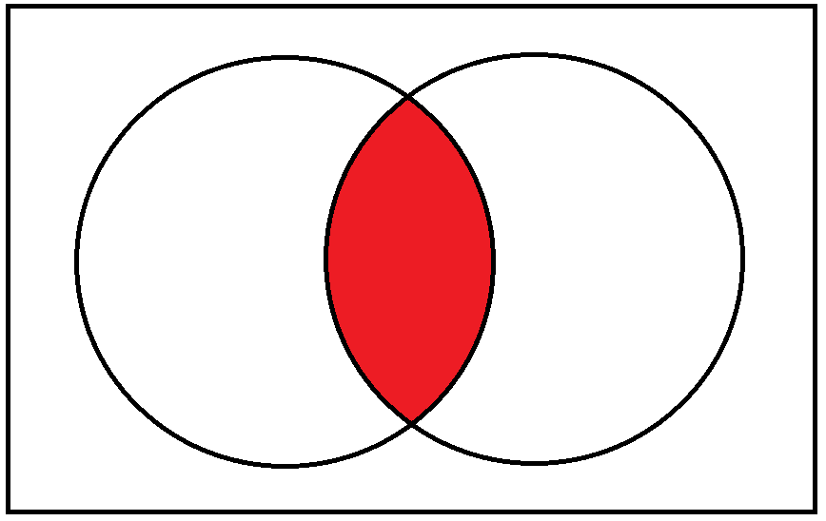
Set Notation
  Venn Diagram:
  one
  two, three six
  four
  five
  A B

Slide 13
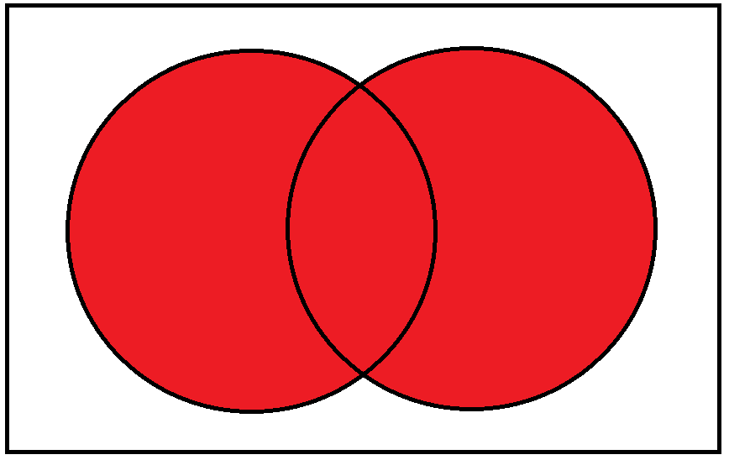
Set Notation
  Venn Diagram:
  one
  two, three six
  four
  five
  A B

Slide 14

Set Notation
  Venn Diagram:
  one
  two, three six
  four
  five
  A B

Slide 15
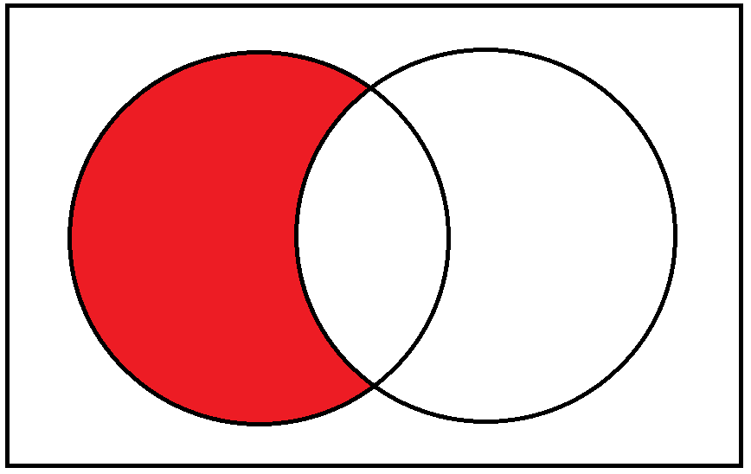
Set Notation
  Venn Diagram:
  one
  two, three six
  four
  five
  A B

Slide 16

Set Notation
  Venn Diagram:
  one
  two, three six
  four
  five
  A B
Notes:
So this gives us all the flexibility we need to manipulate sets.
This is useful for looking at events that we might be interested in.
Now interested in the probabilities associated with such events.

Slide 17

Probability Theory
  To consider Probabilities, we need:
  1. Sample space: Ω
  2. Event space:
  3. Probability measure: P
Notes:
Appreciate that this is a bit abstract, but stick with it!
Want to know the probability/likelihood of events. In order to do this, need a few pieces of information about the system.

Slide 18
Probability Theory
  To consider Probabilities, we need:
  1. Sample space: Ω - the set of all possible outcomes

Slide 19
Probability Theory
  To consider Probabilities, we need:
  2. Event space: - the set of all possible events
Notes:
Event space is a set of subsets of the sample space

Slide 20
Probability Theory
  To consider Probabilities, we need:
  3. Probability measure: P
  P must satisfy two axioms:
  Probability of any outcome is 1 (100% chance)
  If and only if are disjoint
Notes:
The probability measure P is a function that maps elements of the event space to values between 0 and 1.

Slide 21
Probability Theory
  To consider Probabilities, we need:
  3. Probability measure: P
  P must satisfy two axioms:
  Probability of any outcome is 1 (100% chance)
  If and only if are disjoint
Notes:
The probability measure P is a function that maps elements of the event space to values between 0 and 1.

Slide 22
Probability Theory
  To consider Probabilities, we need:
  1. Sample space: Ω
  2. Event space:
  3. Probability measure: P
  As such, a Probability Space is the triple: (Ω, ,P )
Notes:
So, now we know what a probability is.
We know that, in order to be a probability, a probability must satisfy the two axioms from the previous slide.
And in order to consider working with probabilities, we need to know three things about the system under consideration…

Slide 23
Probability Theory
  To consider Probabilities, we need:
  The triple: (Ω, ,P )
  i.e. we need to know:
  The set of potential outcomes;
  The set of potential events that may occur; and
  The probabilities associated with occurrence of those events.

Slide 24
Probability Theory
  Notable properties of a Probability Space (Ω, ,P ):

Slide 25
Probability Theory
  Notable properties of a Probability Space (Ω, ,P ):

Slide 26
Probability Theory
  Notable properties of a Probability Space (Ω, ,P ):

Slide 27
Probability Theory
  Notable properties of a Probability Space (Ω, ,P ):
  A B

Slide 28
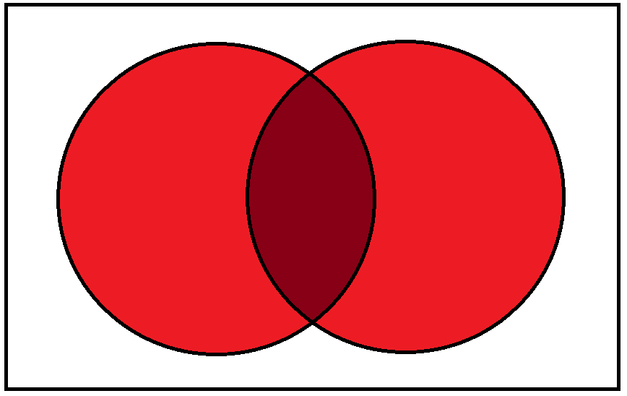
Probability Theory
  Notable properties of a Probability Space (Ω, ,P ):
  A B

Slide 29
Probability Theory
  Notable properties of a Probability Space (Ω, ,P ):
  A B

Slide 30
Probability Theory
  Notable properties of a Probability Space (Ω, ,P ):

Slide 31
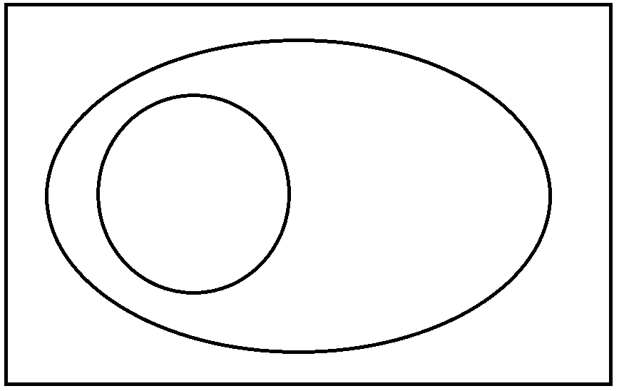
Probability Theory
  Notable properties of a Probability Space (Ω, ,P ):
  If then and
  A B

Slide 32

Probability Theory
  Notable properties of a Probability Space (Ω, ,P ):
  If then and
  A B

Slide 33
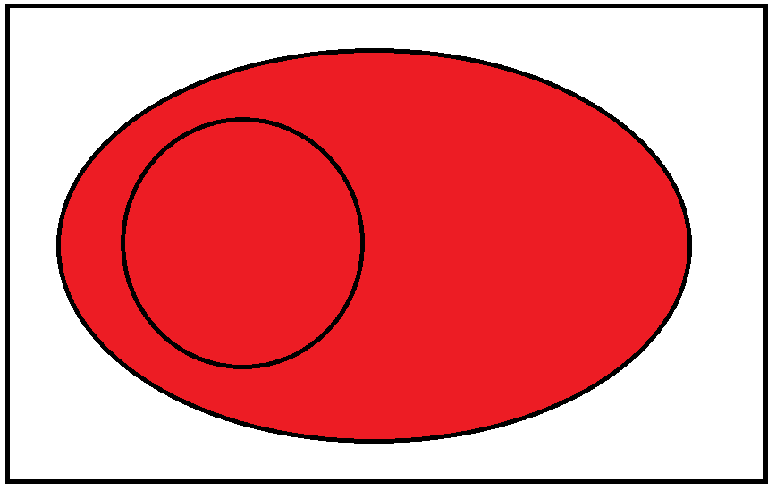
Probability Theory
  Notable properties of a Probability Space (Ω, ,P ):
  If then and
  A B

Slide 34

Probability Theory
  Notable properties of a Probability Space (Ω, ,P ):
  If then and
  A B

Slide 35
Probability Theory
  Notable properties of a Probability Space (Ω, ,P ):
  If then and

Slide 36
Probability Theory
  Notable properties of a Probability Space (Ω, ,P ):
  If then and
Notes:
i.e. an experiment always has to have an outcome!

Slide 37
Probability Theory
  So where’s this all going? These examples are trivial!

Slide 38
Probability Theory
  So where’s this all going? These examples are trivial!
  Suppose there are three bags, B₁, B₂ and B₃, each of which contain a number of coloured balls:
  B₁ – 2 red and 4 white
  B₂ – 1 red and 2 white
  B₃ – 5 red and 4 white
  A ball is randomly removed from one the bags.
  The bags were selected with probability:
  P(B₁) = 1/3
  P(B₂) = 5/12
  P(B₃) = 1/4
  What is the probability that the ball came from B₁, given it is red?

Slide 39
Probability Theory
  Conditional probability:
  Partition Theorem:
  Bayes’ Theorem:
If the partition

Slide 40
Random Variables
  A Random Variable is an object whose value is determined by chance, i.e. random events
  Maps elements of Ω onto real numbers, with corresponding probabilities as specified by P
Notes:
So, we’ve looked at the probabilities associated with discrete sets, but what about if we want to consider a probability distribution? i.e. the distribution of values over an ordered range that random values would tend to take, in a given system. And the expected value of a given distribution. For this, we must consider random variables.
So, now that we know what a Probability is, we can think about what a Random Variable is.

Slide 41
Random Variables
  A Random Variable is an object whose value is determined by chance, i.e. random events
  Maps elements of Ω onto real numbers, with corresponding probabilities as specified by P
  Formally, a Random Variable is a function:
Notes:
Here, the Observation Space is the set of Real numbers (but it could be something else, e.g. a subset of the Real numbers).
Ω is referred to as the support of X, meaning that X is (only) defined on Ω.

Slide 42
Random Variables
  A Random Variable is an object whose value is determined by chance, i.e. random events
  Maps elements of Ω onto real numbers, with corresponding probabilities as specified by P
  Formally, a Random Variable is a function:
  Probability that the random variable X adopts a particular value x:
Notes:
Such variables allow us to investigate the likelihood of occurrence of particular events.
Specifically, we’re interested in the probability that the random variable X takes on some value x. Upper case / lower case.
E.g. probability associated with the set of outcomes w in the sample space Ω, such that the random variable X takes on the value x associated with those outcomes.
This is the formal definition... so if you ever read a stats book and come across this then you’ll know what it means.

Slide 43
Random Variables
  A Random Variable is an object whose value is determined by chance, i.e. random events
  Maps elements of Ω onto real numbers, with corresponding probabilities as specified by P
  Formally, a Random Variable is a function:
  Probability that the random variable X adopts a particular value x:
  Shorthand:
Notes:
However, we will use the shorthand notation from now on.
Capital letter denotes random variable, lower case denotes a particular outcome. An observation of a particular outcome is often called a random variate.

Slide 44
Random Variables
  Example:
  If the result is heads then WIN - X takes the value 1
  If the result is tails then LOSE - X takes the value 0

Slide 45
Random Variables
  Example:
  Win £20 on a six, nothing on four/five, lose £10 on one/two/three

Slide 46
Random Variables
  Example:
  Win £20 on a six, nothing on four/five, lose £10 on one/two/three
  Note – we are considering the probabilities of events in
Notes:
Note we are using all three pieces of information in the probability space.

Slide 47
Probability Mass Functions
  Given a random variable:
  The Probability Mass Function is defined as:
  Only for discrete random variables
Notes:
So we now know about random variables. Now we can consider a probability mass function, which maps outcomes to probabilities.
Note that probabilities associated with the discrete outcomes can be seen like relative weights (or masses).

Slide 48
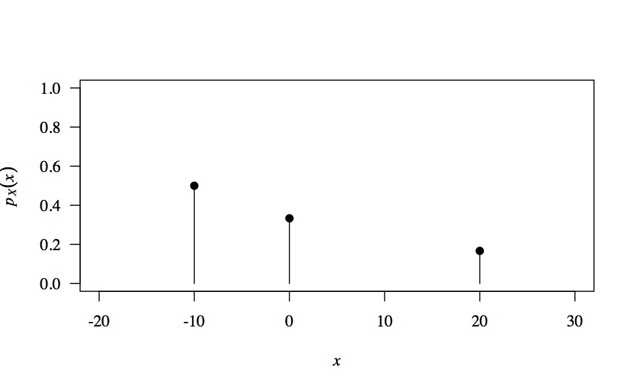
Probability Mass Functions
  Example:
  Win £20 on a six, nothing on four/five, lose £10 on one/two/three

Slide 49
Probability Mass Functions
  Notable properties of Probability Mass Functions:
Notes:
By definition of a probability.

Slide 50
Probability Mass Functions
  Notable properties of Probability Mass Functions:
  Interesting note:
  If p() is some function that has the above two properties, then it is the mass function of some random variable…

Slide 51
Probability Mass Functions
  For a random variable
  Mean:

Slide 52
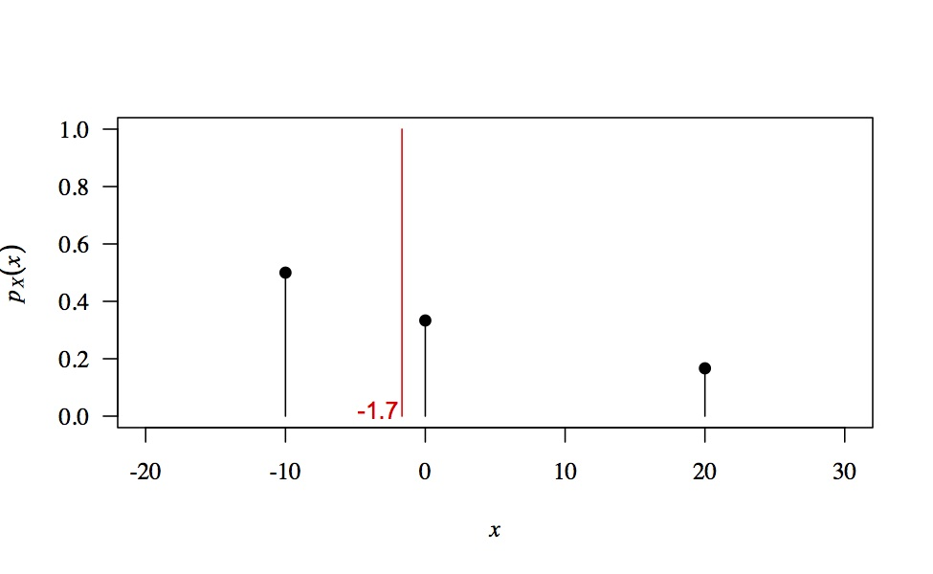
Probability Mass Functions
  For a random variable
  Mean:
  Mean

Slide 53
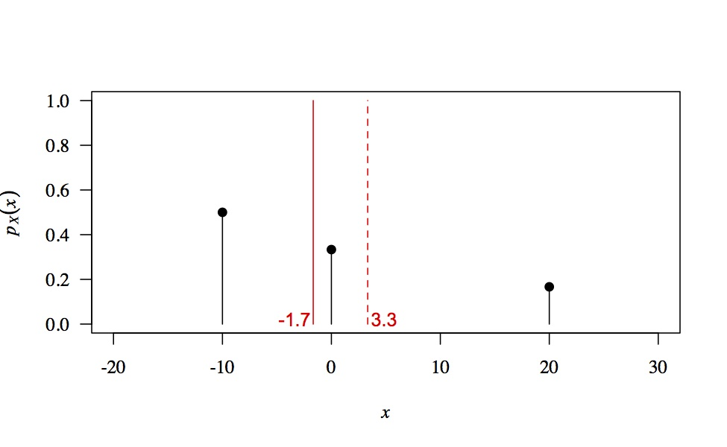
Probability Mass Functions
  For a random variable
  Mean:
  Compare with:
  Mean
Notes:
this is why it is mass - it is weighted

Slide 54
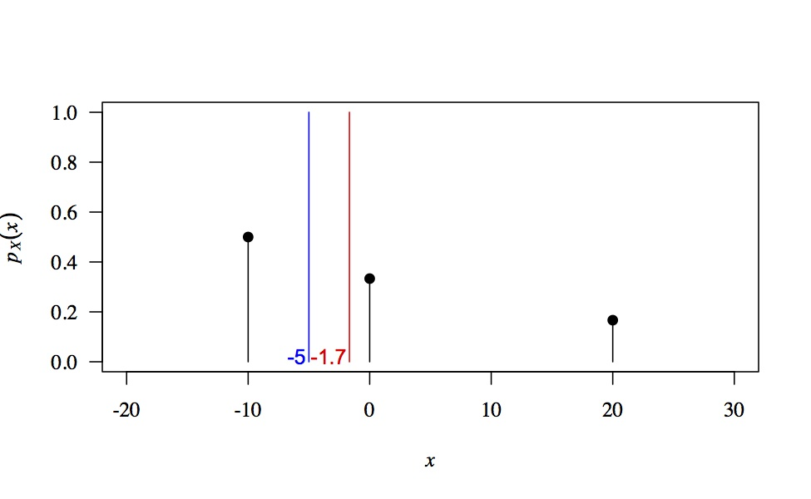
Probability Mass Functions
  For a random variable
  Mean:
  Median:
  any m such that: and
  Mean
  Median

Slide 55
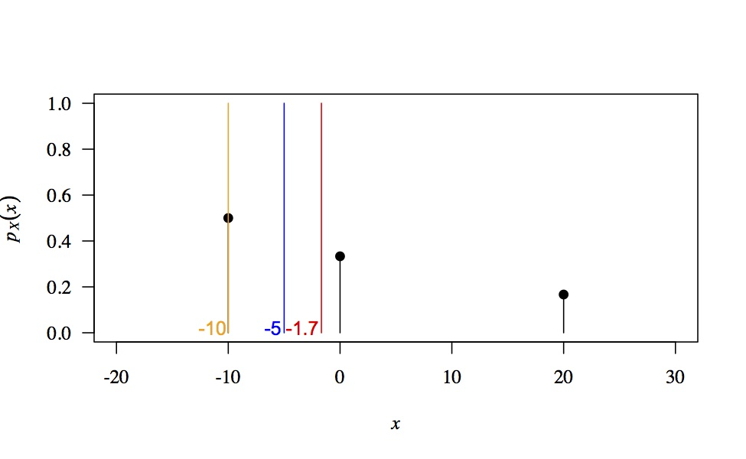
Probability Mass Functions
  For a random variable
  Mean:
  Median:
  any m such that: and
  Mode: : most likely value
  Mean
  Median
  Mode
Notes:
The value that has the highest chance of being observed In a single trial.

Slide 56
Common Discrete Distributions
Notes:
Why are we interested in looking at common distributions?
There are various well-known probability distributions that have been extensively studied. Functional form, justification, expectation, and more complicated things you’d never be interested in.
When you’ve got data, it’s convenient if you’re able to fit it into one of the frameworks of the common distributions. So, when you’ve got some data, you should first think about whether there’s a particular reason why your data should follow a distribution. If not, hypothesis testing.
Consequently, it’s a good idea to have a knowledge of the common probability distributions, and the mechanical reason for their existence.

Slide 57
Common Discrete Distributions
  The Bernoulli Distribution:
  p : success probability
Notes:
The Bernoulli distribution corresponds to an experiment whose outcome is either TRUE or FALSE, with success rate determined by the probability p.
Examples:
Tossing a dice.
In general, it could apply to any experiment that returns success/failure as a result, e.g. based on a score threshold, like with exams.

Slide 58
Common Discrete Distributions
  The Bernoulli Distribution:
  p : success probability
  Example:
  Therefore

Slide 59
Common Discrete Distributions
  The Binomial Distribution:
  n : number of independent trials
  p : success probability

Slide 60
Common Discrete Distributions
  The Binomial Distribution:
  n : number of independent trials
  p : success probability
: probability of getting x successes out of n trials
: probability of x successes
: probability of (n-x) failures
: number of ways to achieve x successes and (n-x) failures
(Binomial coefficient)
Notes:
Number of ways of getting x successes out of n experiments.
N choose x, although it is conventional to use k instead of x

Slide 61
Common Discrete Distributions
  The Binomial Distribution:
  n : number of independent trials
  p : success probability

Slide 62
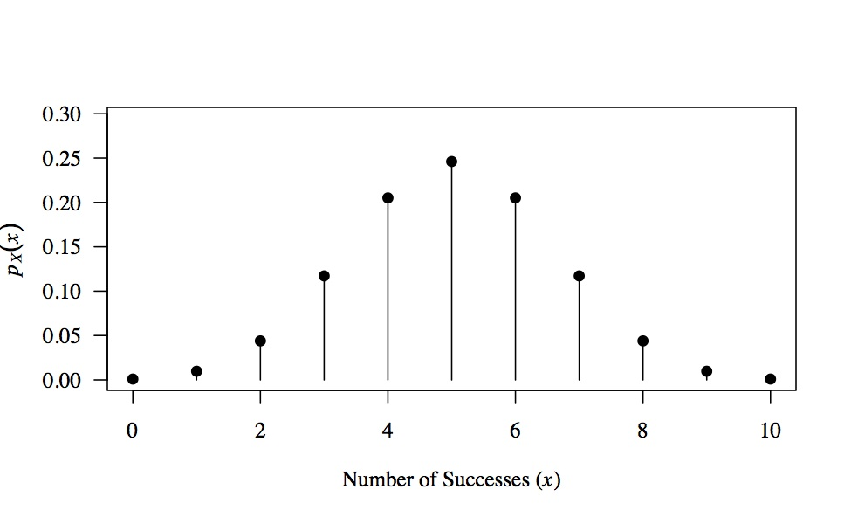
Common Discrete Distributions
  The Binomial Distribution:
  n : number of independent trials
  p : success probability

Slide 63
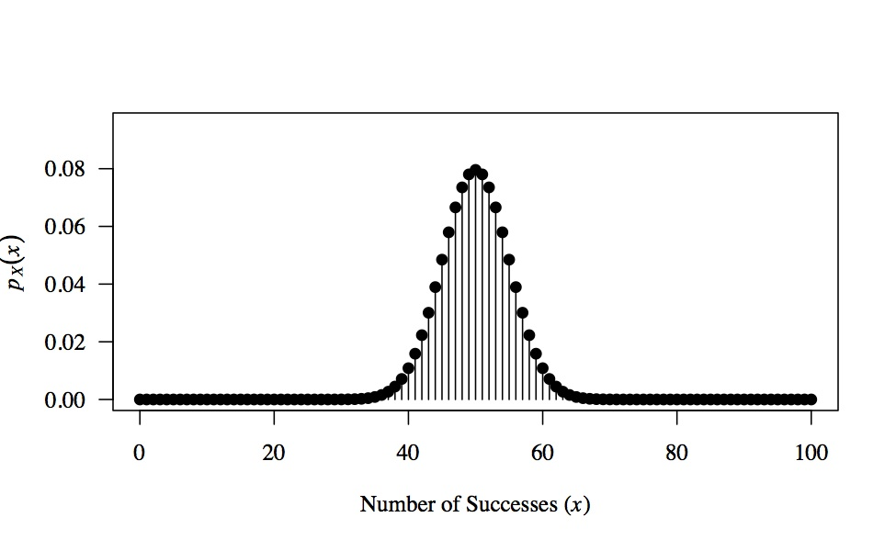
Common Discrete Distributions
  The Binomial Distribution:
  n : number of independent trials
  p : success probability

Slide 64
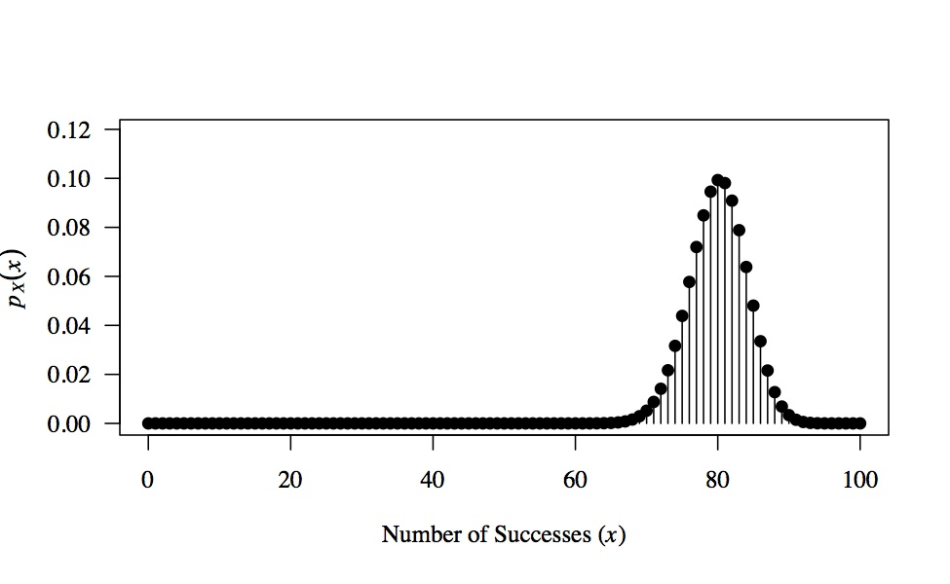
Common Discrete Distributions
  The Binomial Distribution:
  n : number of independent trials
  p : success probability

Slide 65
Common Discrete Distributions
  Example:
  Number of heads in n fair coin toss trials
  In general:
Notes:
Sample space is larger

Slide 66
Common Discrete Distributions
  Example:
  Number of heads in n fair coin toss trials
  In general:
  Notice:

Slide 67
Common Discrete Distributions
  The Poisson Distribution:
  Used to model the number of occurrences of an event
  that occur within a particular interval of time and/or space
  λ : average number of counts (controls rarity of events)
Notes:
Such random variables count the number of discrete occurances, thus such observations are referred to as “counts”.
And the Poisson distribution specifies how likely it is that a particular number of counts will be observed, under the assumption that the observed events are independent.
Examples…
(1) Archetypal example - first known application - number of soldiers killed by horse-kicks each year in the Prussian cavalry
(2) Counting red cars, rabbits, post, emails.
(3) Relevant example: modelling the number of mutations on a DNA strand of given length.
That’s all well and good, but where does this actually come from?...

Slide 68
Common Discrete Distributions
  The Poisson Distribution:
  Want to know the distribution of the number of occurrences of an event
  Binomial?
  However, don’t know how many trials are performed – could be infinite!
  But we do know the average rate of occurrence:
Notes:
Suppose we want to know the distribution of the number of occurrences of a particular event.
That sounds just like an application for the Binomial distribution.
However, suppose that we don’t know how many trials are being performed - we don’t know the total number of experiments!
In principle, there could be a practically infinite number of experiments performed.
Consequently, we have to support an arbitrarily high number of observations – the random variable X could take on any non-negative value.

Slide 69
Common Discrete Distributions
  Binomial:

Slide 70
Common Discrete Distributions
  Binomial:

Slide 71
Common Discrete Distributions
  Binomial:
1
1

Slide 72
Common Discrete Distributions
  Binomial:
1
1

Slide 73
Common Discrete Distributions
  Binomial:
1
1
  ☐

Slide 74
Common Discrete Distributions
  The Poisson distribution is the Binomial distribution as
  If then
  If n is large and p is small then the Binomial distribution can be approximated using the Poisson distribution
  This is referred to as the:
    “Poisson Limit Theorem”
    “Poisson Approximation to the Binomial”
    “Law of Rare Events”
  fixed
  Poisson is often more computationally convenient than Binomial

Slide 75
References
  Countless books + online resources!
  Probability theory and distributions:
  Grimmett and Stirzker (2001) Probability and Random Processes. Oxford University Press.
  General comprehensive introduction to (almost) everything mathematics (including a bit of probability theory):
  Garrity (2002) All the mathematics you missed: but need to know for graduate school. Cambridge University Press.

