Slide 1
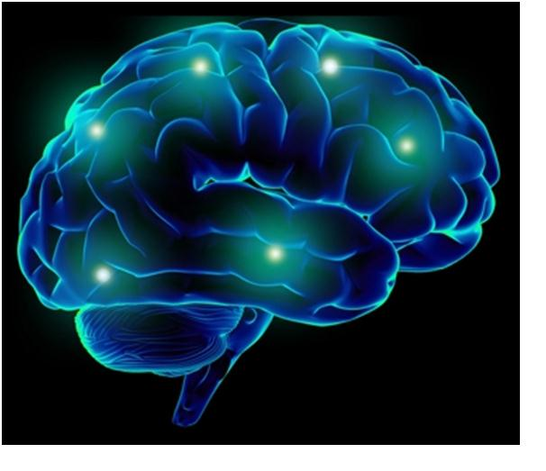
Changing Brains

Slide 2
The
Teenage
Brain

Slide 3
Our youth now love luxury. They have bad manners, contempt for authority; they show disrespect for their elders and love chatter in place of exercise; they no longer rise when elders enter the room; they contradict their parents, chatter before company; gobble up their food and tyrannize their teachers.
Socrates 469-399 BCE

Slide 4
the young are heated by Nature as drunken men by wine
Aristotle 384-322 BCE

Slide 5
there were no age between ten and three-and-twenty, or that youth would sleep out the rest; for there is nothing in the between but getting wenches with child, wronging the ancientry, stealing, fighting
William Shakespeare 1564-1616

Slide 6
Have Things Changed in 2000 (or 200,000) years?

Slide 7
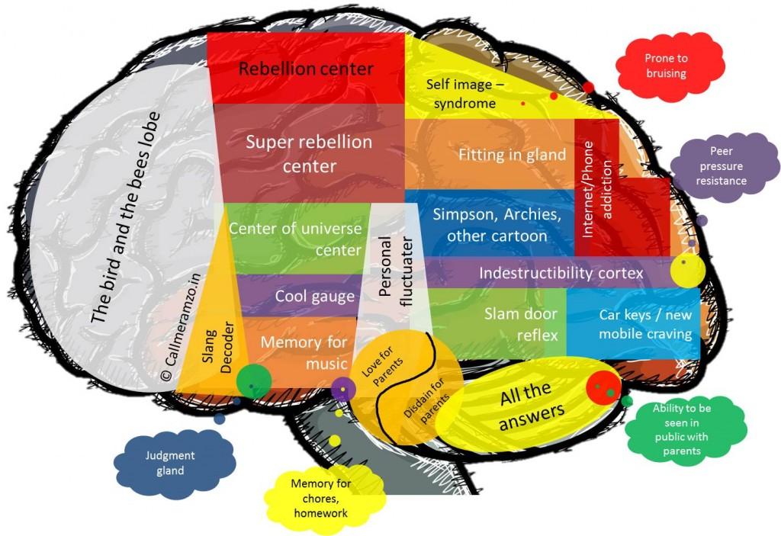
What’s Going on?
In the Teenage Brain

Slide 8
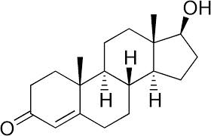
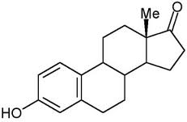
Steroid sex hormones
Testosterone
Oestrogen
Notes:
In response to internal & external cues (metabolic competence, resource availability), neurons secrete gonadotrophin releasing hormone from the hypothalamus, stimulating the release of LH & FSH (pituitary) which in turn stimulate the release of testosterone & oestrogen from gonads. Not all changes that occur during adolescence are the result of steroid sex hormones, some are developmental.

Slide 9
What do Steroid Sex Hormones Do in the Brain?
Activational Effects – modify the activity of target cells – effects are transient.
Example: female rats are more sexually receptive following an increase in oestrogen.
Organisational Effects – sculpt the structure of the nervous system – effects are permanent

Slide 10
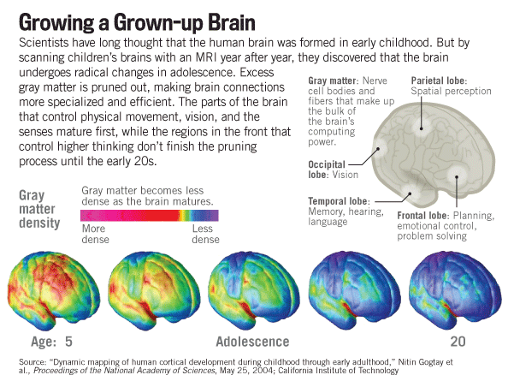

Slide 11
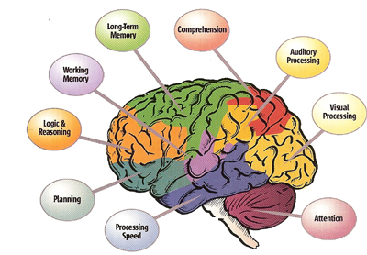
The Whole Brain is Affected
Notes:
The entire brain undergoes developmental changes during adolescence, but two areas are of great interest and the changes in these areas are thought to account to account for many of the behaviours that are prominent during teenage years. Theses two areas are the pre-frontal cortex (PFC) and the amygdala.

Slide 12
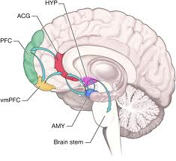
The Pre-frontal cortex and the amygdala
PFC – involved in executive function:
The amygdala is involved in the unconscious processing and memory of reactions to emotional events.
Increase in pfc neurons just before puberty
Pruning.
Increases in size
Thickening & myelination
Notes:
The increase in the number of PFC neurons prior to puberty probably results in too many connections. There follows a period of pruning resulting in the loss of approximately 15% of grey matter (possibly complete by 16-18, some reports suggest the process continues into the 20s. This pruning seems more pronounced in females than males. This is followed by a period of thickening and myelination.
The right amygdala is also linked with taking action as well as being linked to negative emotions, which may help explain why males tend to respond to emotionally stressful stimuli physically. The left amygdala allows for the recall of details, but it also results in more thought rather than action in response to emotionally stressful stimuli, which may explain the lack of physical response in women. This physical response could also, however, be the result of increased muscular strength in males after puberty.
ACG = anterior cingulate cortex – complex mediation of top down, bottom up integration in decision-making. Assigns control to appropriate brain regions.

Slide 13
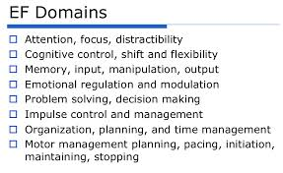
The PFC
Executive function

Slide 14
The Amygdala
Processes and interprets sensory data
Assigns emotional meaning, especially negative
Modulates the flow of information from the cortex to the hypothalamus
Affects autonomic, endocrine and affective responses
Notes:
The amygdala is part of the limbic system. It is also heavily involved in processing of facial expression – social cues.
Allows humans to understand and interact with each other. These functions include recognition of faces and bodily gestures, evaluation of what another person is thinking or feeling, prediction of what that person is about to do next and communication with the person

Slide 15
Reading Emotion from Facial Expressions
1. This face is expressing...
Embarrassment
Fear
Sadness
Surprise
http://greatergood.berkeley.edu/ei_quiz
Notes:
Fear

Slide 16
This face is expressing...
Sadness
Shame
Disgust
Contempt
http://greatergood.berkeley.edu/ei_quiz
Notes:
Contempt

Slide 17
This face is expressing...
Sadness
Pain
Anger
Disgust
http://greatergood.berkeley.edu/ei_quiz
Notes:
Anger

Slide 18
2. This face is expressing...
Flirtatiousness
Interest
Happiness
Politeness
http://greatergood.berkeley.edu/ei_quiz
Notes:
Happiness

Slide 19
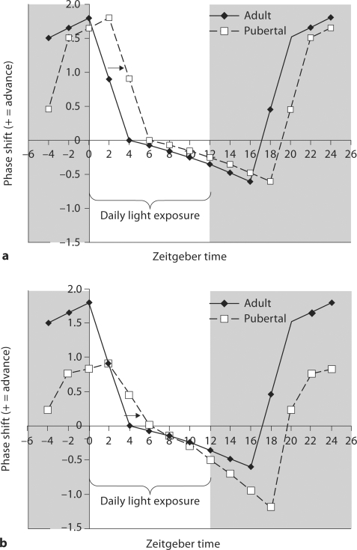
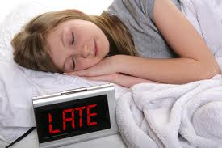
Sleep
Notes:
33-75% of adolescents have sleep disturbances – slight lengthening of circadian phase?
Zeitgeber time: the time the synchronisation of the sleep cycle occurs in the experiment. The SCN also responds to light by delaying the release of other hormones like melatonin, which is associated with sleep onset and is produced when the eyes signal to the SCN that it is dark. Melatonin levels rise in the evening and stay elevated throughout the night, promoting sleep.
In teenagers, research has shown that melatonin levels in the blood naturally rise later at night than in most children and adults. Since teens may have difficulty going to bed early to get enough sleep, it can help to keep the lights dim at night as bedtime approaches. It can also help to get into bright light as soon as possible in the morning.

Slide 20
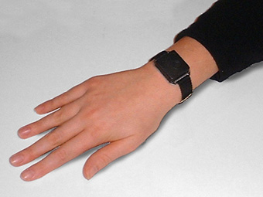
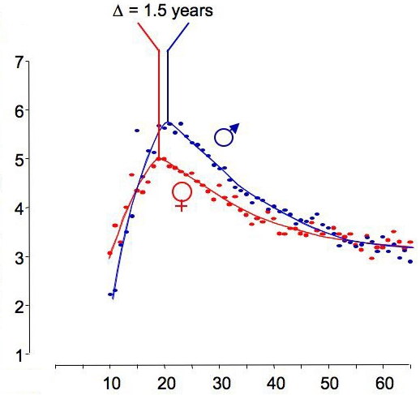
Chronotype - effect of gender and adolescence
“Owls”
Actogram, F 16 yrs
Tues/ Wed
Wed/ Thur
Thus/ Fri
Fri/ Sat
Sat/ Sun
Sun/ Mon
Mon/ Tues
“Larks”
Tues/ Wed
0 12 24 36 48
Clock time
So, what might we learn from mouse clocks?
EUCLOCK FP6, http://www.euclock.org/
Notes:
The graph shows how the teenagers shift from being early risers “larks” to late risers “owls” during adolescence and into the twenties. The figure on the right shows an actogram from a 16 year old female. She is rising to get to college during the week but at the weekend, her sleep wake cycle shows that she wakes much later and goes to sleep later.

Slide 21
Why would anyone DO that?
Notes:
Risk-taking increases between childhood and adolescence as a result of changes around the time of puberty in the brain’s socio-emotional system leading to increased reward-seeking, especially in the presence of peers, fueled mainly by a dramatic remodelling of the brain’s dopaminergic system. Risk-taking declines between adolescence and adulthood because of changes in the brain’s cognitive control system – changes which improve individuals’ capacity for self-regulation.
The greatest threats to the well-being of young people in industrialized societies come from preventable and often self-inflicted causes, including automobile and other accidents (which together account for nearly half of all fatalities among American youth), violence, drug and alcohol use, and sexual risk-taking
The increase in sensation-seeking in adolescence is due not to functional dopamine deficits but to a temporary loss of “buffering capacity” associated with the disappearance of dopamine autoreceptors in the prefrontal cortex that serve a regulatory negative-feedback function during childhood. This loss of buffering capacity, resulting in diminished inhibitory control of dopamine release, would result in relatively higher levels of circulating dopamine in prefrontal regions in response to comparable degrees of reward during adolescence than would be the case during childhood or adulthood. This increase in the sensitivity and efficiency of the dopaminergic system, which, in theory, would make potentially rewarding stimuli experienced as more rewarding and thereby heighten reward salience. NOT a steroidal response (occurs in gonadectomised animals), but is a much stronger phenomenon in early maturers. ? Bigger gap between the change in the dopaminergic system and the full maturation of the cognitive control system.

Slide 25
Adolescence and Mental Illness
Approximately 20% of adolescents have a diagnosable mental health disorder.
Many mental health disorders first present during adolescence.
Suicide is the third leading cause of death in adolescents and young adults.
Existing mental health problems become increasingly complex and intense as children transition into adolescence.
— Mental health problems may lead to poor school performance, school dropout, strained family relationships, involvement with the child welfare or juvenile justice systems, substance abuse, and engaging in risky sexual behaviors.
From National Centre for Children in Poverty http://www.nccp.org/publications/pub_878.html
Notes:
Early puberty in humans has been identified as a risk factor for a variety of psychopathologies,
including eating disorders and depression. The underlying causes for this increased risk are debated. Physiological and hormonal changes during puberty may alter neural circuits directly. Alternatively, the physiological changes associated with early puberty may alter an adolescent’s social experiences during puberty, causing an increased risk for psycho-pathology.
Eating disorders are sex-biased psychopathologies that emerge during puberty have been shown to be associated with increased levels of circulating estradiol.

Slide 26
Stages of Adolescence

Slide 27
The Pros and Cons
Increased risk of damage from drugs/alcohol
Increased risk of developing addiction
Increased risk of mental illness
Increased risk-taking
Areas of the brain controlling impulsive behaviour, judgement and emotional control mature last.
Greater capacity to learn and create.
Greater capacity to embrace high risk/high reward decisions.

Slide 28
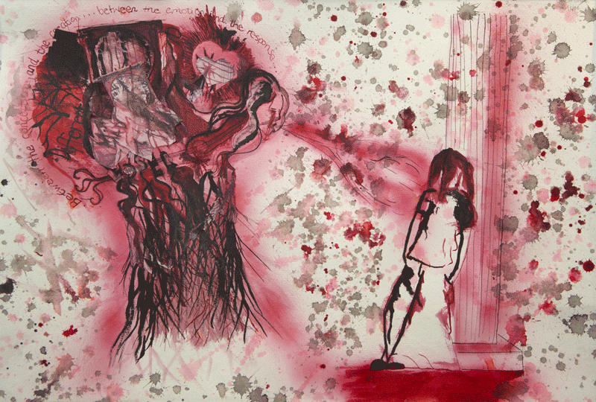
Artist’s Response
Consider why it is essential to re-wire the brain in a complex social organism.
Think about how that process is a very individual one.
You may wish to consider the risks of over-interpreting this data or whether understanding how the brain changes during adolescence should change social structures.
Empathise and communicate, but remember to present your art grounded in our scientific understanding.
Inside the Brain of a REAL teenager Sara Green ITB 2006

Slide 29
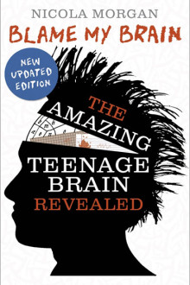
Acknowledgements
Prof Sarah-Jayne Blakemore
Institute of Cognitive Neuroscience
University College London
AND
Much of the material in this talk is taken from the 1st Edition of Nicola Morgan’s very readable book “Blame My Brain”, the 3rd edition of which has just been published, and from the many excellent papers published by Sarah-Jayne Blakemore.
Any errors in the information in this talk are entirely my own.
May 2nd 2013

