Slide 1
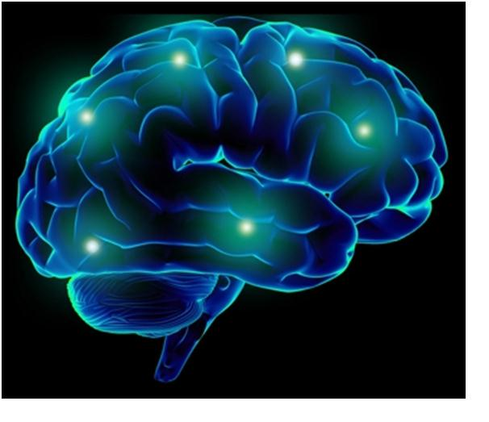
Changing Brains

Slide 2
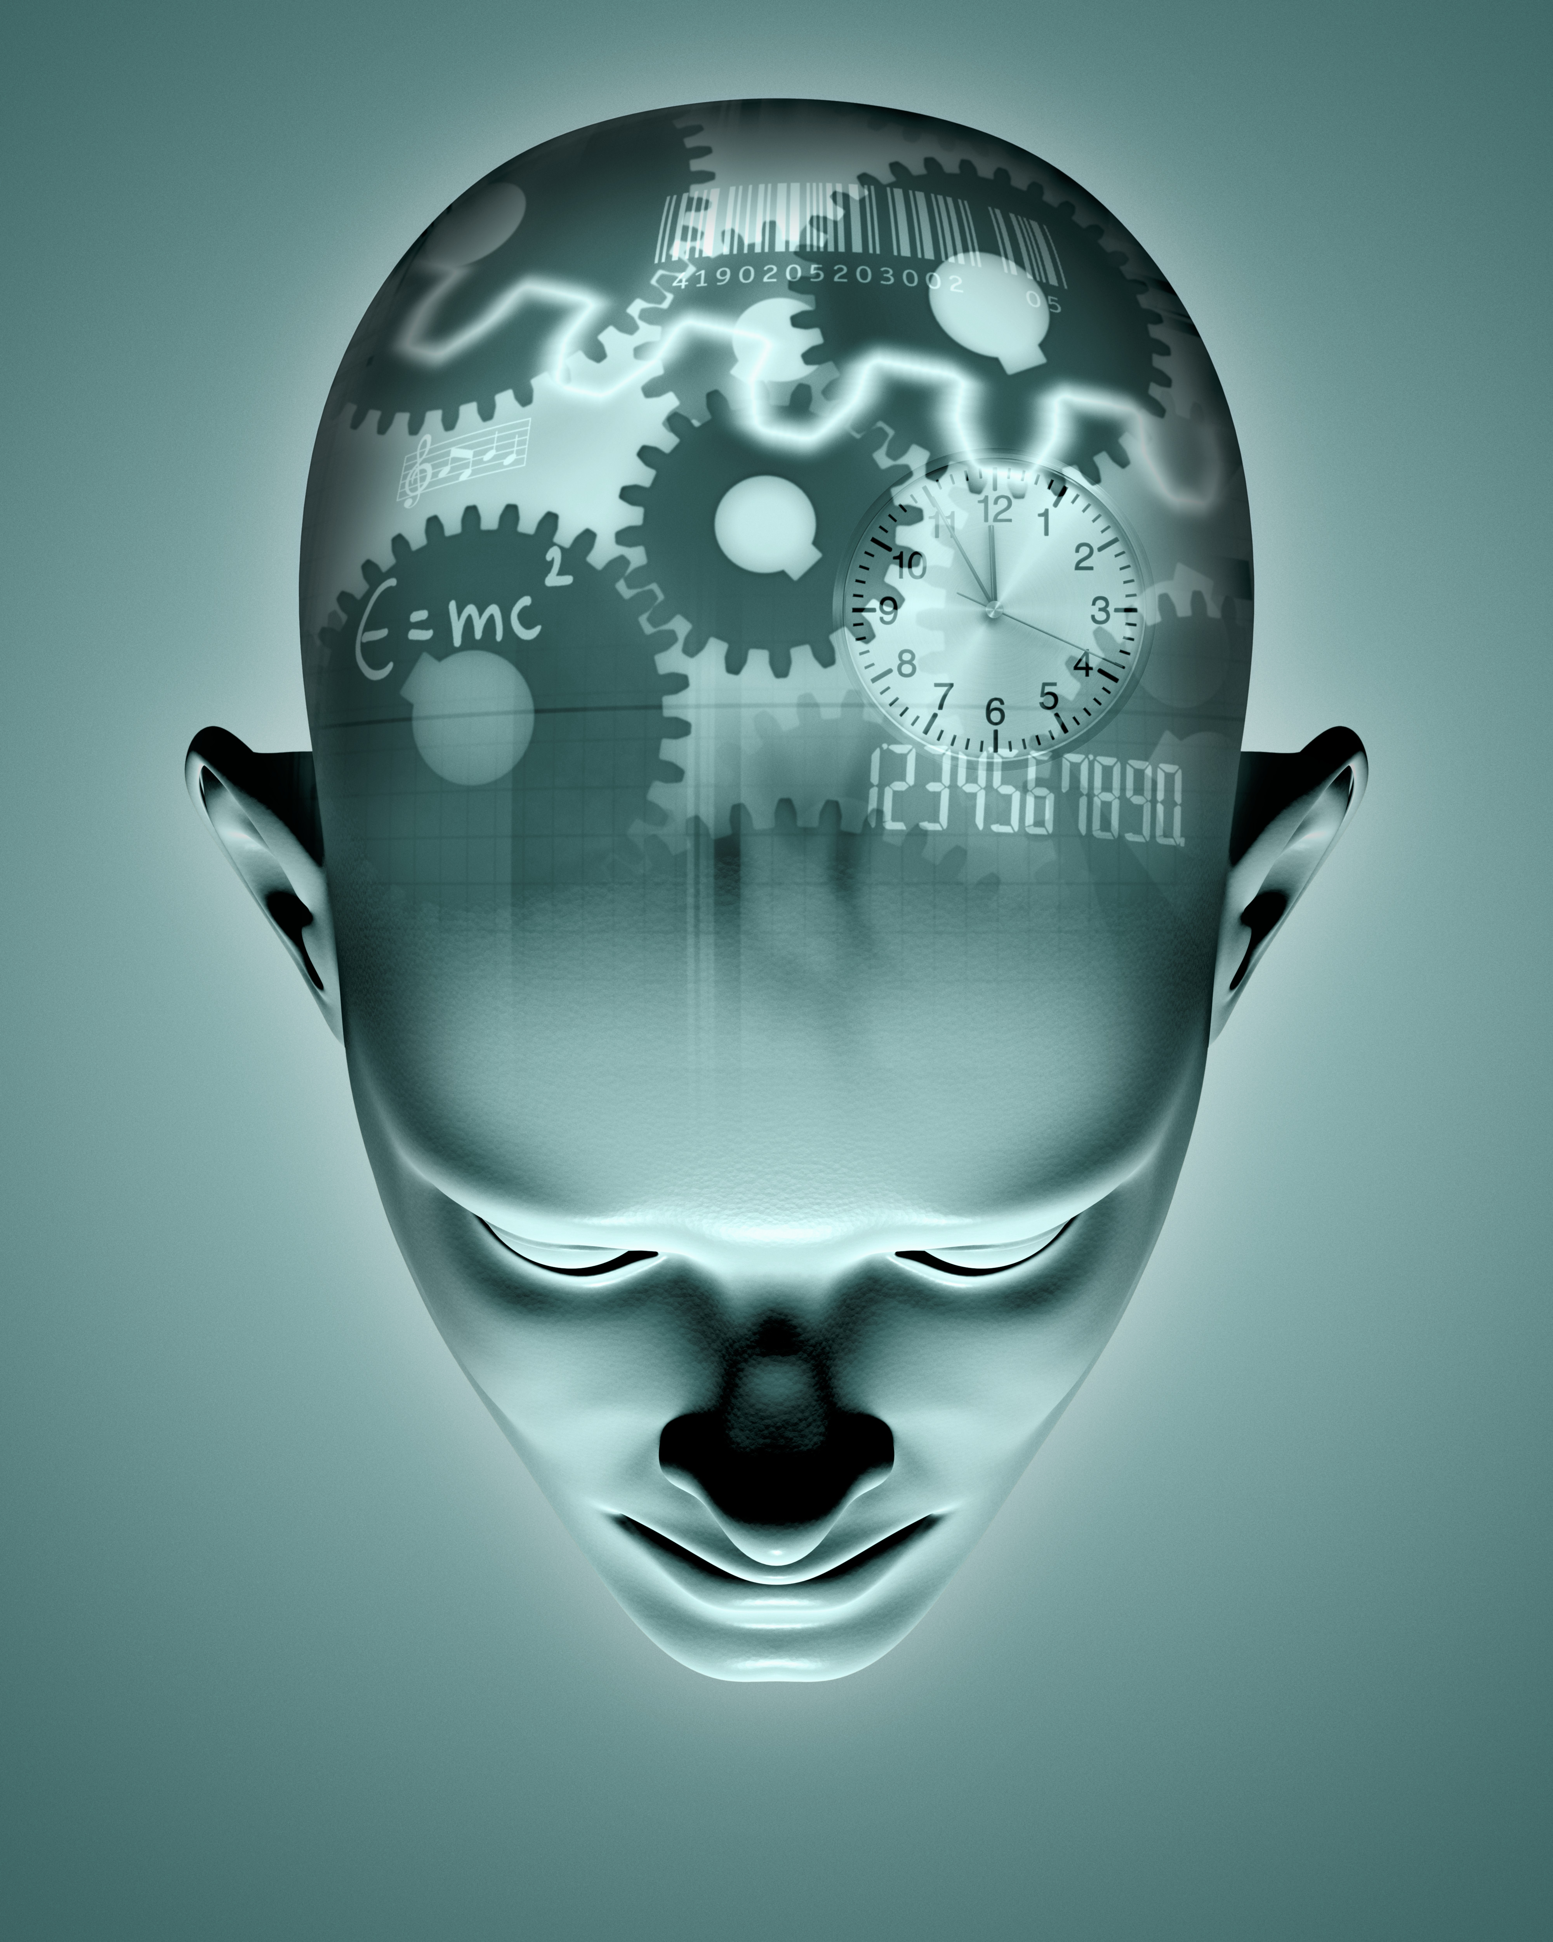
Neurotechnology The Artificial Brain?

Slide 3
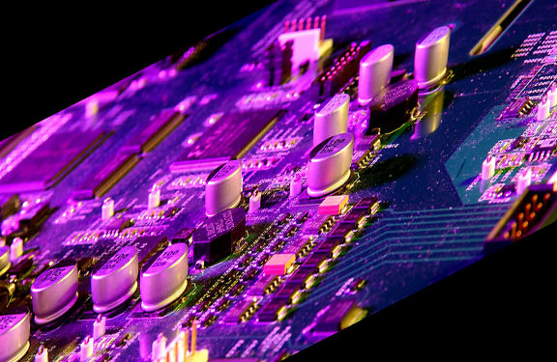
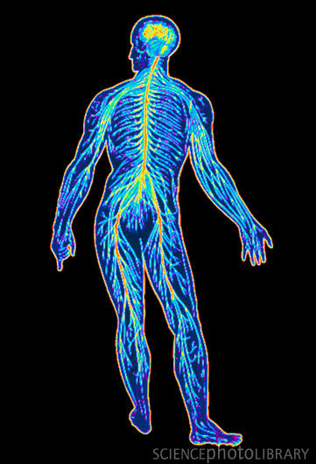
Neurotechnology is any technology that improves or repairs nervous system function or facilitates understanding of the nervous system.
Medical Electronics
Nervous System
Brain-machine interfaces (BMIs) have been defined as
devices that detect intent—typically intended movement—from
brain activity, and translate it into an output action, such as
control of a cursor on a screen or a robotic arm.

Slide 4
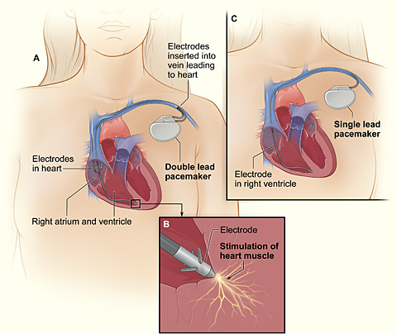
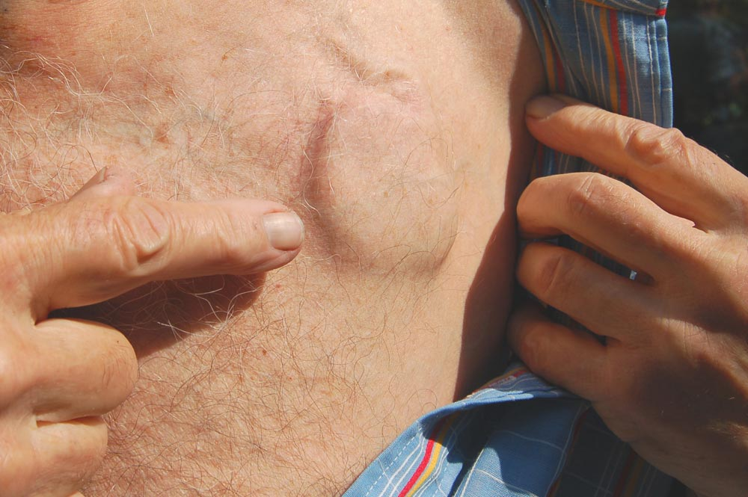
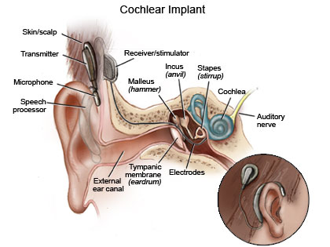
Amazing?
New?
First pacemakers were introduced in the early 1960s
3 million people worldwide use them
1st cochlear implants developed in the late 1970s
~ 225,000 fitted worldwide

Slide 5
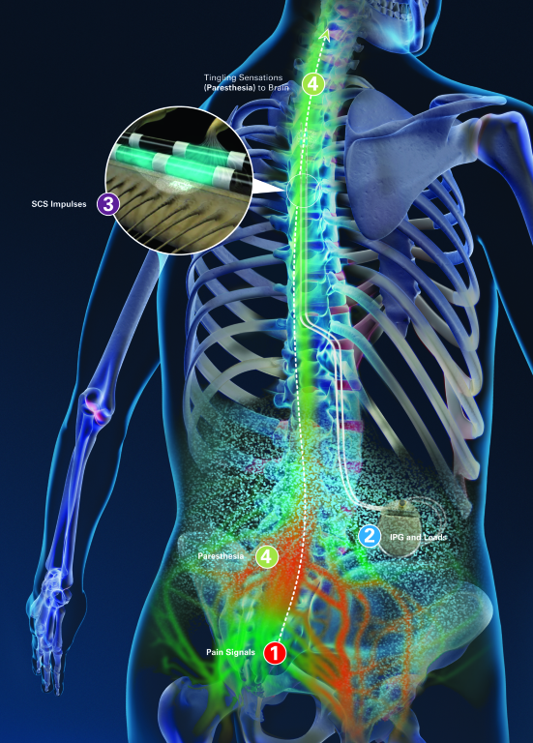
Neuromodulation works by using electrical stimulation to improve control of an existing part of the nervous system. Examples include spinal cord stimulation systems used for chronic pain management that block pain signals to the brain and gastric stimulation systems, which are used to block the signals of hunger.
There are three different types of neuromodulation:
Deep brain stimulation (DBS)
Transcranial magnetic stimulation (TMS)
Vagal nerve stimulation

Slide 6
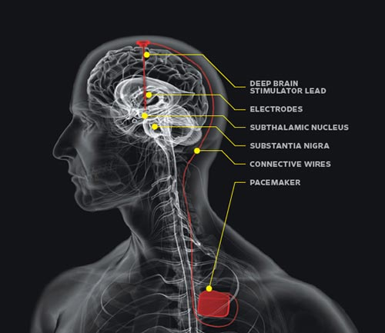
Deep brain stimulation (DBS)
This involves the placement of an electrode inside the brain with a wire running down the neck connected to a battery pack or pulse generator under the skin in the chest or abdomen.
Currently used to treat Parkinson's disease, epilepsy, stroke and severe obsessive compulsive disorders.
Research is underway into its use to treat obesity, Tourette's syndrome, anorexia, addictions.
Notes:
In Parkinson's disease, loss of dopamine-producing cells leads to excessive and abnormally patterned activity in both the globus pallidus (Gpi) and the sub-thalamic nuclei . "Pacing" of these nuclei with a constant, steady-frequency electrical pulse corrects this excessive and abnormal activity. DBS does not act directly on dopamine producing cells and does not affect brain dopamine levels. Instead, it compensates for one of the major secondary effects of dopamine loss, the excessive and abnormally patterned electrical discharge in the GPi or the STN (sub-thalamic nuclei). The exact mechanism by which the constant frequency stimulation pulse affects nearby brain cells has not been determined.

Slide 7
Problems with DBS:
2% risk of brain bleed with PD DPS highest within 30 days of surgery
Infection 4%
High cost DBS PD £25-30K offset against cost of therapy & care
Scarring
Size of implant
Surgery required to change implant batteries
Notes:
The DBS electrode itself may last a number of years without needing replacement. The implantable pulse generator may need replacement via a simple outpatient procedure every three to five years (for the typical patient with Parkinson’s disease) or less, and depends on the amount of current delivered through the electrode. Thus, higher settings result in a shorter battery life.

Slide 8
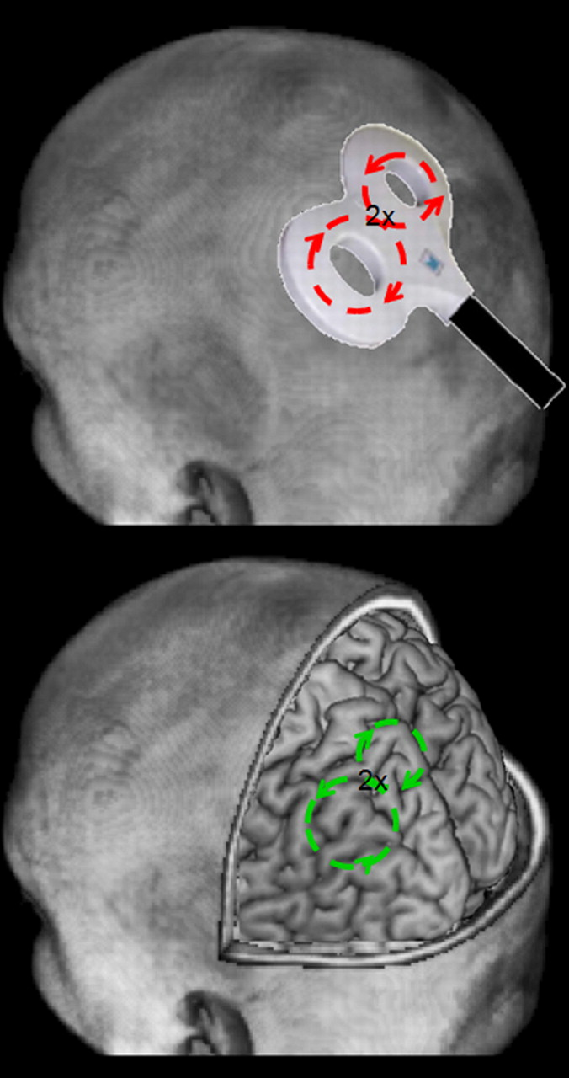
Transcranial Magnetic Stimulation
When a strong, rapid current is passed through a stimulating coil (top), a rapidly changing magnetic field is produced, which induces current into the brain (bottom).
Bolognini N , and Ro T J. Neurosci. 2010;30:9647-9650
©2010 by Society for Neuroscience
Notes:
When a strong, rapid current is passed through a stimulating coil (top), a rapidly changing magnetic field is produced, which induces current into the brain (bottom).
Very useful to create transient “lesions”.

Slide 9
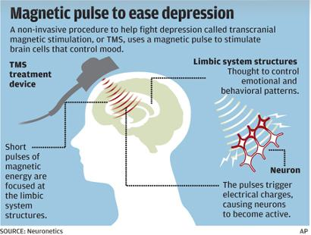
Transcranial magnetic stimulation (TMS)
This involves the application of a magnetic field to induce electrical currents into the brain. It is a non-invasive procedure.
Currently used in several countries to treat depression, or to enhance cognitive functions such as attention, understanding, perception.
Future applications may include treatment for severe migraines.
There is significant interest in the development of TMS to enhance mood and cognitive skills such as problem-solving and memory.
As a result of this ion flow, action potentials are triggered in neurons that are within the induced current field, along with a subsequent period of deactivation, presumably through prolonged IPSPs. Because normal ongoing brain activity is disrupted by this induced current, TMS provides a way for investigators to produce a transient and reversible period of brain disruption or “virtual lesion.” Thus, unlike other experimental techniques [e.g., functional magnetic resonance imaging (fMRI), electroencephalography (EEG)/event-related potentials (ERPs)], TMS can assess whether a given brain area is necessary for a given function rather than simply correlated with it.
TCMS requires hospital visits 5 x 40 min visits each week for up to six weeks

Slide 10
Problems with TMS
Only surface structures of the brain (i.e., most of cortex and some of cerebellum) can be targeted.
rTMS (repetitve transcranial magnetic stimulation) devices are marketed for the treatment of certain types of major depression in Canada, Australia, New Zealand, the European Union, Israel and the United States.
Notes:
For experimental transient lesioning, the loud click associated with the high current flowing through the metallic stimulating coil, and scalp sensations and head and neck muscle contractions, require careful control conditions to be included in any experimental design to rule out nonspecific effects of the TMS.

Slide 11
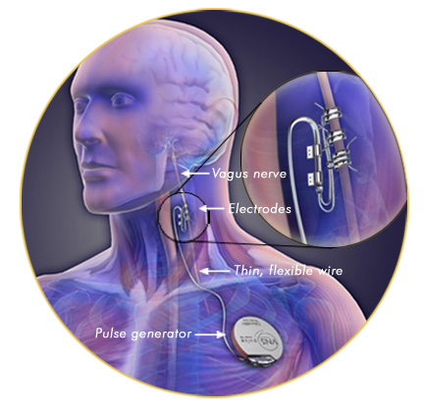
Vagus Nerve Stimulation
Used to treat refractory epilepsy, produces a 40% reduction in fits in 40% of patients
Vagus nerve is both motor and sensory
Notes:
Mechanism not clearly understood - fMRI indicates activation of thalamus & insular cortex

Slide 12
Brain-machine interfaces (BMIs)
devices that detect intent—typically intended movement—from
brain activity, and translate it into an output action, such as
control of a cursor on a screen or a robotic arm.
acquiring a neural signal that can be consciously controlled;
analyzing that signal to identify an intended motor output; and
executing the intended action
Notes:
BMIs targetted at those who are severely or completely disabled for whom small
functional improvements would translate into substantial
changes in quality of life.

Slide 13
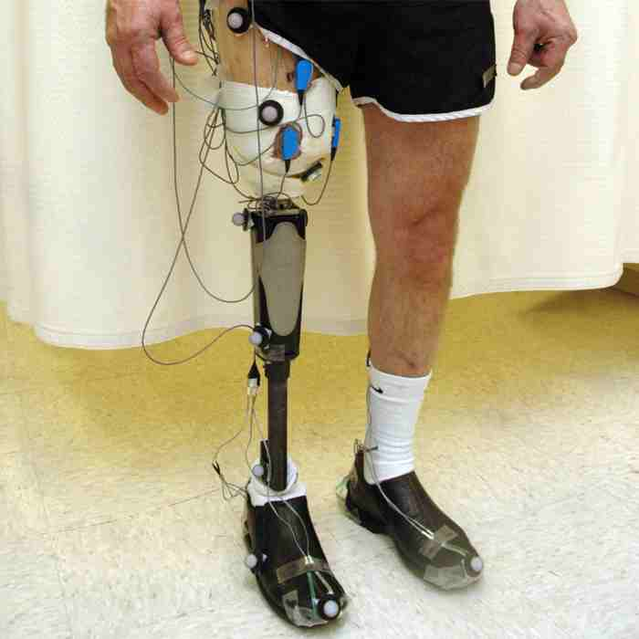
Neural Prostheses and Neural Rehabilitation is used in conjunction with a planned training program to replace or improve function of an impaired nervous system or to provide a better, more controllable prosthesis following loss of a limb.

Slide 14
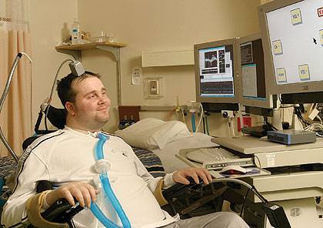
NeuroSensing and Diagnostics are tools to improve monitoring of activity in the nervous system, brain state activity or improve diagnosis of a condition. A peripheral nerve sensing test system that detects sensory impairments due to carpal tunnel syndrome is an example of a neurosensing system in practice. Another example is EMG (electromyography) devices utilized to communicate with a computer system.
BCI connects the brain to a computer
Neuroprosthetics connect the nervous system to a device
Matt Nagle's neuroprosthetic lets him move a cursor using thought alone.

Slide 15
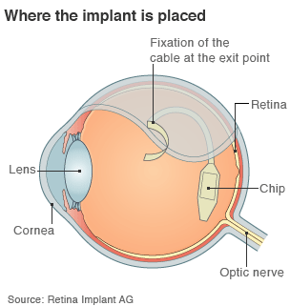
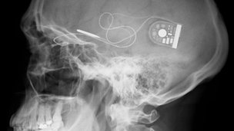
Retinal Implants
Notes:
Blind people have described smiles on friendly faces, the food on their plates, and household objects from telephones to dustbins, after surgeons fitted them with electronic chips to partially restore their vision.
Results from the first eight patients to enrole in a clinical trial of the retinal implants show that five found the chips improved their eyesight enough to be useful in everyday life.

Slide 16
Problems with Neuroprosthetics
Non-linear input/output – intensity of intenet does not translate into faster or more powerful movement.
Position
Re-programming on start-up
Speed of information transfer eg.retinal protheses
Feedback delay
Lack of precision coordinated movement
Poor signal quality

Slide 17
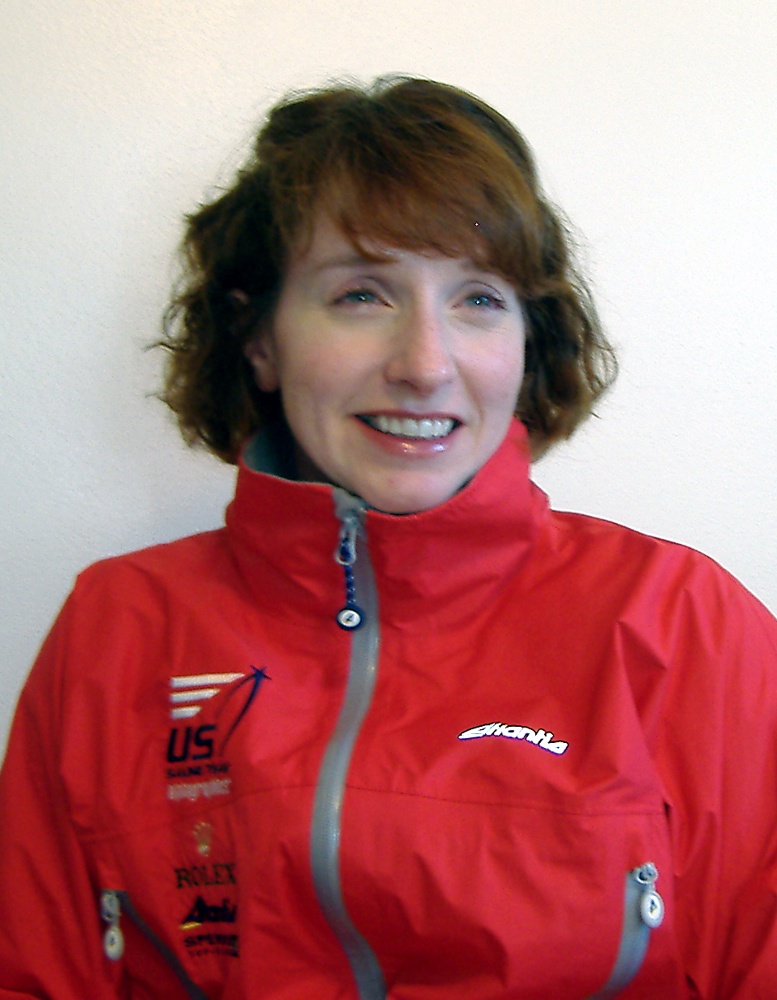
Jennifer French
US Sailing Paralympic Silver Medalist
While snowboarding in 1998, French suffered a severe spinal cord injury that left her a quadriplegic.
The following year she received implants that allowed her to stand and, ultimately, walk down the aisle at her wedding.
She is the first woman to receive an implanted neural prosthetic device allowing her to use paralysed lower limbs.

Slide 18
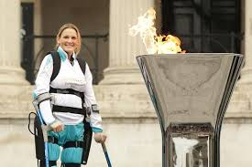
Claire Lomas & ReWalk
Claire Lomas is an event rider who was paralysed from the chest down following an injury. Using the ReWalk bionic suit, she completed the London Marathon in 17 days.

Slide 19
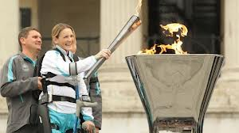
The ReWalk exoskeleton suit uses motorized legs that power knee and hip movement and is controlled by on-board computers and motion sensors, restoring self-initiated walking without needing tethers or switches to begin stepping. ReWalk controls movement using subtle changes in center of gravity, mimics natural gait and provides functional walking speed. A forward tilt of the upper body is sensed by the system, which triggers the first step. Repeated body shifting generates a sequence of steps, which allows natural and efficient walking. The ReWalk also sits, stands, allows turning and has the ability to climb and descend stairs. Using crutches for support, the user can walk and speak eye-to-eye with others on city streets and also navigate slopes and uneven terrain.

Slide 20
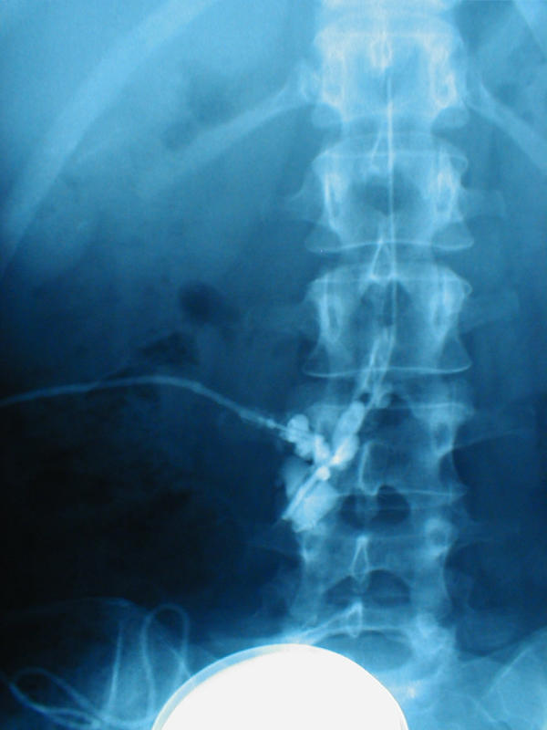
NeuroPharmaceuticals is an emerging field of therapy, applied through the use of devices combined with pharmaceuticals, particularly for cognition and emotional treatments. Examples include pumps for baclofen to treat spasticity or morphine for chronic pain.
Intrathecal pump delivers medication to spinal fluid. There is no feedback loop.

Slide 21
Artist’s Response
Has technology advanced to the stage where injury/disease matters less?
What is the relationship between the person and the machine and the person using such technology and people who do not?
If repair is possible, is enhancement also a realistic goal?

Slide 22
