Slide 1
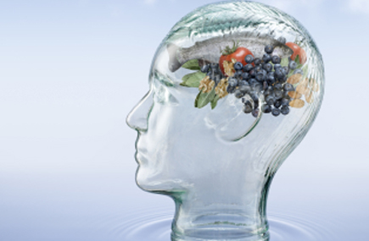
FOOD FOR THOUGHT

Slide 2
What food does the brain need?
Our brains weigh ~ 1.4 kg = 2% of body weight
The brain requires 20% of resting metabolic consumption (1600 calories/day = 320cals)
~16 watts
supercomputer 1000 watts
Energy comes from glucose & when a particular brain region is active, blood vessels dilate to deliver more glucose & oxygen.

Slide 3
What else does the brain need?
Amino acids to make new proteins and neurotransmitters
Vitamins to carry out essential processes, especially B vitamins, and to act as antioxidants (E & C)
Fatty acids, especially omega-3 oils found in fish
Minerals
A well nourished person with a balanced diet will have an abundance of these nutrients.

Slide 4
Very small changes in nutrients available to the brain can make a big difference…
Especially to the developing brain

Slide 5
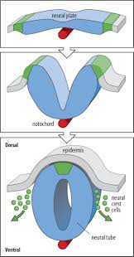
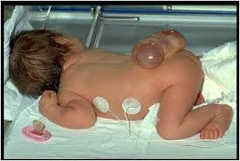
Folic acid & neural tube defects
Notes:
Importance of folic acid MRC 1991
Very high demand for this micronutrient in NT formation

Slide 6
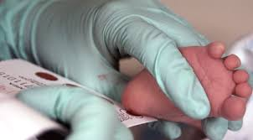
Phenylketonuria
Untreated PKU results in intellectual disability and often seizures.

Slide 7
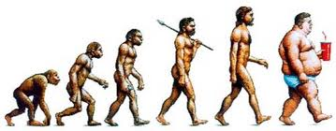
These sorts of effects of nutrition on the brain are fortunately rare.
For most people, the food we need for healthy brains is available…
Especially the calories!

Slide 8
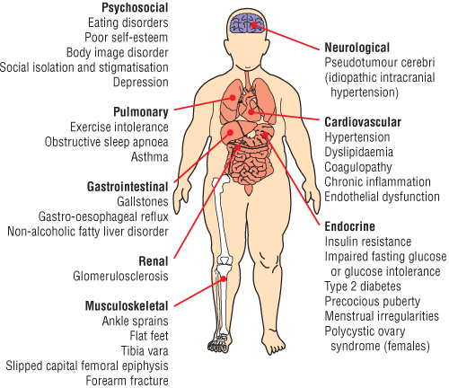
Obesity: too much of a good thing?

Slide 9
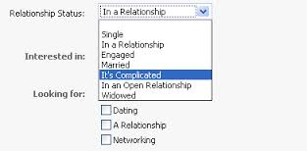
Eating behaviour is highly complex
Notes:
Neural circuits involved in feeding behaviour coordinate with brain centres that modulate energy homeostasis and cognitive function.
If we shop for food when we’re full, we are less likely to buy a lot.
Smelling & seeing foods can trigger hunger.
Eating triggers insulin release, which can lead to synaptic plasticity.
Lack of food stimulates Ghrelin release, which can also support synaptic plasticity & cognitive function.
Chemical messeges derived from adipose tissue through leptin can activate specific receptors in the hypothalamus & hippocampus, influencing learning & memory.
Hypothalamus regulates appetite, coordinates actuvity in the gut and integrates visceral function with the amygdala, hippocampus & cortex.

Slide 10
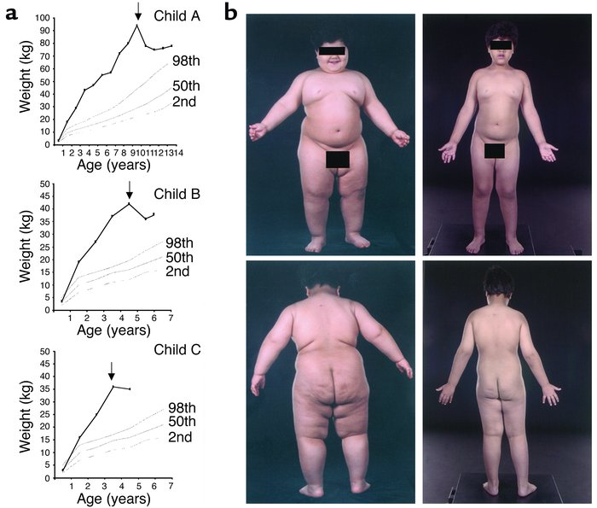
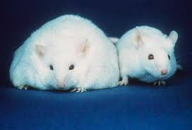
Leptin Deficiency
Notes:
1st identified in obese mice
Acts on hypothalamus to regulate food intake & energy expenditure.
Extremely rare

Slide 11
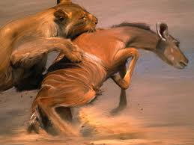
For most people, it’s not so simple…
We like food
We WANT food
AND
Notes:
So, why do we overeat?

Slide 12
We find food, especially sweet foods, rewarding

Slide 13
And we are prepared to work hard to get them
“Do your homework and you can have a sweet!”

Slide 15
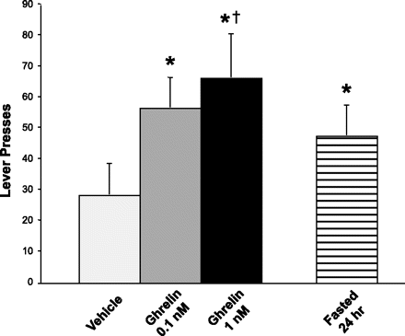
The effects of Ghrelin on Food Seeking in Rats

Slide 16
Possible reasons for overeating
Disruption of reward circuitry
More powerfully motivated to acquire food
Maladaption to food environment
Food as an addictive substance, especially sweet foods
Obesity leading to impairment of executive function
Notes:
Just as there is no hunger center, there is no pleasure center in the brain.

Slide 17
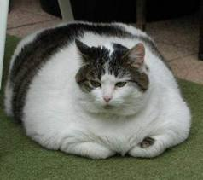
Cognitive impairment and obesity are co-related and causality is complex
Low scores of executive function at age 4 predict elevated BMI at age 8

Slide 18
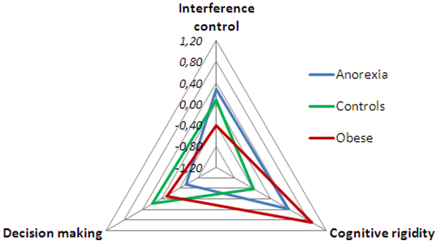
Figure 1. Radar chart illustrating the performance of the Anorexia nervosa, Obese and Healthy eating/weight control groups for interference control, cognitive rigidity and decision making.
Fagundo AB, de la Torre R, Jiménez-Murcia S, Agüera Z, et al. (2012) Executive Functions Profile in Extreme Eating/Weight Conditions: From Anorexia Nervosa to Obesity. PLoS ONE 7(8): e43382. doi:10.1371/journal.pone.0043382
http://www.plosone.org/article/info:doi/10.1371/journal.pone.0043382

Slide 19
There are no simple solutions
Must always consider other factors
Lifestyle: eg exercise
Intrinsic: eg genetics

Slide 20
Artist’s Response
Please, no brains full of food!
Powerful communication without oversimplifying.
Possible consideration of biological evolution vs technical development.
Enjoy Imagining the Brain!

