Slide 1
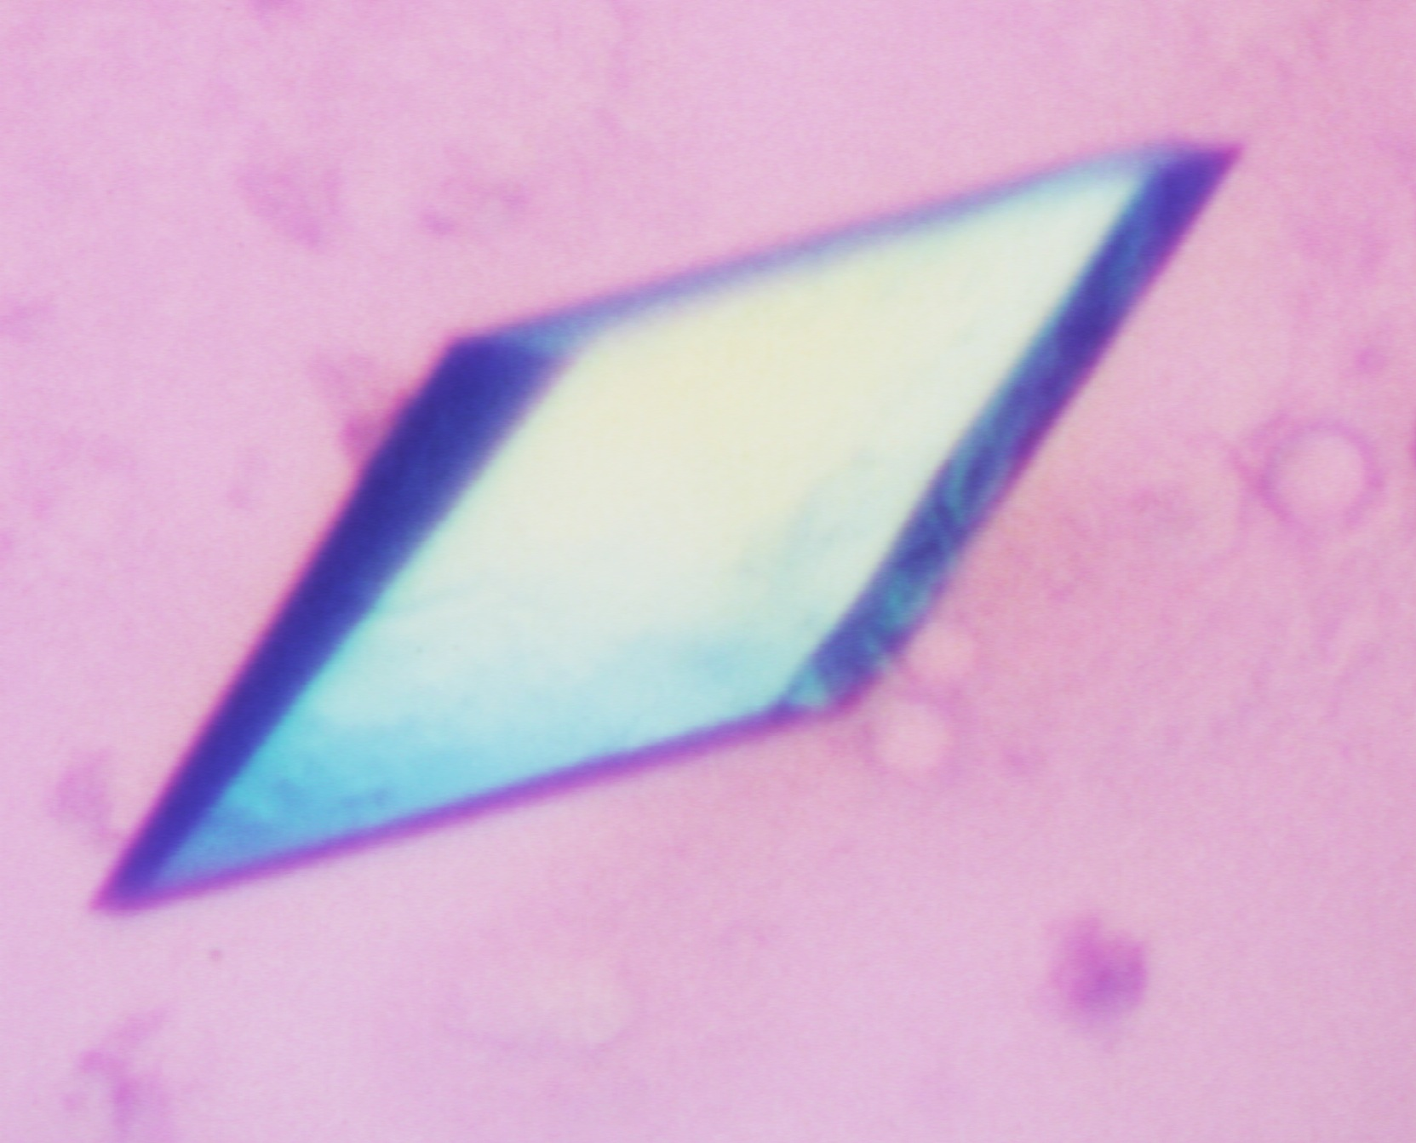
Expression, purification, characterization, and crystallization

Slide 2
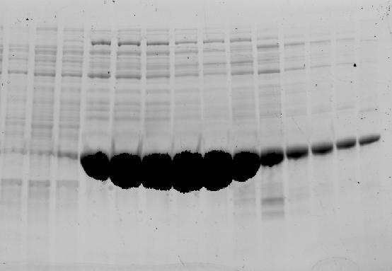

Slide 3
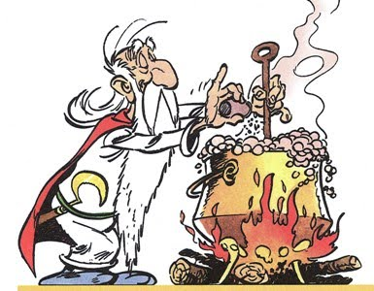

Slide 4
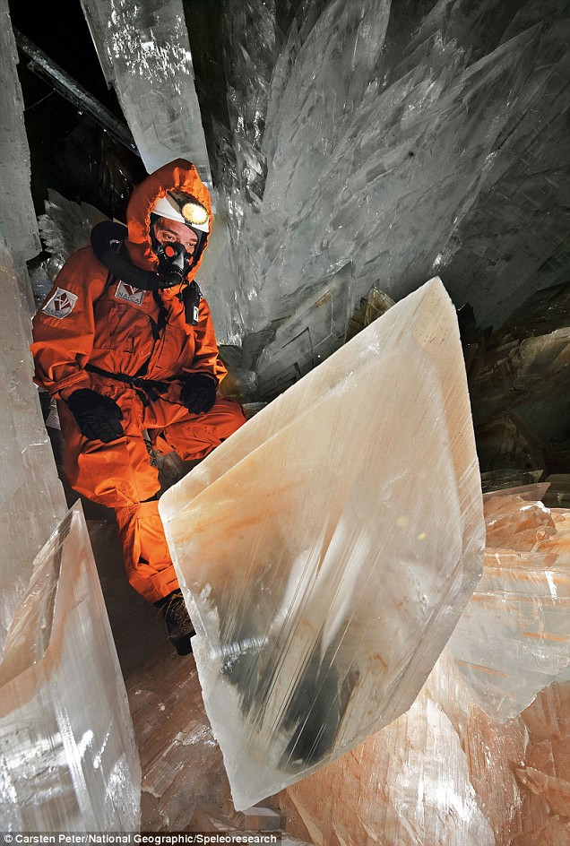

Slide 5
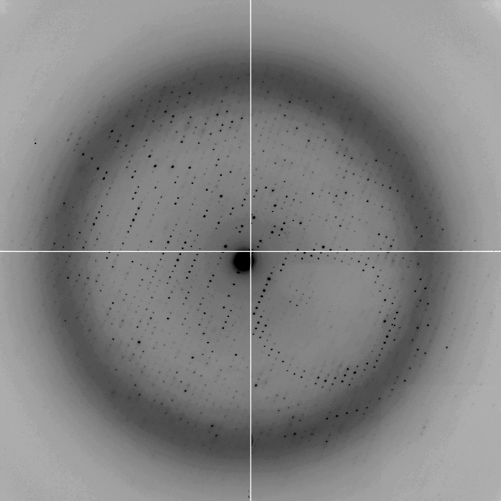

Slide 6
So how does one go about solving a crystal structure?
formulate question very hard!
make sample cloning, expression, purification
make crystal screening, optimisation
collect diffraction data synchrotron, integration, scaling
solve phase problem MR, SIRAS, MIRAS, SAD, MAD, hybrid
build model manual or autotracing
refine model agreement of model and data
interpret model very hard! back to top?
… and might fail at any step!
Boss
you
you
Post-doc
Post-doc/Randy/Phil
Post-doc/you
Post-doc/Garib
Boss
This is the part where YOU make all the difference!!

Slide 7
Disclaimer:
This is a limited (i.e. my) view of how to do crystallography
You have to find out what works for you
(But some of this might be useful)

Slide 8
What to crystallize: Different species
Bacterial: Great diversity, Easy to work with
Archeal: Half way between bacterial and eukaryotic
Eukaryotic: more difficult, but sometimes essential

Slide 9
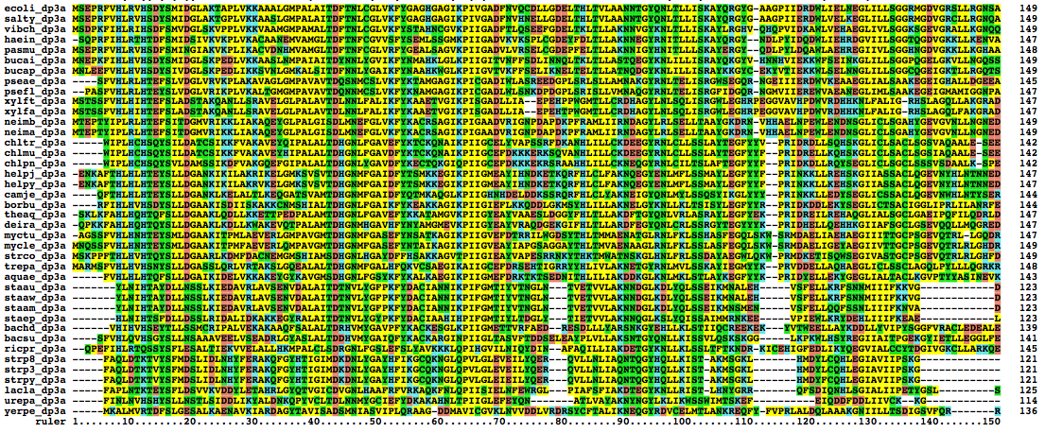
What to crystallize: Different species

Slide 10
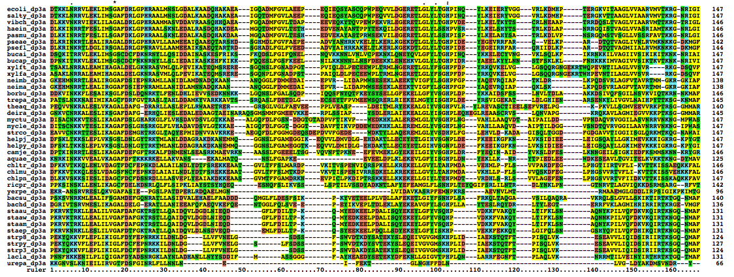
What to crystallize: Different constructs
Max Planck Institute Teubingen toolkit => sequence searches, 2ndary structure prediction
Clustal (alignments) Jalview (view/edit)

Slide 11
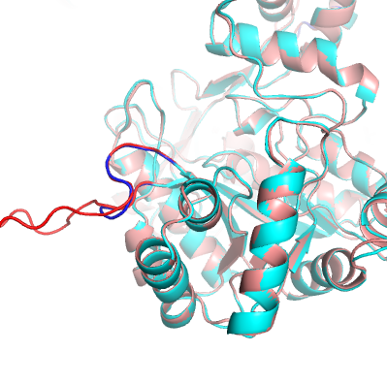
What to crystallize: Different constructs
Modeller (Andrej Sali, UCSF)

Slide 12
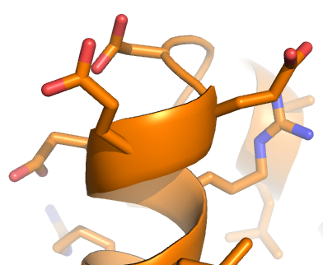
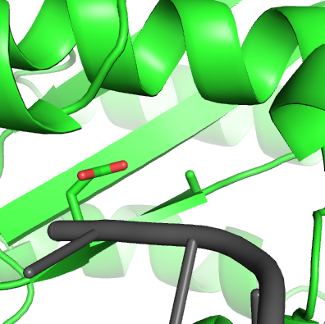
What to crystallize: make mutants
Surface engineering: hydrophylic residues at loops into hydrophobic residues
Mutate active site residues: catch it in the act
Derewenda ZS. Application of protein engineering to enhance crystallizability and improve crystal properties.
Acta Crystallogr D Biol Crystallogr. 2010 May;66(Pt 5):604-15. PubMed PMID: 20445236

Slide 13
What to crystallize: add partner protein and/or substrate!
(or anything else that will stabilize your protein)
Partner protein (if complex)
Peptide
DNA/RNA
ATP/GTP (or non-hydrolysable analogue)
Inhibitor
…
But how do you know what to add??
Study your protein!
ATPase activity

Slide 14
… or cross your fingers and hope for the best
X family
Pol β GCCGCGGGAAA
(Pelletier ’94) CGGCGCCC
Pol β CGACTACGCGACAGCC
(Batra ’06) GCTGATGCGC GTCGG
A family
Bacillus CGTACTACGAGAGA
(Kiefer ’98) GCATGATGC
T7 phage GCTTTTGCTGCCGG TCACGGTTCCCC
(Doublie ’98) CGAAAACGACGGCCAGTGCCAAG
Taq CTGGTGCCGCGGGAAA
(Li ’98) GACCACGGCGCCC
B family
RB69 GCGCCTGACGAATGGACA
(Franklin ’01) GCGGACTGCTTACC_{d}T
Y family
Dpo4 CCCCCTTCCTGATTACTT
(Ling ’01) GGGGGAAGGACTAA
A = added during crystallization
A = not visible in structure

Slide 15
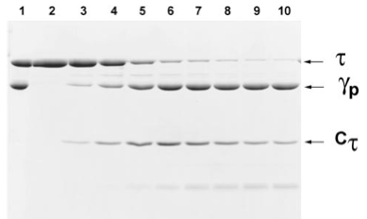
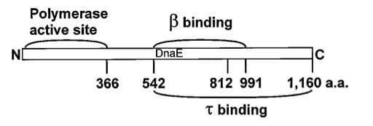
What to crystallize: DO NOT…
..do limited proteolysis
.. believe everything
that is published
Biochemistry
(1996)
Crystal Structure
(2006)
Active site: 401/403
β-bind: 920-924
τ-bind: 1072-1160

Slide 16
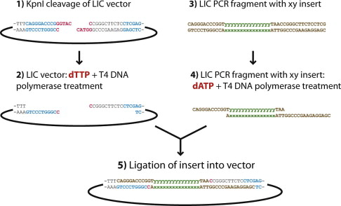
What to crystallize: how to clone
http://www2.lmb.internal/wiki/index.php/Lamers_lab -> cloning
Aslanidis C, de Jong PJ. Ligation-independent cloning of PCR products (LIC-PCR).
Nucleic Acids Res. 1990 Oct 25;18(20):6069-74. PubMed PMID: 2235490

Slide 17
Protein expression in E. coli
What happens here?
OD600
Time

Slide 18
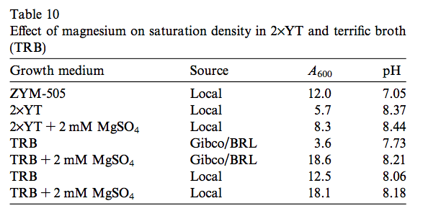
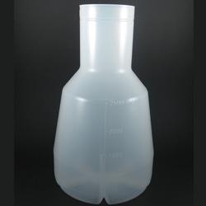
Studier, F. W. Protein production by auto-induction in high density shaking cultures.
Protein Expr Purif 41, 207–234 (2005).
E. coli is easily satisfied…
Need enough food: 2xTY (or even better: terrific broth)
Need Mg: 1mM MgSO₄
Need lots of O₂:use baffled flasks (Thomson UtraYield)
Prevent leaky expression: 1% glucose (and pLysS plasmid)
Don’t like extra baggage (i.e your plasmids): do NOT do starter culture

Slide 19
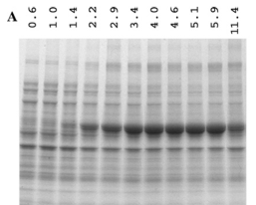
Max protein production in 1-2 hrs…
Fool proof protocol:
Transform enough cell to plate out on 6 plates & grow overnight
Scrape ALL cells and inoculate 6 x 0.5 Ltr 2xTY + 1mM MgSO4, 1% Glucose, Antibiotic
Grow 2-3 hrs at 37ºC to OD₆₀₀=3-6 in BAFFLED UltraYield flasks (2.5 Ltr)
Add 1 volume of RT 2xTY (+Mg, Gluc, Antib, IPTG)
Express protein for 1-2 hrs @ 30ºC
Harvest cells and freeze
=> 70-100g cells => 80-100mg protein (need ~10 mg to set up 2000 drops)

Slide 20
Sorry: I don’t know much about protein expression in yeast, baculovirus or other systems
Don’t ever say (or even think): “but this is how everyone does it”
Andrew Carter: Yeast to OD600=80
Imre Berger: multi protein expression in baculovirus
Wayne Hendrickson: SeMet expression for phasing
William Studier: using T7 phages for protein expression in E. coli

Slide 21
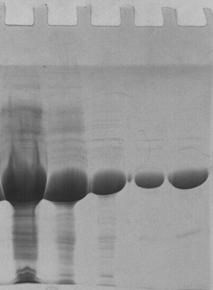
Protein purification
Lysate
Phenyl
SP
Q
S200
Tags
Hydrophobic
Ion-exchange
Affinity
Size exclusion
Buffer exchange
Protein storage
www.gelifesciences.com
> Service & support
> Handbooks

Slide 22
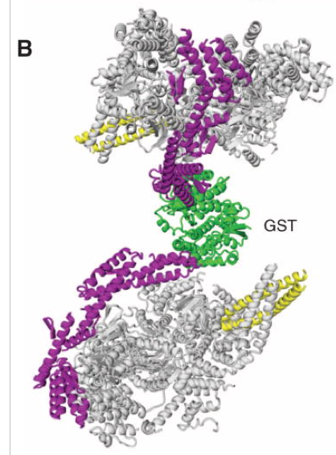
Protein purification
Tags
Hydrophobic
Ion-exchange
Affinity
Size exclusion
Buffer exchange
Protein storage
GST is a dimer!
N-terminus may be buried
or part of active site!
Histrap columns can leak Ni into your protein
N
Ni
Ni
Ni
Ni
Ni
Ni
Ni

Slide 23
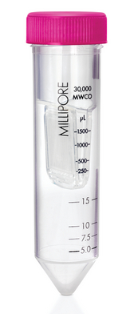
Protein purification
Do you really need to a run a gel filtration run??
Only good if:
- You have lots of aggregates
- You have degradation products
Concentrating afterwards can do more harm then good
Tags
Hydrophobic
Ion-exchange
Affinity
Size exclusion
Buffer exchange
Protein storage

Slide 24
Protein purification
Tags
Hydrophobic
Ion-exchange
Affinity
Size exclusion
Buffer exchange
Protein storage
Instead of dialyzing try:
* 5-10 fold dilution
* Desalting column (30 minutes)
* Changing pH by adding HCl or NaOH (within buffer capacity)

Slide 25
Protein purification
Tags
Hydrophobic
Ion-exchange
Affinity
Size exclusion
Buffer exchange
Protein storage
If you can, freeze your protein
Flash freeze protein in LN2. Use PCR tubes if needed
Thaw in hand, then store on ice
Find optimal storage buffer (use solubility screen)
Deng, J. et al. An improved protocol for rapid freezing of protein samples
for long-term storage. Acta Crystallogr. D Biol. Crystallogr. 60, 203–204 (2004).

Slide 26
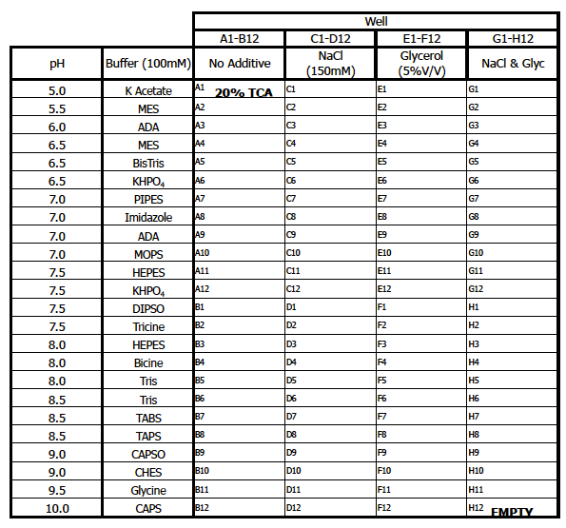
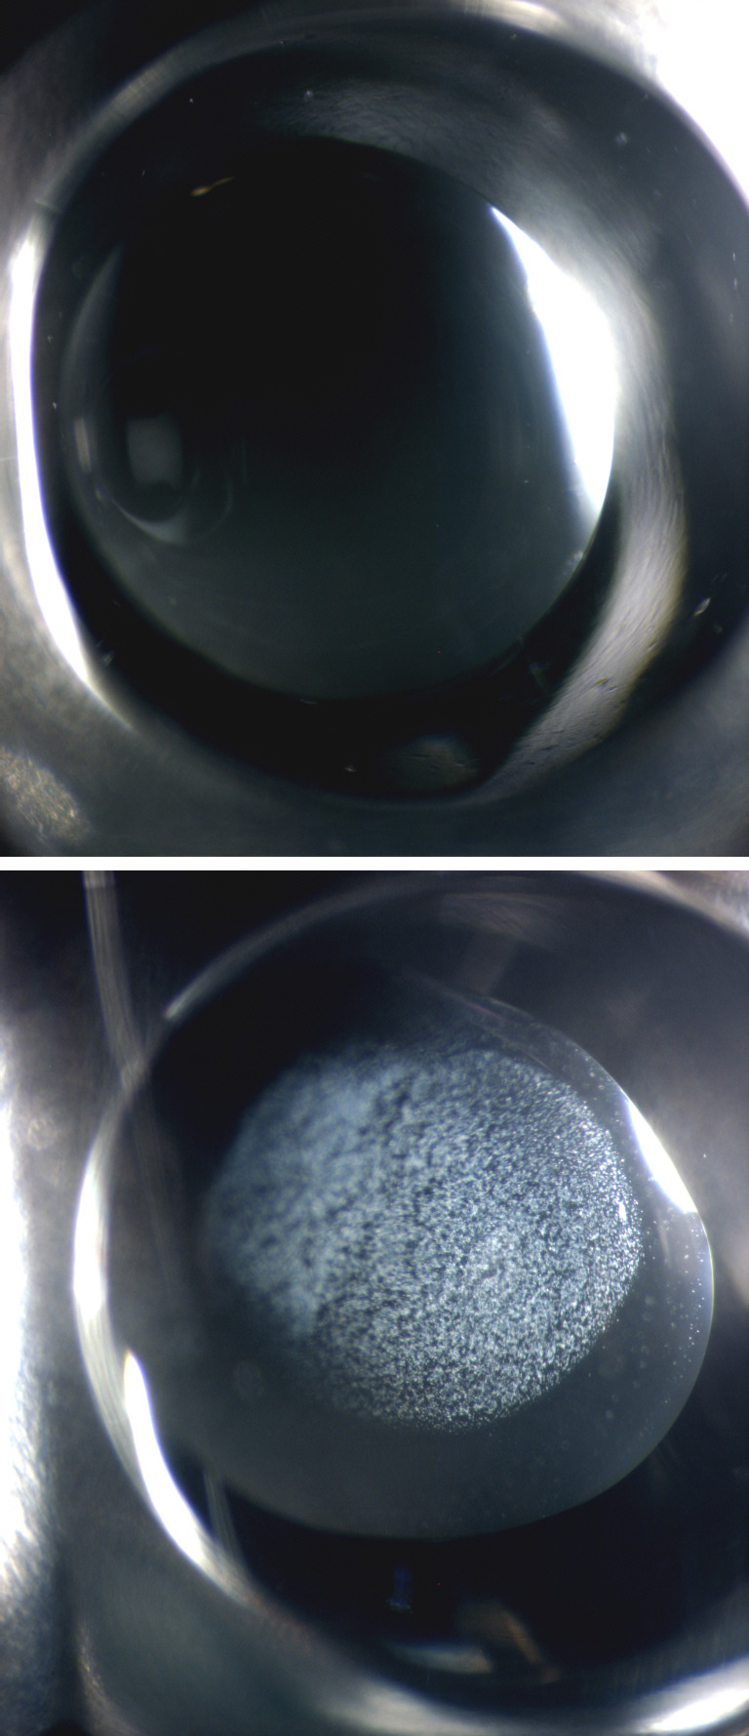
1-10mg/ml
100nl/drop
Incubate 1-24 hrs
Protein characterization
Solubility Screen

Slide 27
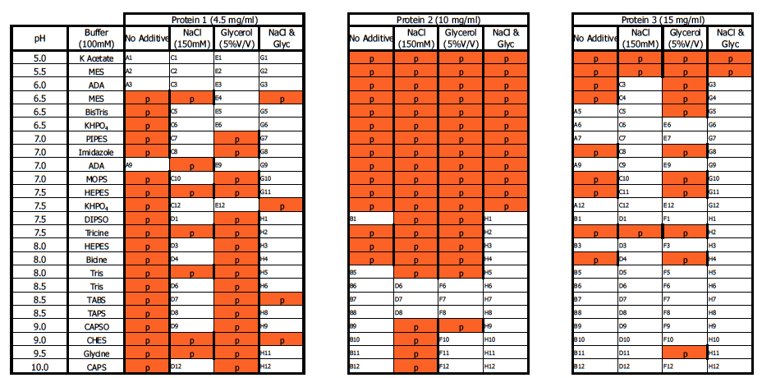
1-10mg/ml
100nl/drop
Incubate 1-24 hrs
Protein characterization
Solubility Screen
See: http://www2.lmb.internal/wiki/index.php/Lamers_lab
> Crystallography > Solubility screen
Or Jena Bioscience JBScreen Solubility HTS

Slide 28
1-10mg/ml
100nl/drop
Incubate 1-24 hrs
Protein characterization
Solubility Screen
Now also available for:
activity assays
protein labeling
cross-linking
freezing

Slide 29
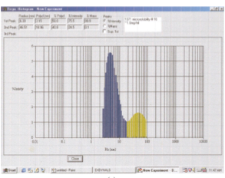
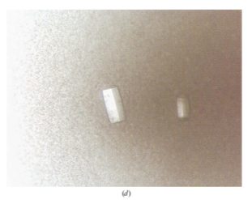
Protein characterization
Dynamic Light Scattering
5uL, 1-5mg/ml
Monodisperse proteins give more crystal hits
Jancarik, J., Pufan, R., Hong, C., Kim, S.-H. & Kim, R. Optimum solubility (OS) screening: an efficient method to optimize buffer conditions for homogeneity and crystallization of proteins. Acta Cryst (2004). D60, 1670-1673 (2004)

Slide 30
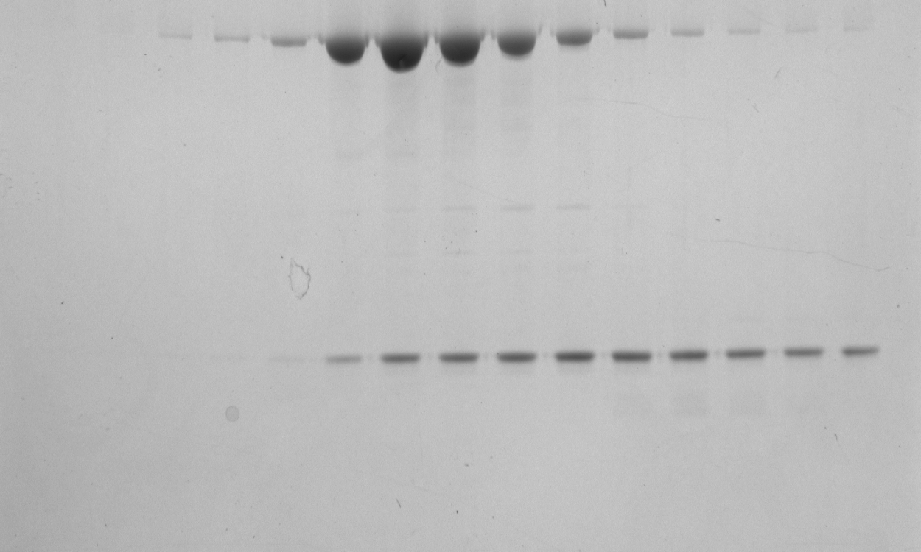
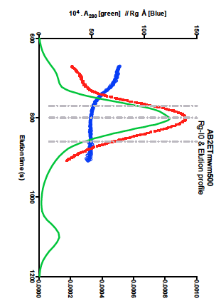
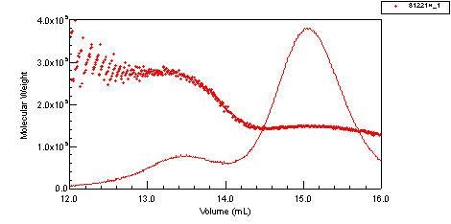
Protein characterization
Analytical gel filtration
SEC-MALS
SEC-SAXS
Pol III
10 μM
Clamp
5 μM
Pol III
1.5 μM
mAU
Clamp
Retention (ml)
Fraction

Slide 31
Protein characterization
No protein
Pol III-clamp-exo
Activity assay (Semet MutS)
Pol III-exo
Pol III-clamp-exo^{mutant}
Pol III
Pol III-clamp
ATPase activity

Slide 32
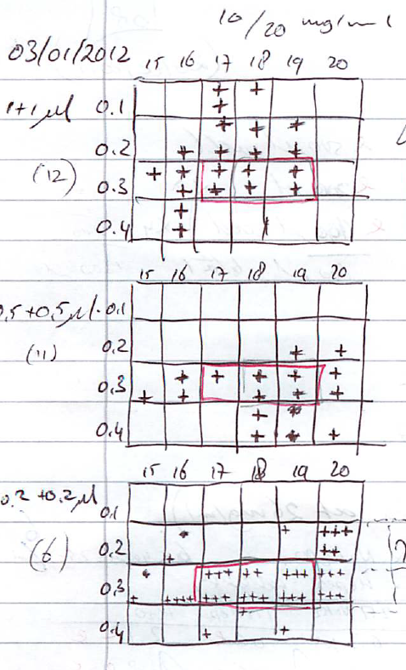
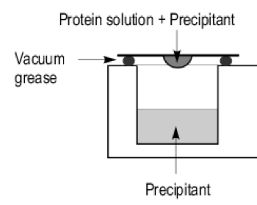
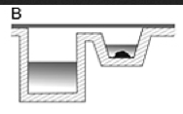
Protein crystallization
Are robotic approaches the best way?
Diller DJ, Hol WG. An accurate numerical model for calculating the equilibration rate of a hanging-drop experiment. Acta Crystallogr D Biol Crystallogr. 1999 Mar;55(Pt 3):656-63. PubMed PMID: 10089462.

Slide 33
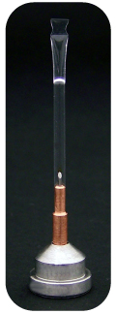
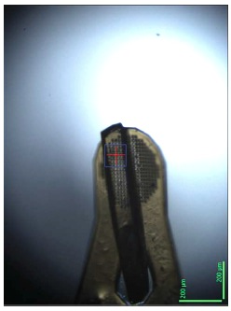
Cryocrystallography (freezing)
Principles of cryocrystallography (1)
Freeze in liquid nitrogen or gas stream?
Beware of the layer of cold air over the liquid nitrogen (2)
Test crystal at room temp: Mitegen crystal sleeve: MicroRT
Test different cryos & precipitant concentrations
Remove any mother liqour (3)
Dehydrate with PEGs
Dehydrate with controlled humidified air (4)
1. Garman, E. F. & Schneider, T. R. Macromolecular Cryocrystallography. J. Appl. Cryst (1997). 30, 211-237
2. Warkentin, M., Berejnov, V., Husseini, N. S. & Thorne, R. E. Hyperquenching for protein cryocrystallography. J Appl Crystallogr 39, 805–811 (2006).
3. Pellegrini, E., Piano, D. & Bowler, M. W. Direct cryocooling of naked crystals: are cryoprotection agents always necessary? Acta Cryst (2011). D67, 902-906
4. Russi, S. et al. Inducing phase changes in crystals of macromolecules: status and perspectives for controlled crystal dehydration. J. Struct. Biol. 175, 236–243 (2011).

Slide 34
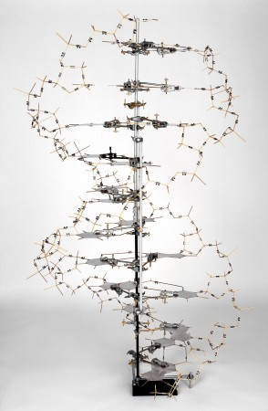
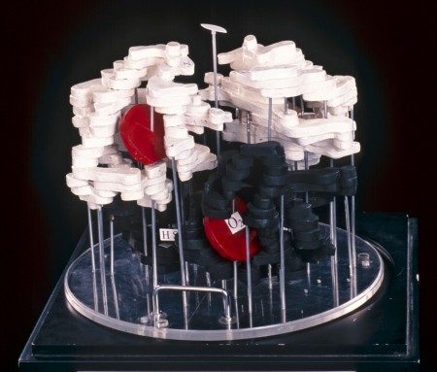
First protein structure: Haemoblobin 1959
(Perutz & Kendrew)
First DNA structure, 1953
(Watson & Crick)
In a difficult project you’re not going to succeed because you do the same
as everyone else, but because you do something different…

Slide 35
Recommended reading:
Ligation Independent Cloning
Aslanidis C, de Jong PJ. Ligation-independent cloning of PCR products (LIC-PCR).
Nucleic Acids Res. 1990 Oct 25;18(20):6069-74. PubMed PMID: 2235490
Protein expression
Studier, F. W. Protein production by auto-induction in high density shaking cultures.
Protein Expr Purif 41, 207–234 (2005).
Protein enginering
Derewenda ZS. Application of protein engineering to enhance crystallizability and
improve crystal properties. Acta Crystallogr D Biol Crystallogr.
2010 May;66(Pt 5):604-15. PubMed PMID: 20445236
SERP server http://services.mbi.ucla.edu/SER/
Protein purification
www.gelifesciences.com > Service & support > Handbooks
Hanging drop diffusion
Diller DJ, Hol WG. An accurate numerical model for calculating the equilibration rate
of a hanging-drop experiment. Acta Crystallogr D Biol Crystallogr.
1999 Mar;55(Pt 3):656-63. PubMed PMID: 10089462
Cryo crystallography
Garman, E. F. & Schneider, T. R. Macromolecular Cryocrystallography. J. Appl. Cryst (1997). 30, 211-237
Warkentin, M., Berejnov, V., Husseini, N. S. & Thorne, R. E. Hyperquenching for protein
cryocrystallography. J Appl Crystallogr 39, 805–811 (2006)
Pellegrini, E., Piano, D. & Bowler, M. W. Direct cryocooling of naked crystals: are
cryoprotection agents always necessary? Acta Cryst (2011). D67, 902-906
Russi, S et al. Inducing phase changes in crystals of macromolecules: status
and perspectives for controlled crystal dehydration. J. Struct. Biol. 175, 236-243 (2011)

Slide 36
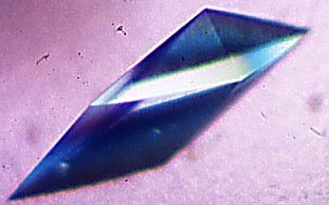
When all goes well…

